Slide 1

Methods for Literature Reviewing and evidence synthesis
Professor Sheila Payne
Professor Nancy Preston
professionalpalliativehub.com/research/

Slide 2
Methods for Literature Reviewing and evidence synthesis
Nancy Preston and Sheila Payne
International Observatory on End of Life Care, Lancaster University, United Kingdom

Slide 3



Slide 4

What is this?
“those who do not learn from the past are condemned to repeat it.” (Petticrew and Roberts, 2006 p270)

Slide 5
Plan
Why is a systematic review important
What is a systematic approach to literature?
How to get the question right
Tips on searching
How to synthesise your findings

Slide 6
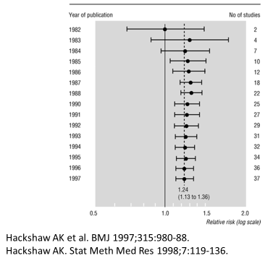

Health – passive smoking and lung cancer
Quantitative Metanalysis
Qualitative Evidence Synthesis

Slide 7
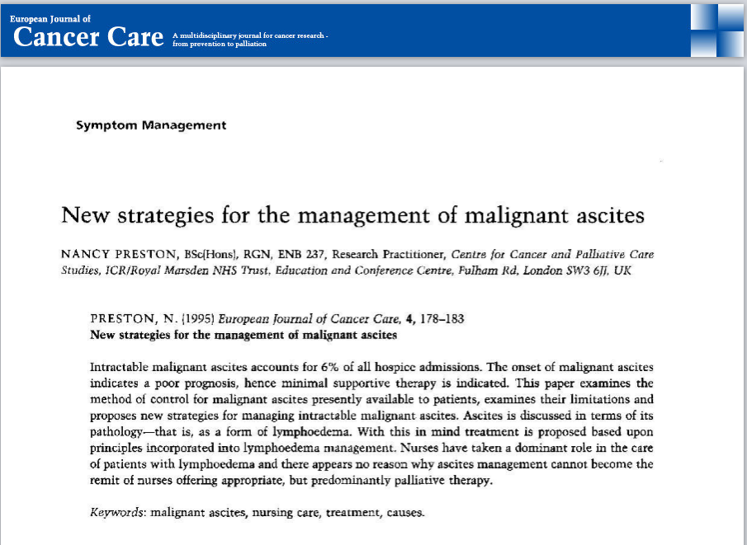

Slide 8
Differences between literature reviews and systematic reviews
Feature | Literature Review | Systematic Review
Question | Often broad in scope | Often focussed question
Sources and search | Not usually specified | Comprehensive & explicit search
Selection | Not usually specified & potentially biased | Criterion based selection uniformly applied
Appraisal | Variable | Rigorous critical appraisal
Synthesis | Qualitative summary | Quantitate or qualitative synthesis
Inferences | Sometimes evidence based | Should be evidence based

Slide 9
Artificial Intelligence (AI) – how does this influence literature reviewing?
AI cannot replicate a comprehensive search
AI may help provide a summary of specific areas of research but critical appraisal still needs to be undertaken
If you use AI, 1) important that you understand the strength and weakness of each included study, and 2) reflect on whether the study is relevant to your review question
Be aware of your institutional requirements on the use of AI
When writing up your review for publication, be aware of journal requirements on the use of AI

Slide 10

Stage 1: the review question

Slide 11
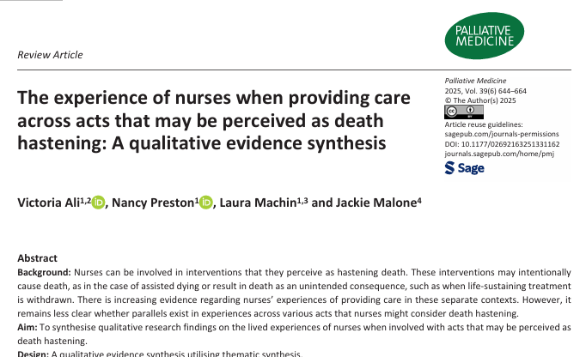
Worked example
What can be learnt from synthesising qualitative research findings on the lived experiences of nurses when involved with acts that may be perceived as death hastening?

Slide 12
What are the experiences of family and friends providing care at home for a person at the end of life or in the context of the patient’s hastened death?
Objectives:
What are the experiences of caregivers of patients at the end of life? (preliminary synthesis)
What are the experiences of caregivers of patients electing hastened death? (preliminary synthesis)
In what ways are caregivers’ experiences similar or different at end of life vs hastened death? (exploring relationships in the data)
In what ways does the qualitative literature on end-of-life and hastened death caregiving support or refute Hudson’s model of caregiving experience? (assessing the robustness of the synthesis)

Slide 13
PICO etc
Different tools to help you formulate the review question but more importantly search for the literature
http://www.docs.is.ed.ac.uk/docs/Libraries/PDF/PICOS.pdf
PICO | PICOs | SPICE | SPIDER | ECLIPSe
Population | Population | Setting | Sample | Expectation
Intervention | Phenomena of interest | Perspective | Phenomenon | Client Group
Comparison |  | Intervention | Design | Location
Outcome |  | Comparison | Evaluation | Impact
 |  | Evaluation | Research | Professionals
 |  |  |  | Service

Slide 14
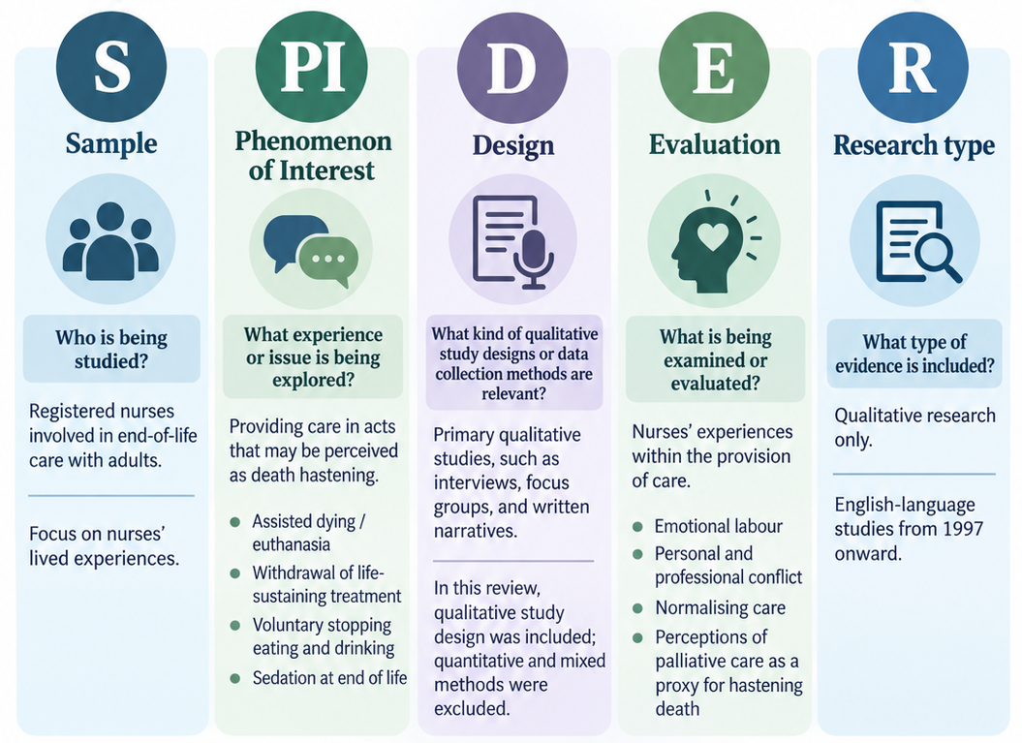
Worked example
What can be learnt from synthesising qualitative research findings on the lived experiences of nurses when involved with acts that may be perceived as death hastening?
Drove search

Slide 15
Worked example
What can be learnt from synthesising qualitative research findings on the lived experiences of nurses when involved with acts that may be perceived as death hastening?
Helped determine eligibility

Slide 16

Stage 2: Inclusion criteria

Slide 17
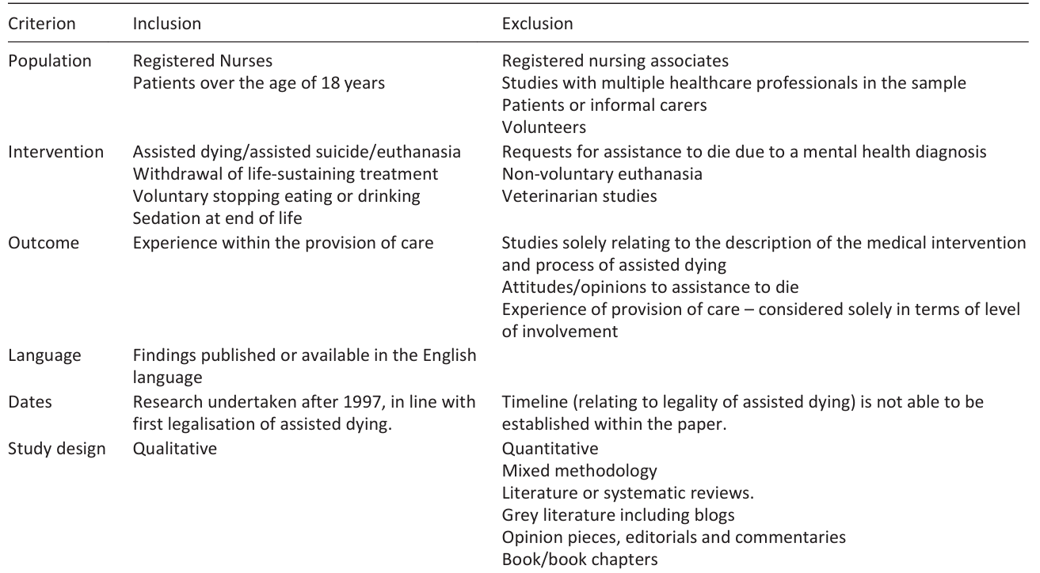
Stage 2: inclusion criteria

Slide 18
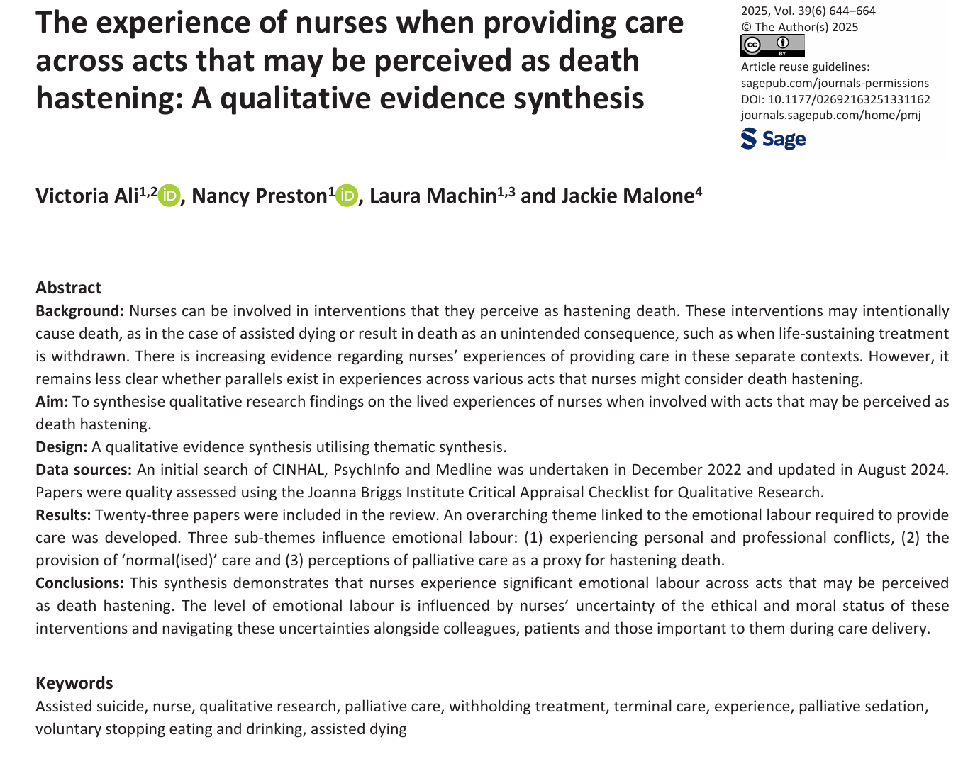

Stage 3: developing search strategy is an iterative process
How have others done this? Or planning..
Key words from potential papers
MeSH terms
Limiters

Slide 19
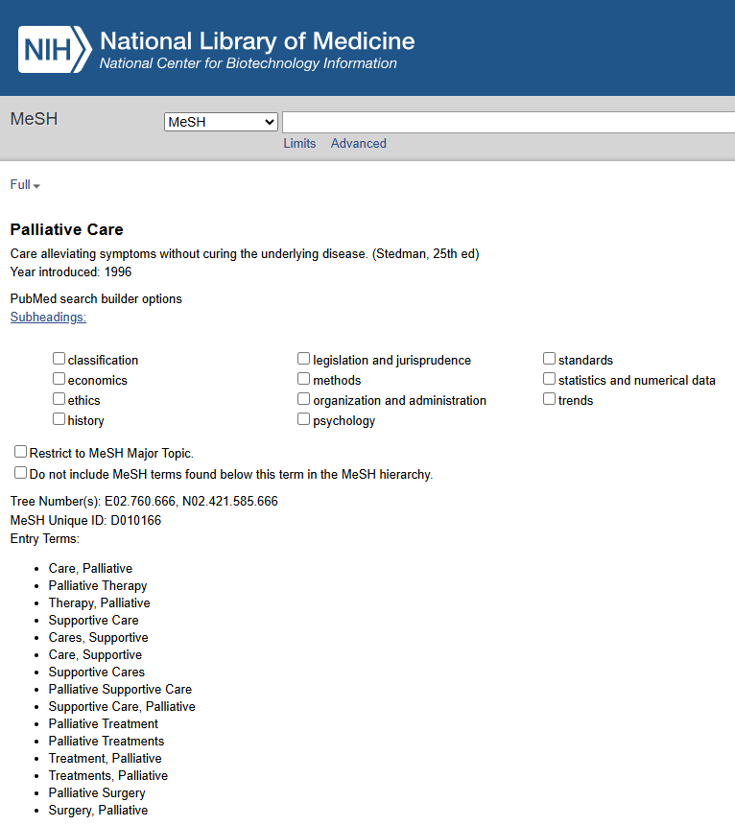

Stage 3: developing search strategy is an iterative process
How have others done this? Or planning..
Key words from potential papers
MeSH terms
Filters

Slide 20



Stage 3: other sources
Reference lists of included studies
Citation tracking
Test against known papers

Slide 21

How many papers?
2000 not too bad

Slide 22
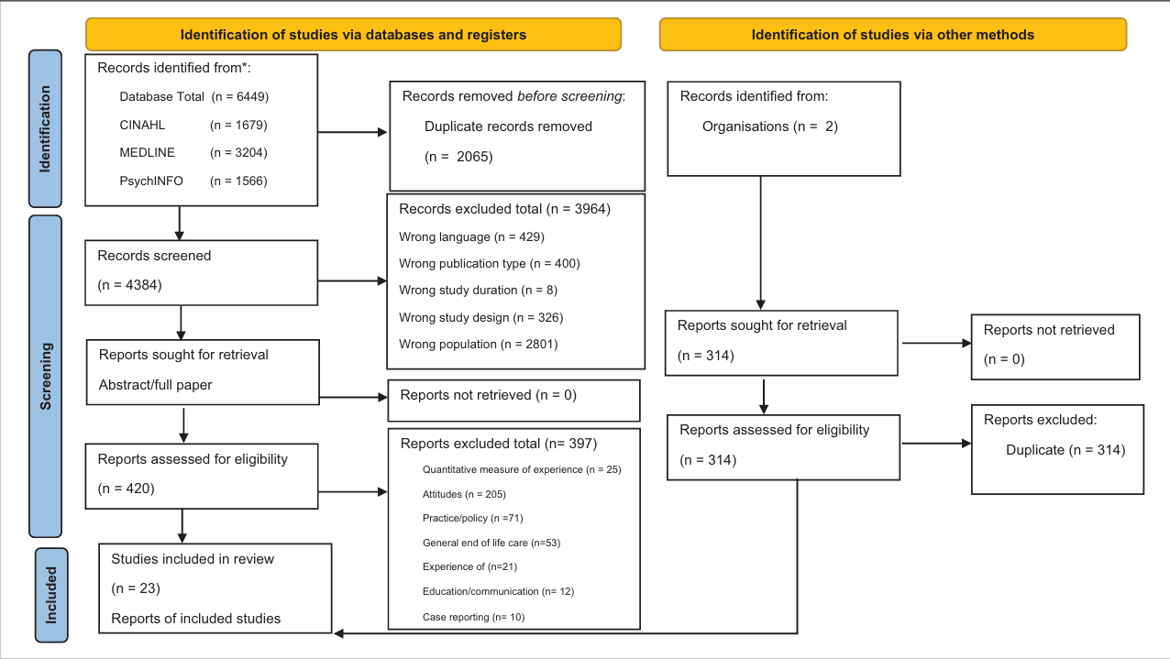

Slide 23

How many papers?
2000 not too bad

Slide 24
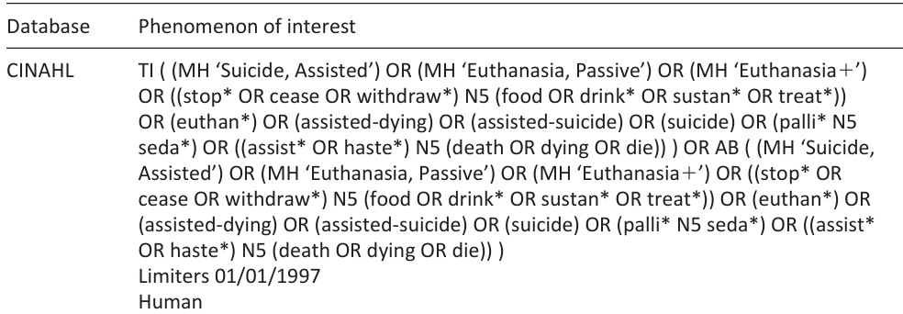
Stage 3 cont: replicable, publishable search strategy

Slide 25
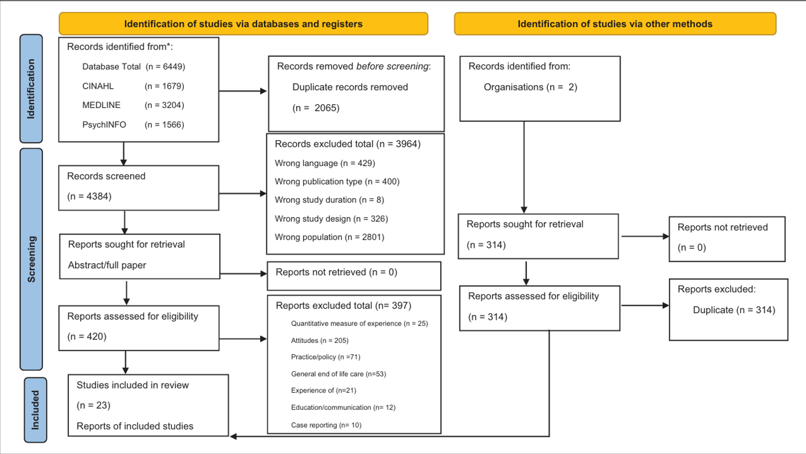
Stage 4: Selecting the papers
Grey Literature
Conference abstracts
Unpublished literature
Good quality
Title checking for inclusion
Then check abstracts
Then full paper
4384

Slide 26
Who selects – rigour and publishability
Single reviewer?
Two reviewers each paper?
Second reviewer for a proportion – 10%
Team?
Worked example: A second reviewer screened 10% papers

Slide 27
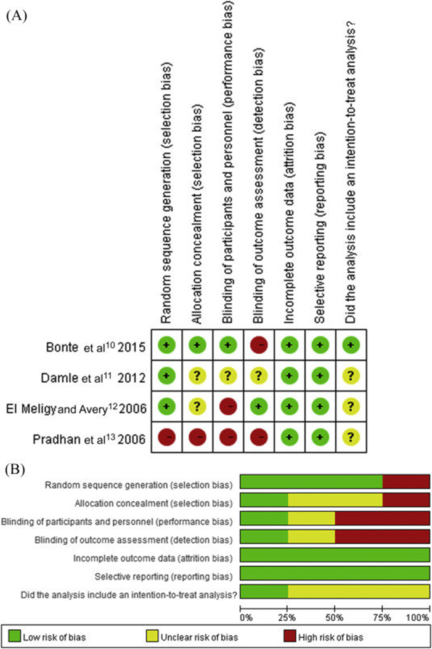
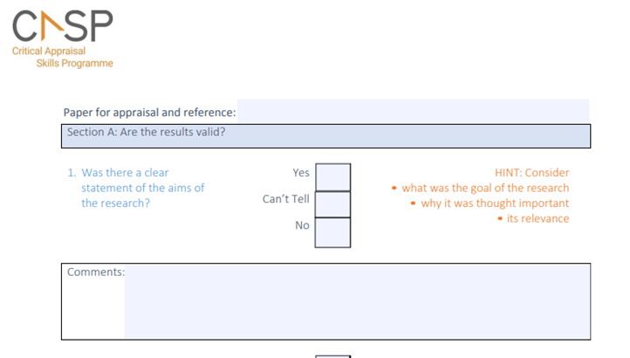
Stage 5: Quality appraisal
Journals like this
Can use a tool
What will you do with the results?
Inclusion criteria or critique?
Hawker, S., Payne, S., Kerr, C., Hardey, M., & Powell, J. (2002). Appraising the evidence: reviewing disparate data systematically. Qualitative health research, 12(9), 1284-1299.

Slide 28
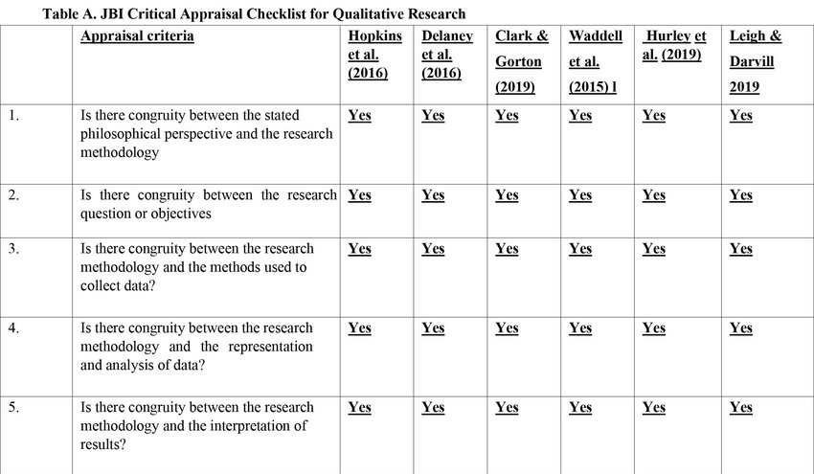
Stage 5: worked example
Journals like this – conducted quality appraisal
Can use a tool – used Joanne Briggs Institute quality tool
What will you do with the results? - considered reflexively
Inclusion criteria or critique? – no papers excluded

Slide 29


Stage 6: data extraction
Adapt existing one or from scratch
Create Data extraction form – pilot
Turn data into tables and/or ‘themes’

Slide 30
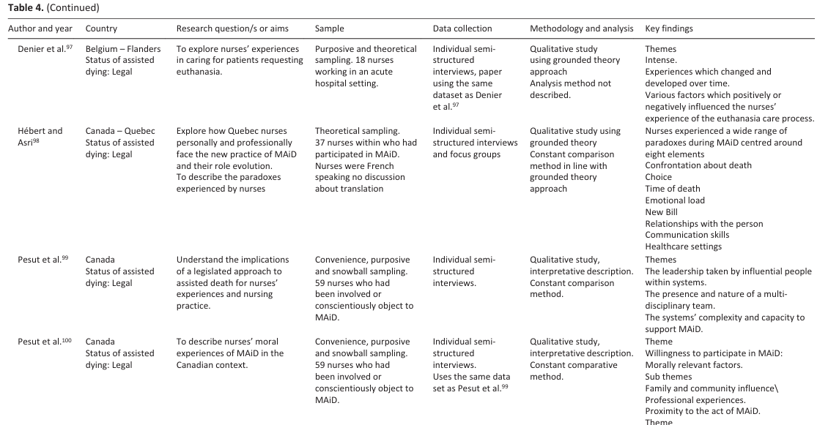
Worked example

Slide 31
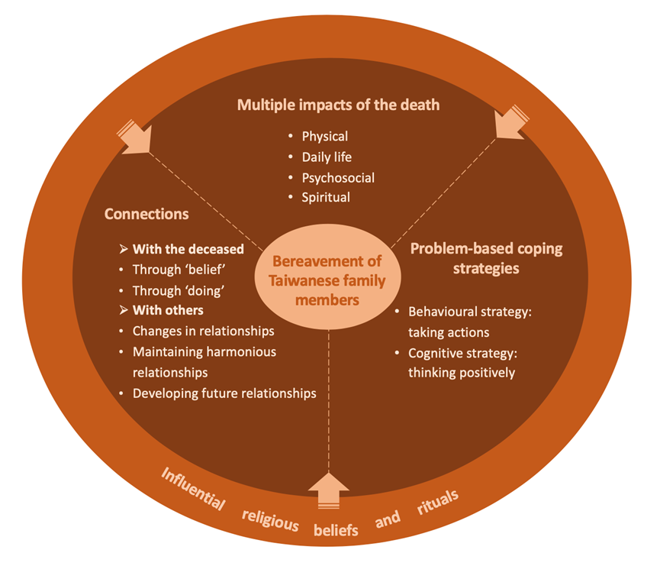
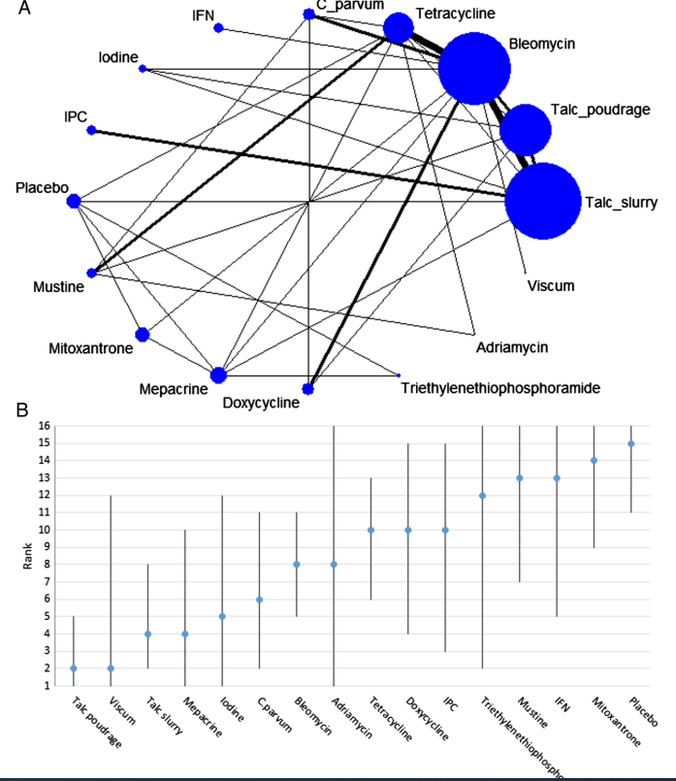
Stage 6: Synthesis
Metanalysis or network analysis
Summary/model theory
Worked example: narrative summary

Slide 32
Examples of reviews
Meta-analysis: Effectiveness of and implementation requirements for telehealth in palliative care patients with advanced cancer: A systematic review and meta-analysis (2026) Palliative Medicine
Meta-ethnography:Reasons for patients in high income countries accessing hospital care while receiving specialist community palliative care: A systematic review and meta-ethnography (2026) Palliative Medicine
Thematic synthesis: Primary palliative care in low- and middle-income countries: A systematic review and thematic synthesis of the evidence for models and outcomes (2024) Palliative Medicine
Meta-synthesis: Patient and family perspectives on rural palliative care models: A systematic review and meta-synthesis (2024) Palliative Medicine
Integrative review: Identity and equity in palliative care: An integrative review of intersectional research (2026) Palliative Medicine
Hermeneutic analysis: Dignity of the nurse: A hermeneutic literature review (2026) Nursing ethics
Grounded theory: Healthcare providers' attitudes and associated factors on palliative care referral: A qualitative systematic review and meta‐aggregation - Zhang - 2024 - Journal of Clinical Nursing - Wiley Online Library
Realist Review: Contexts, mechanisms and outcomes of home-based palliative care implementation in low- and middle-income countries: A realist review (2026) Palliative Medicine

Slide 33



Slide 34

Files will be available on
Past Events - The Palliative Hub Professional (professionalpalliativehub.com/events)
)
Thank you for your time

