Slide 1

‘PCRN Webinar: AI and Digital Health Resources in Palliative Care Research: Quality, Accessibility and the Challenges Ahead’
Presented by
Dr Jeff Hanna and Lisa Strutt
professionalpalliativehub.com/research/

Slide 2


AI and Digital Health Resources in Palliative Care Research: Quality, Accessibility and the Challenges Ahead
Jeff Hanna + Lisa Strutt

Slide 3
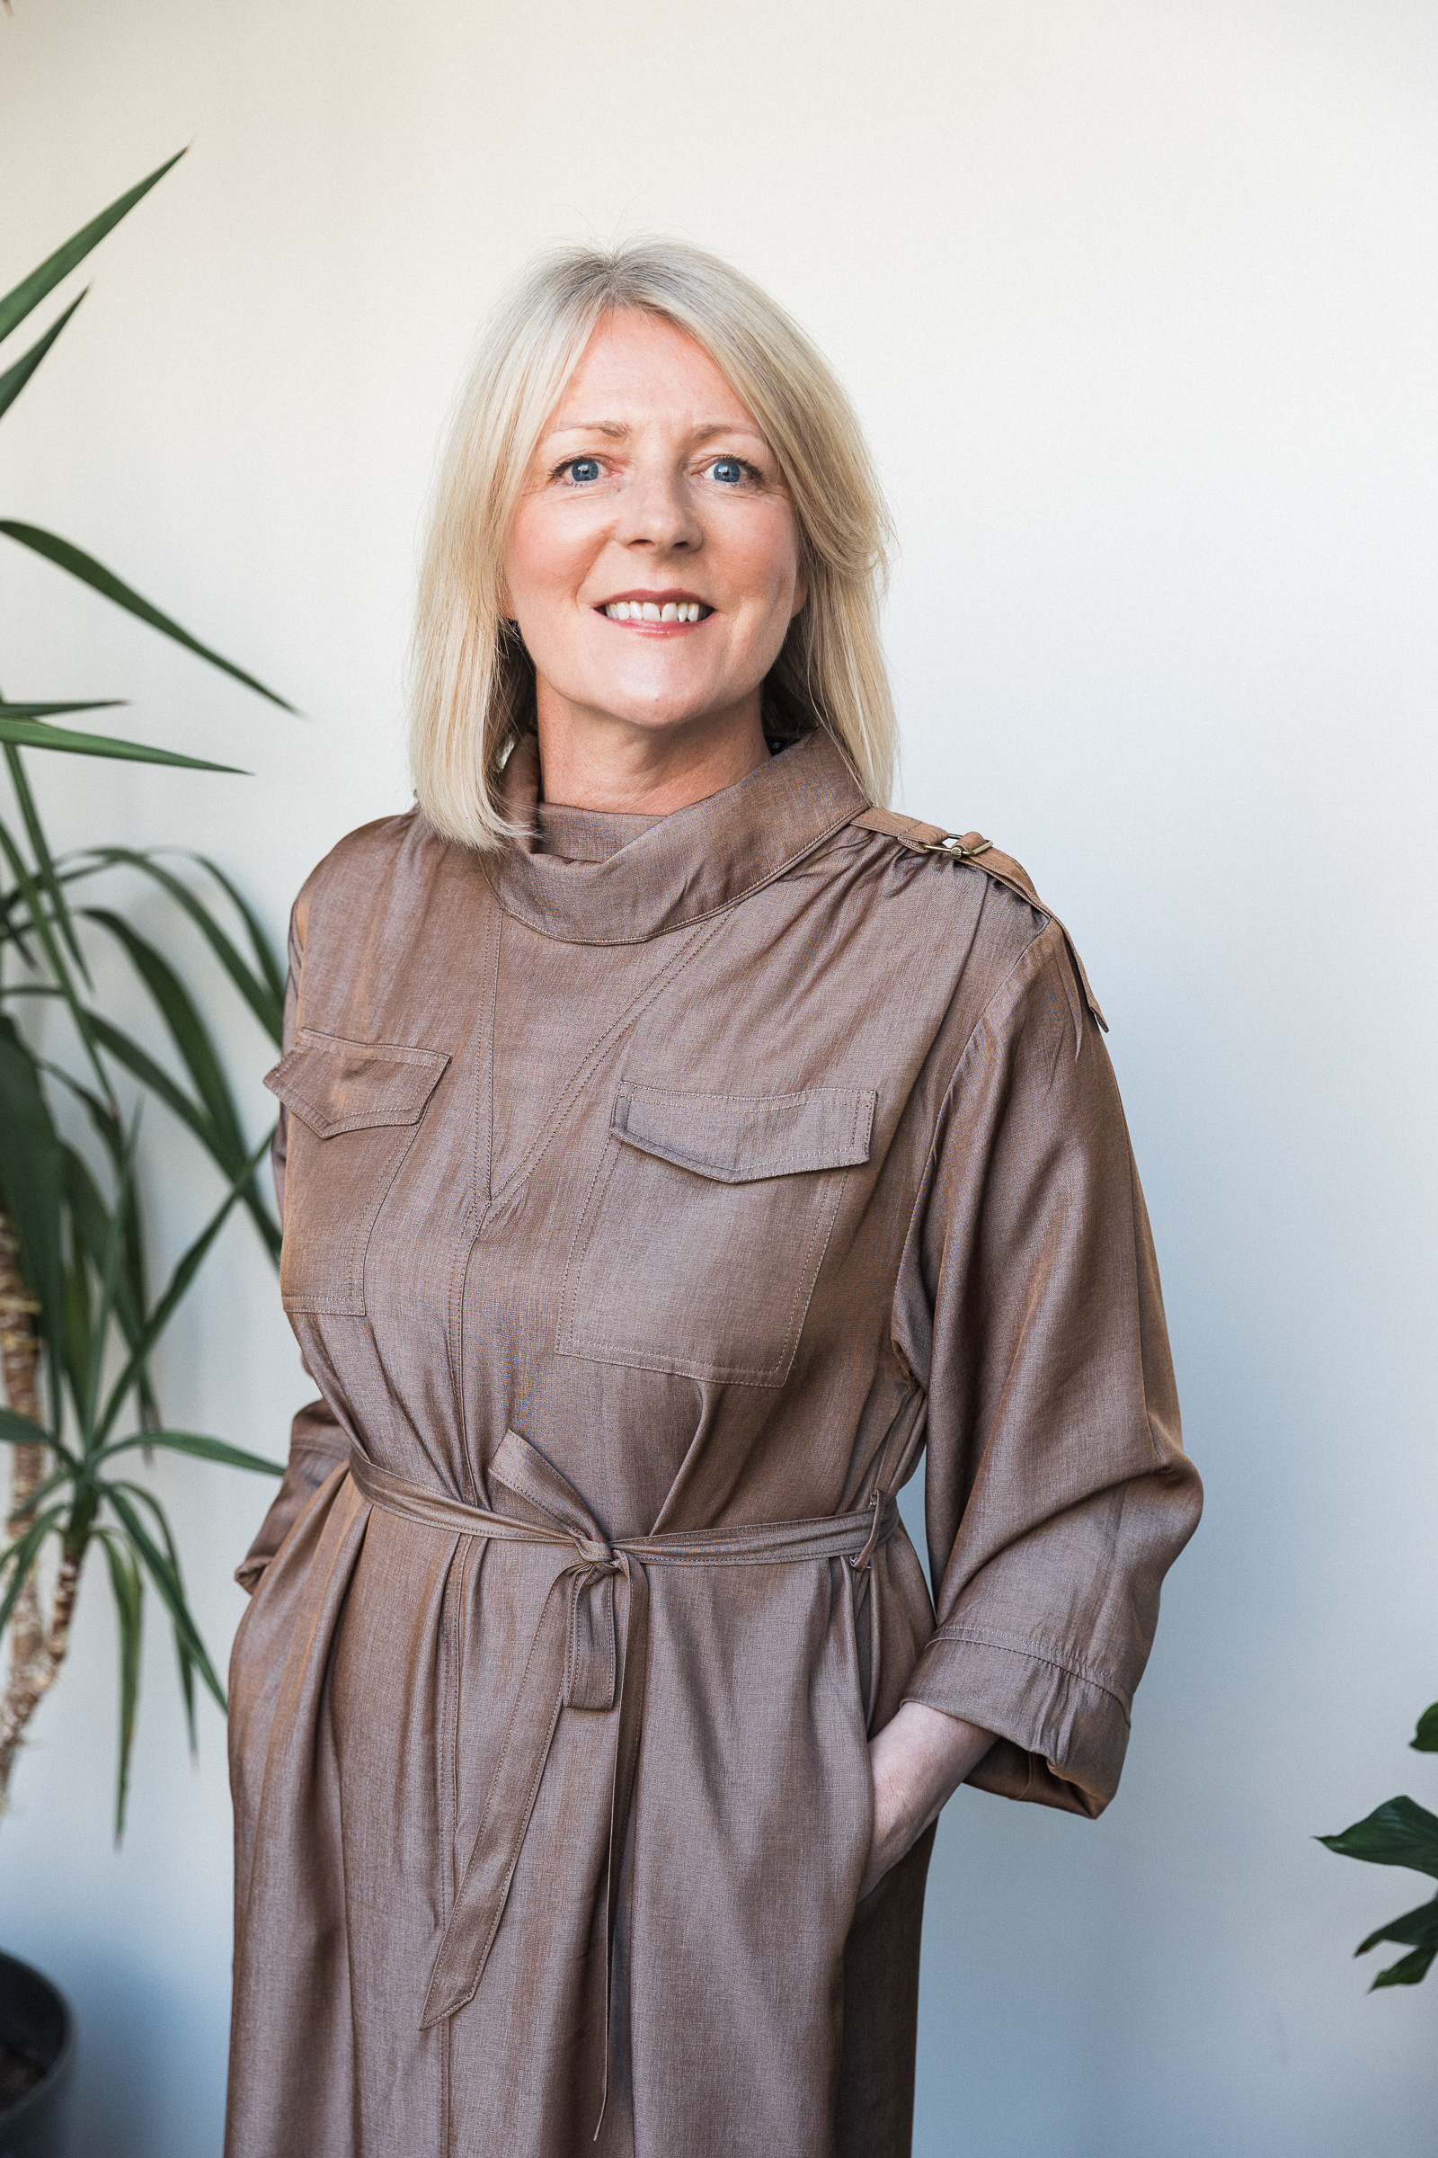
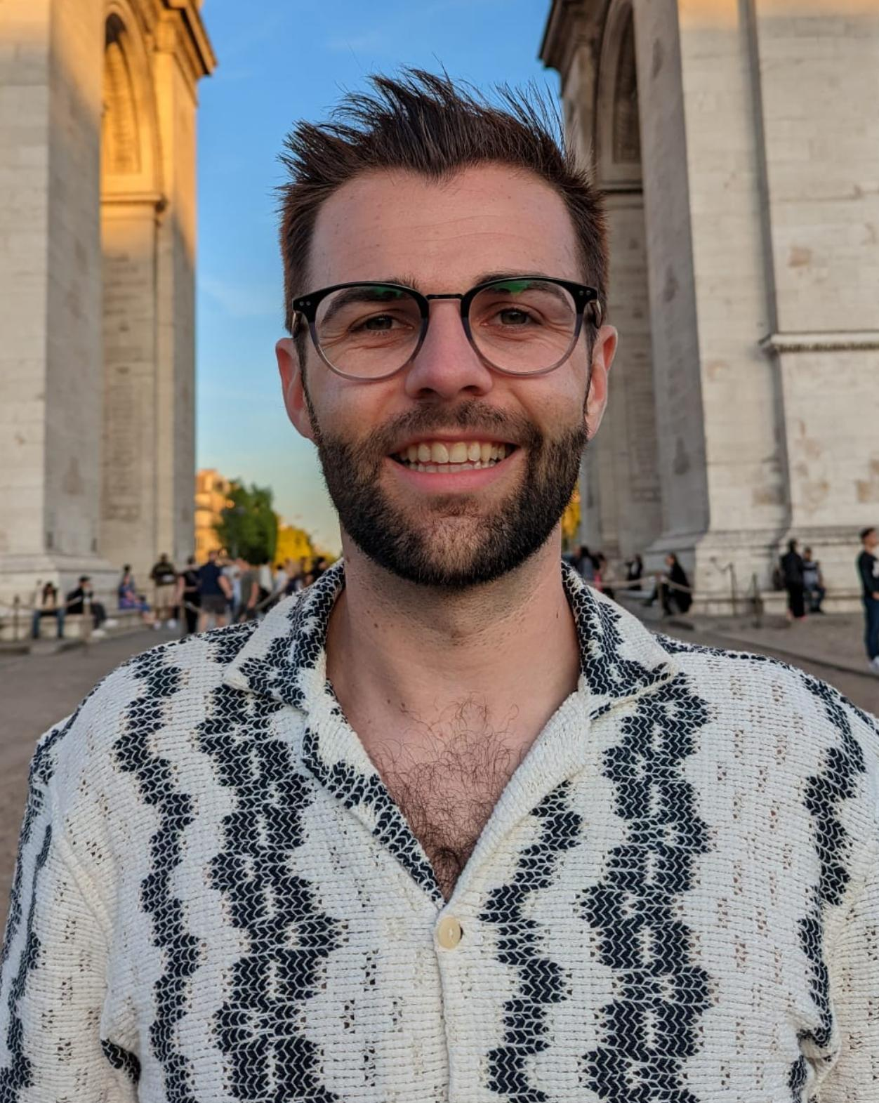
Dr Jeff Hanna
Lecturer in Clinical Cancer Nursing
Ulster University /
South Eastern Health and Social Care Trust
WHO ARE WE?
Lisa Strutt
Leadership Coach
and
Lived-experience advisor

Slide 4

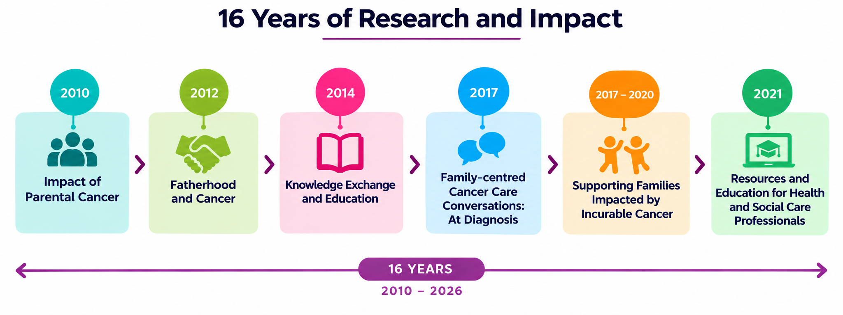

Slide 5
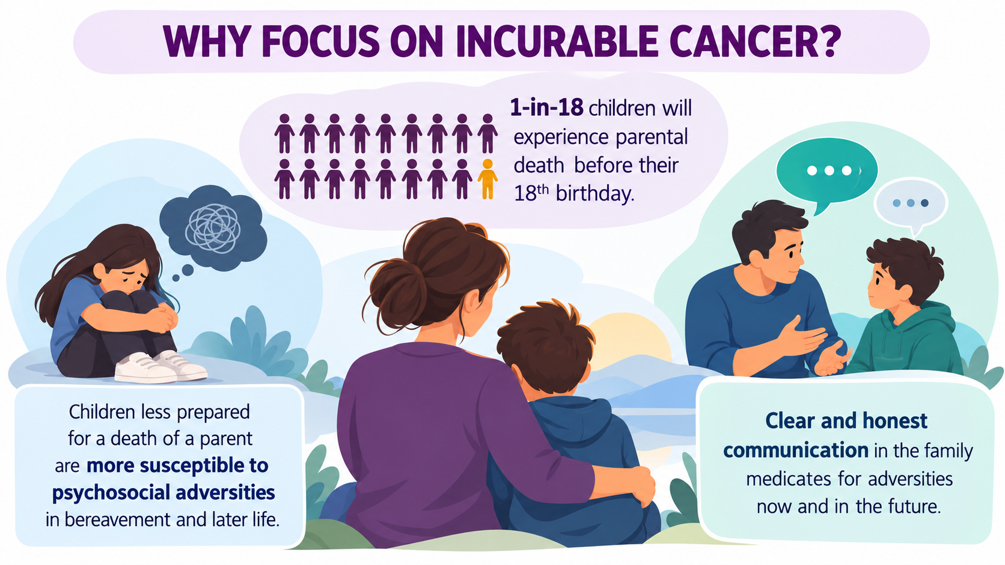

Slide 6
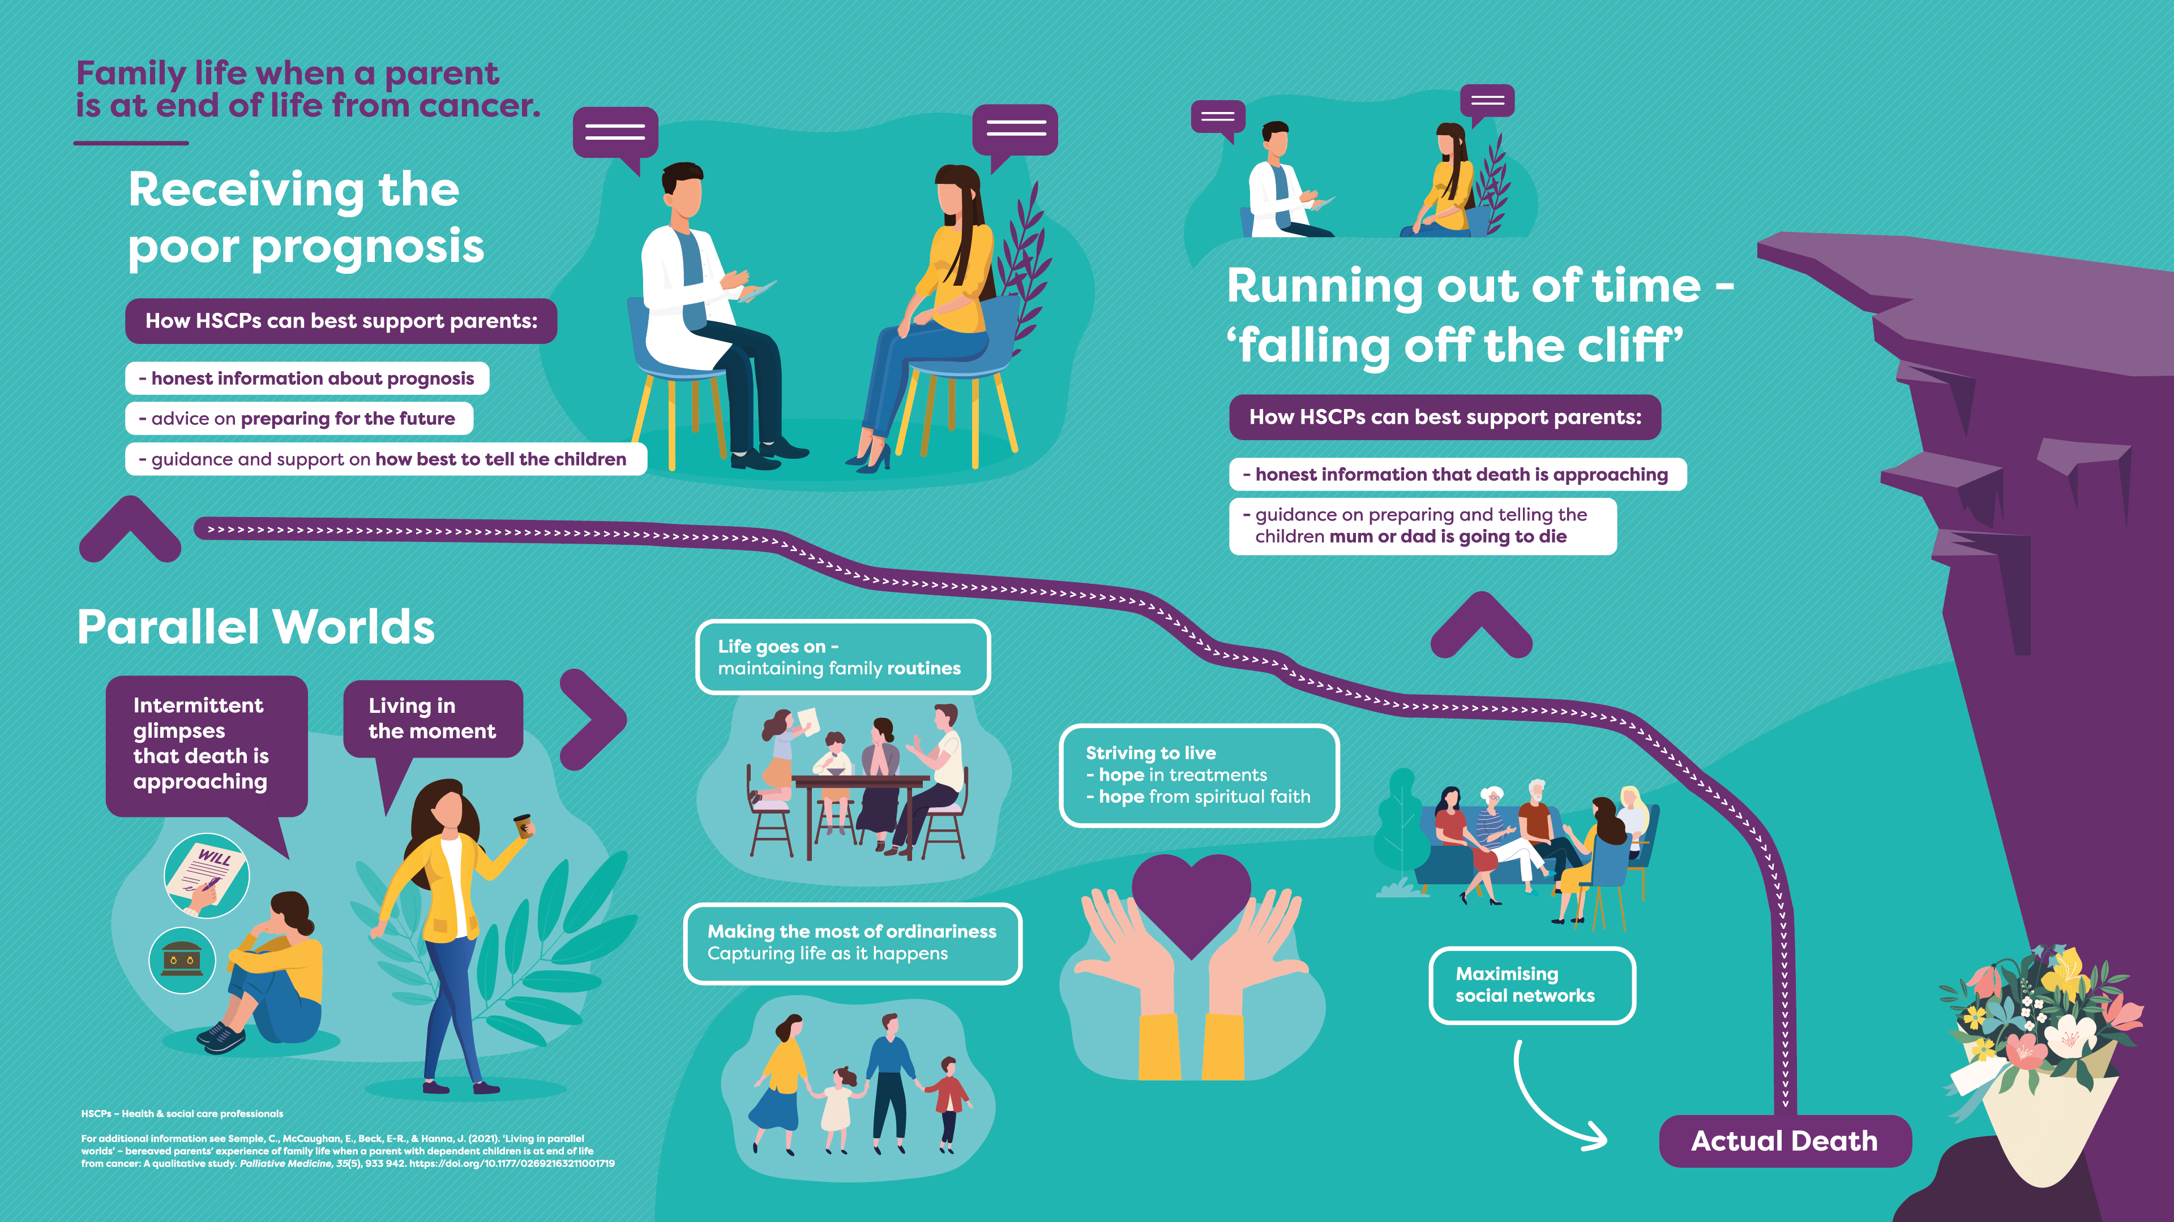

Slide 7
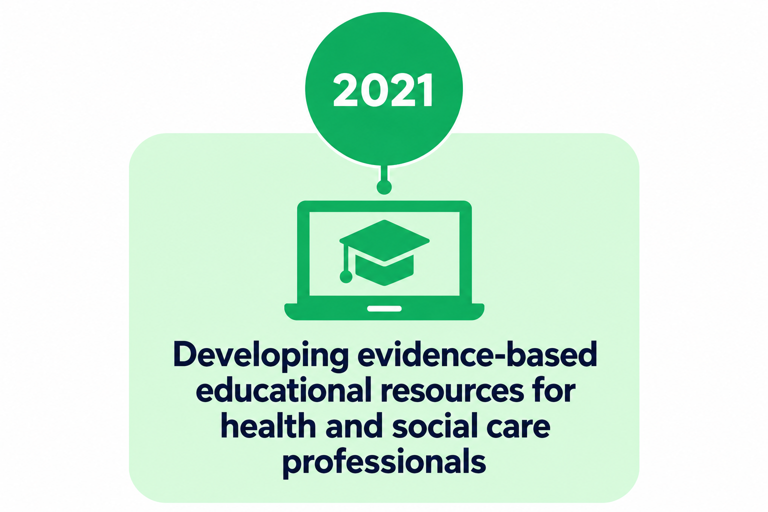

Slide 8
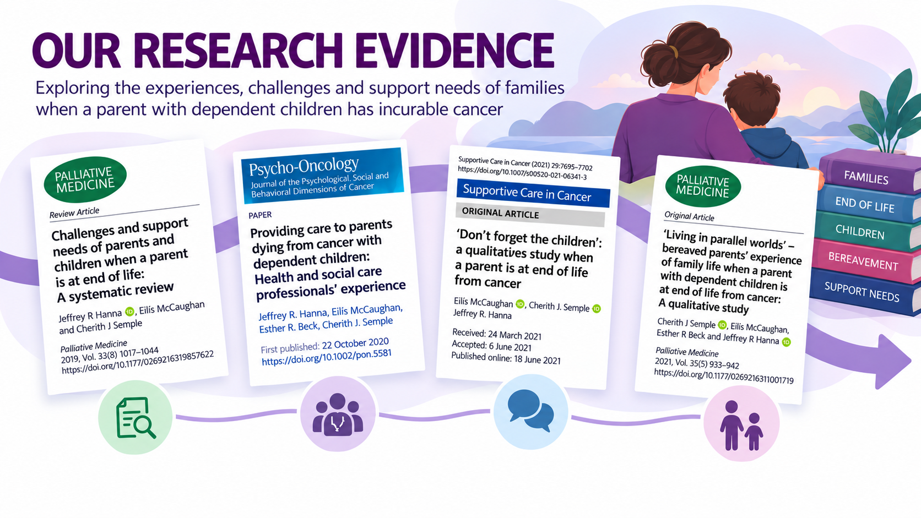

Slide 9
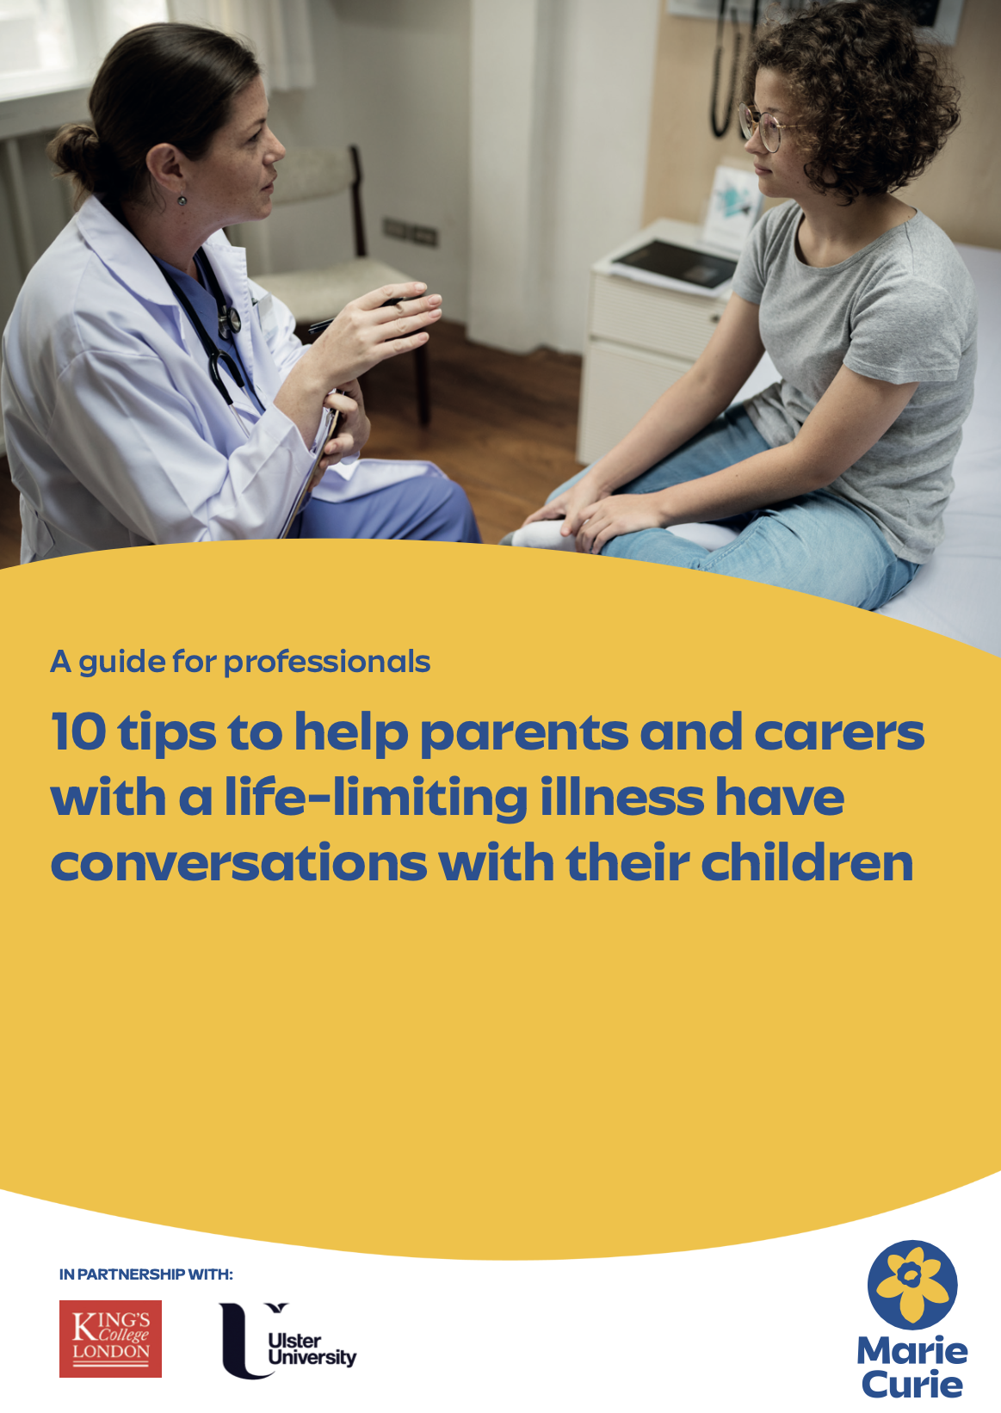
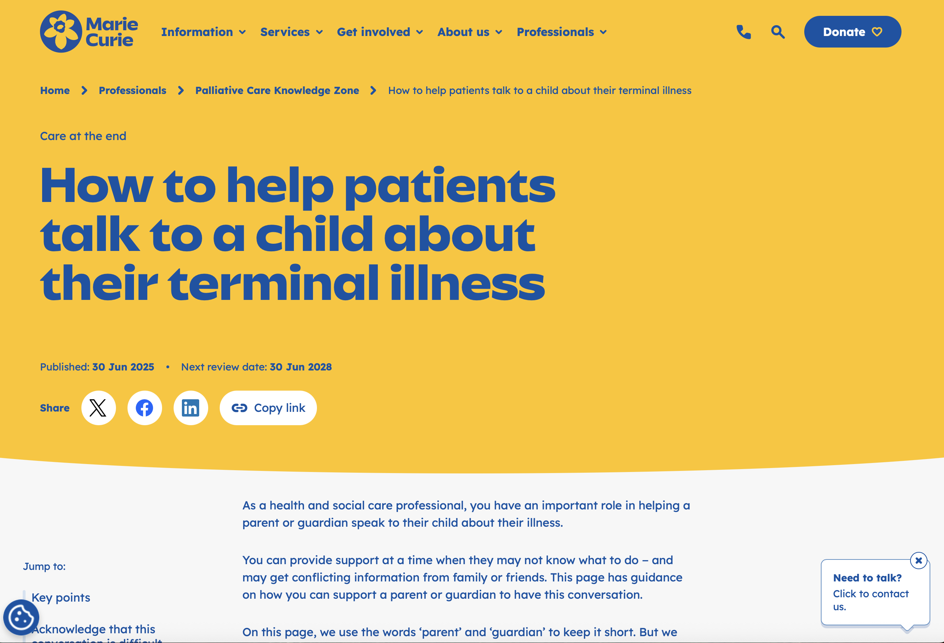
Why can’t the doctors
make mum better?
‘ The doctors and nurses are doing all they can to help mum, but the cancer is still there. The doctors and nurses will make sure mum is well looked after’
https://www.mariecurie.org.uk/professionals/palliative-care-knowledge-zone/parent-talking-to-their-children-about-their-health

Slide 10
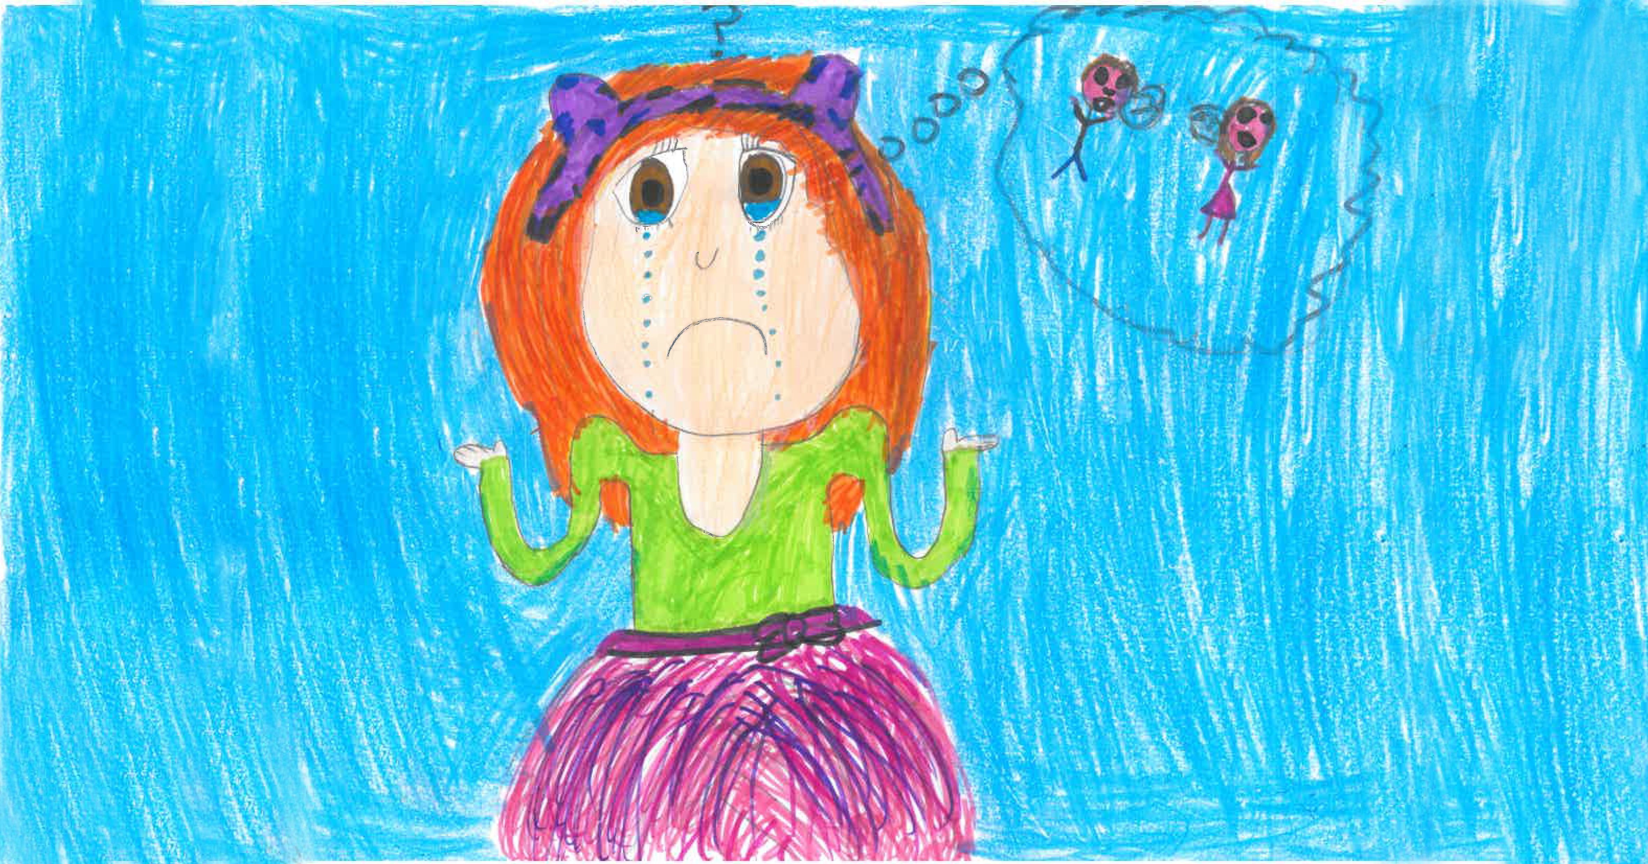
Family-centred Cancer
Care Conversations:
The Talking,
Telling and
Sharing
Framework:
End of Life
This step-by-step framework is designed to help professionals empower parents on when and how to communicate their poor prognosis with their children

Slide 11
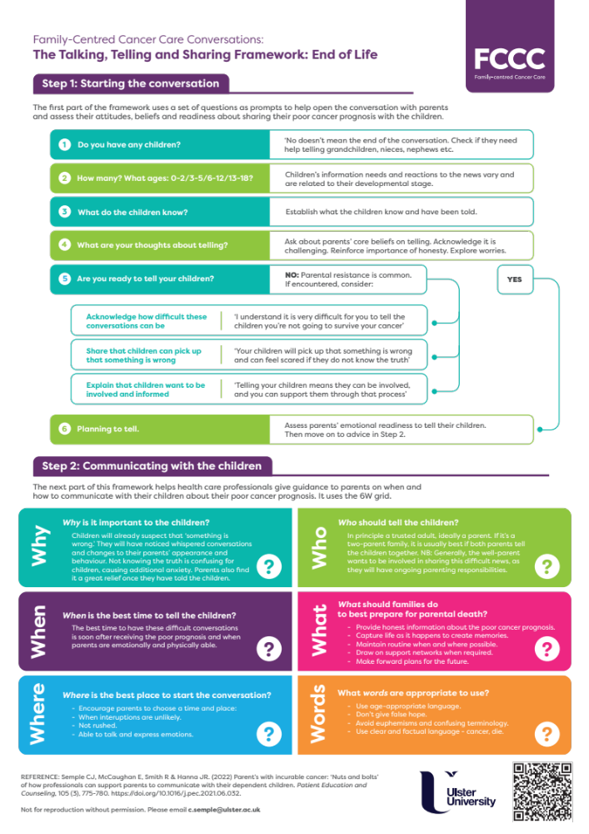
Overview of communication framework
There are two steps in the Talking, Telling and Sharing Framework.
Step 1
This will help open the conversation with parents to
assess their attitudes, beliefs and readiness about sharing
their poor prognosis with the children
Step 2
This will help professionals give guidance to parents on
when and how to communicate their poor prognosis
with their children

Slide 12
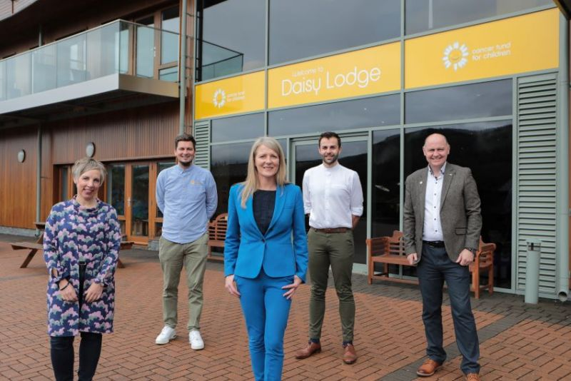
The beginning of our collaboration

Slide 13
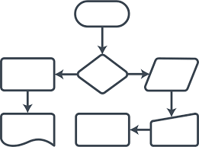






Face-to-Face Educational Training
Duration
Evidence-base
Framework
Educational videos
Bereaved parent
Facilitators

Slide 14
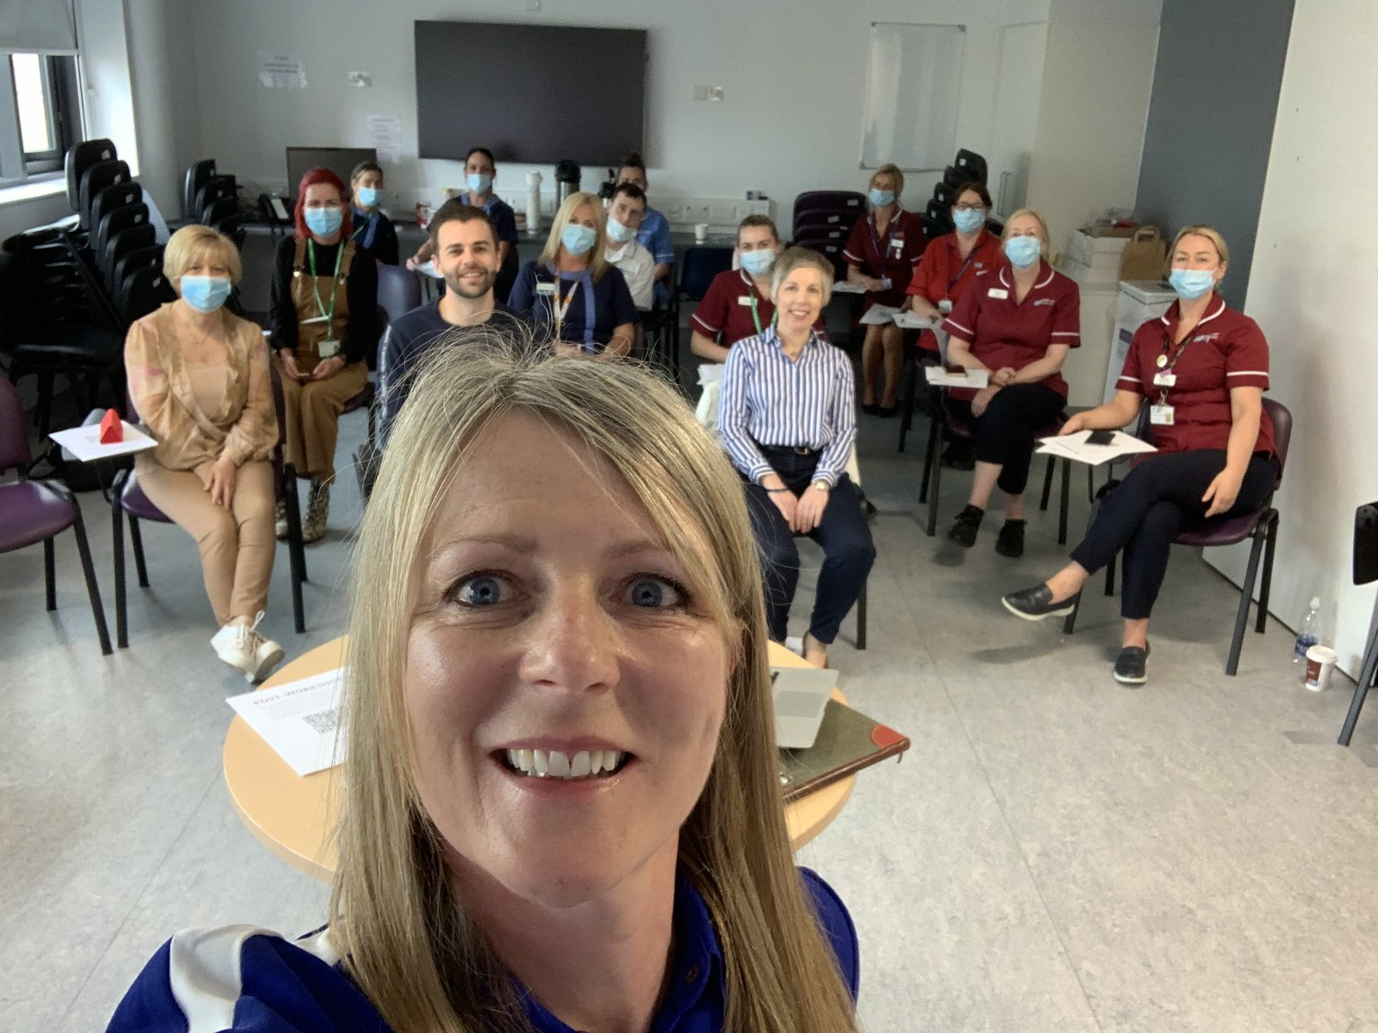
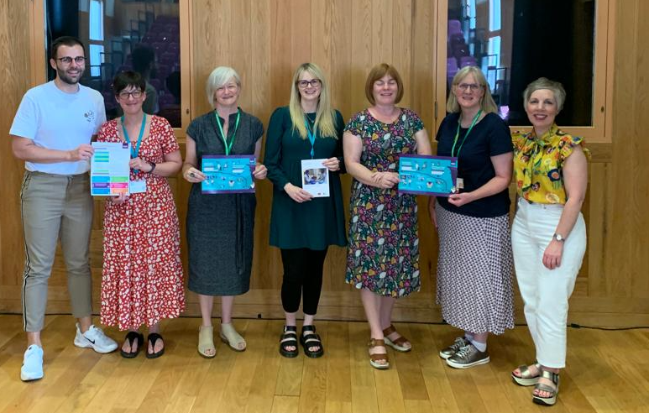
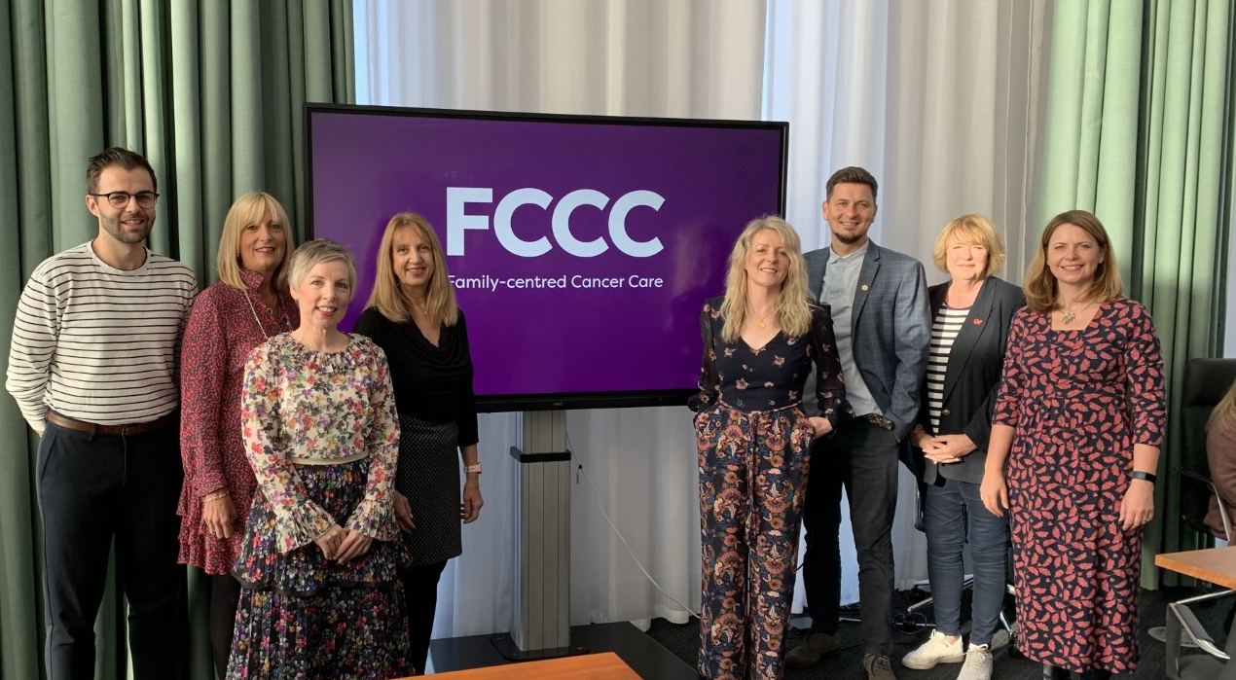
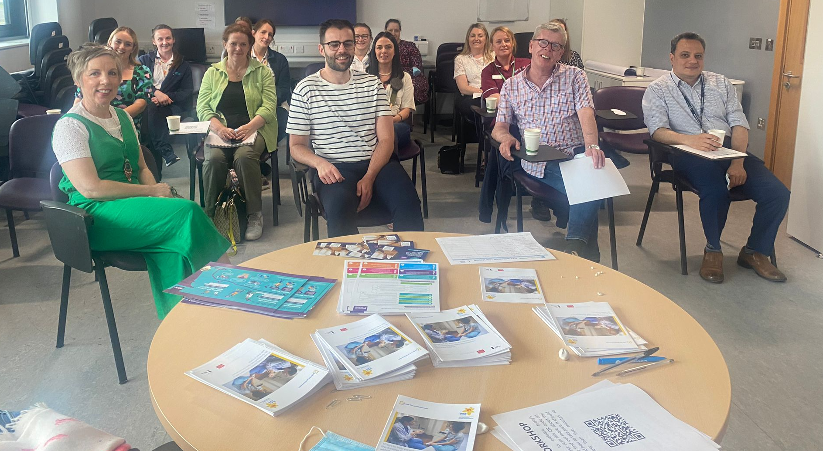
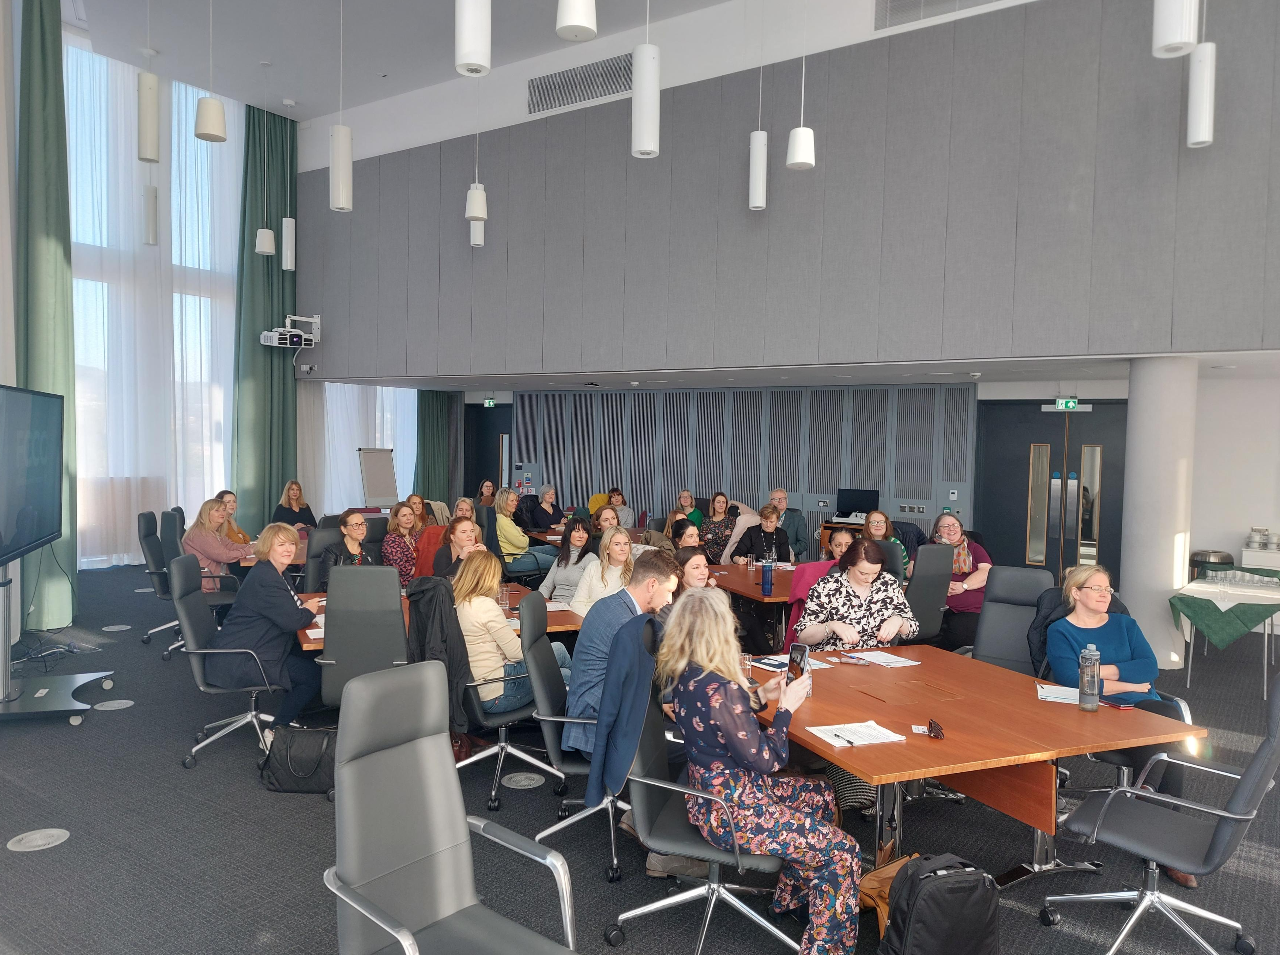
Face-to-Face Educational Training
.
Over 3000 HSCPs trained across UK, Ireland and Denmark

Slide 15
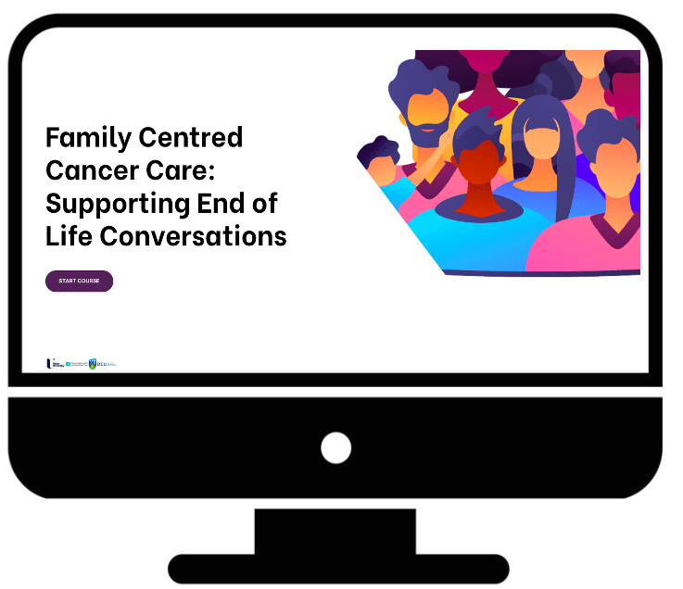
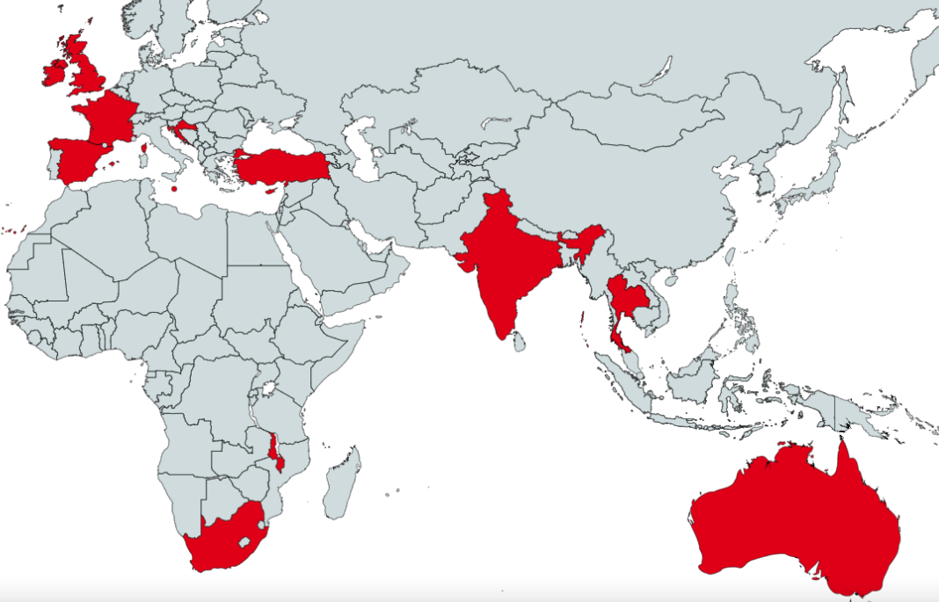



FAMILY-CENTRED CANCER CARE – EDUCATION FOR PROFESSIONALS
www.fccceoled.com

Slide 16
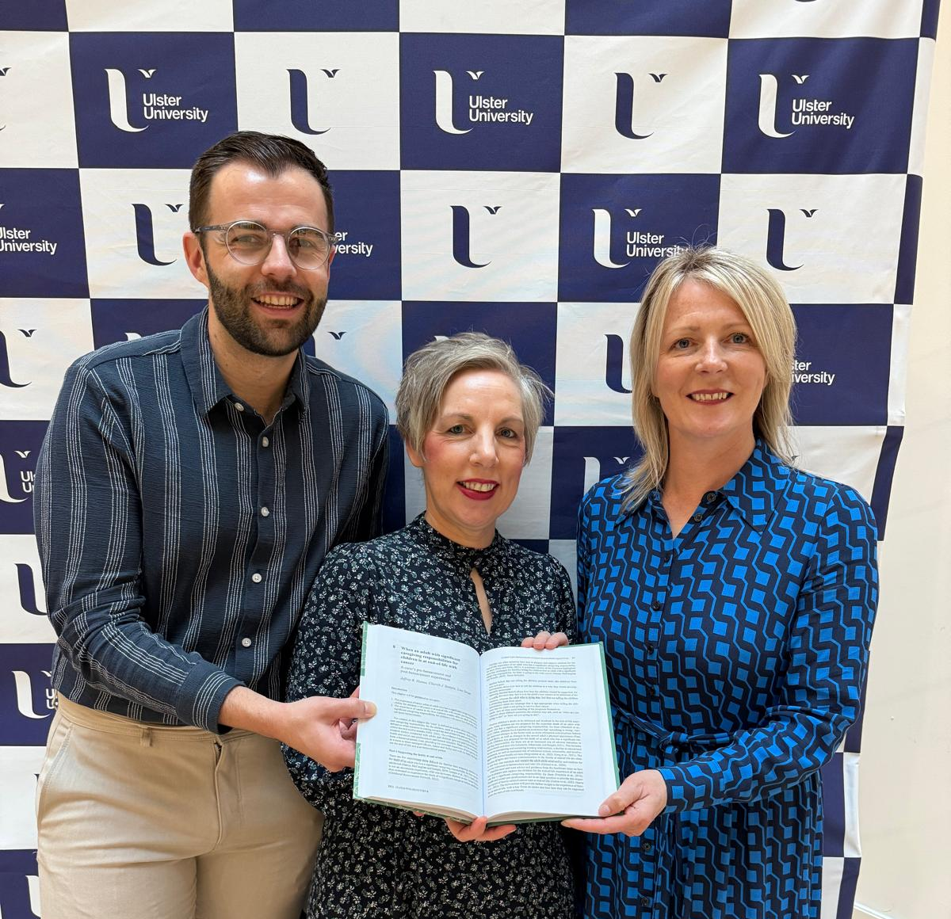
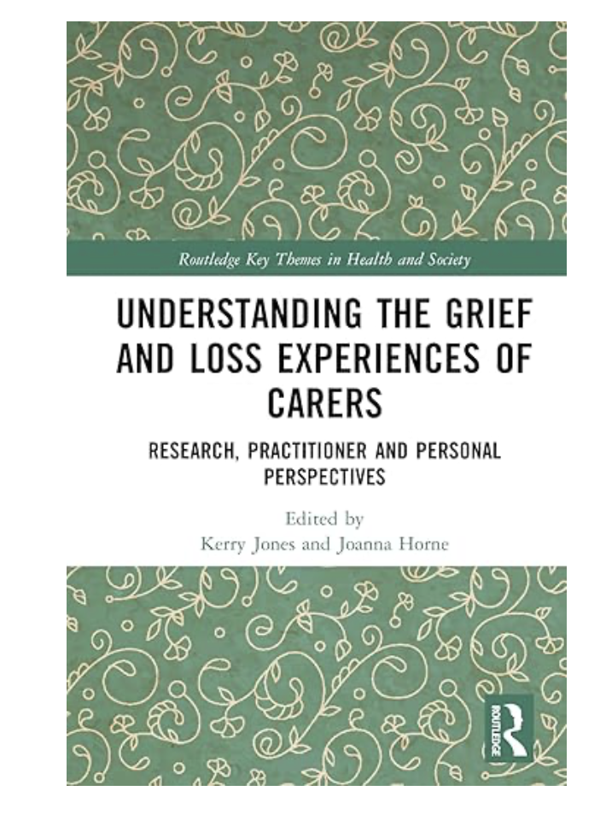
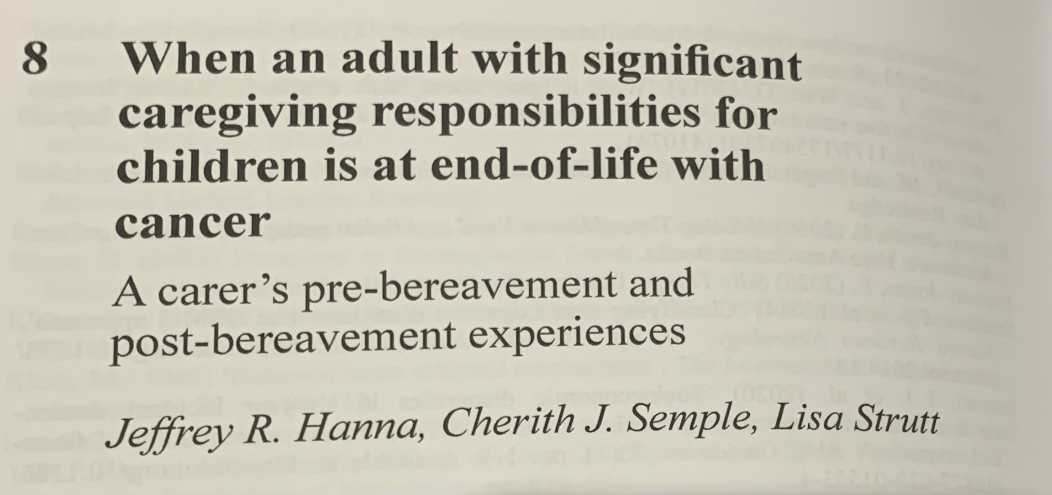
Book chapter
Why can’t the doctors
make mum better?
‘ The doctors and nurses are doing all they can to help mum, but the cancer is still there. The doctors and nurses will make sure mum is well looked after’

Slide 17
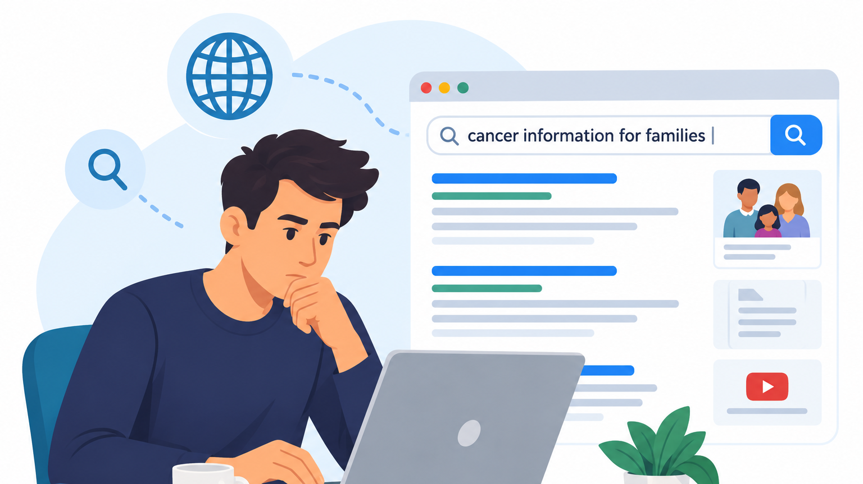
What about the Internet?

Slide 18
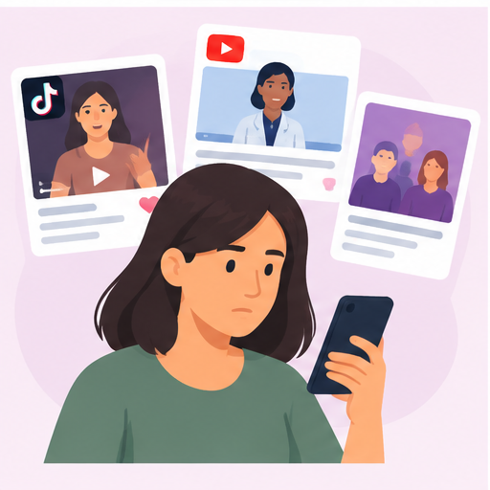
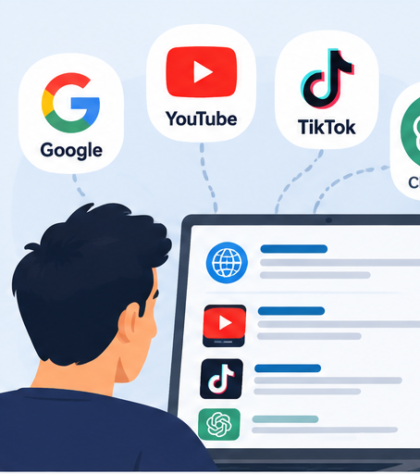
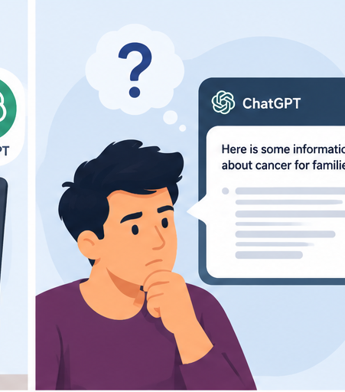


Identifying the sources to review
Notes:
First step was identifying the platforms where adults go to.
Working with our PPI group we landed on a number of key sources:
Digital resources
Google – how do we use google to search for information
Social media – TikTok and YouTube.
AI – four sources identified – WhatsApp Meta, Google Ai, DeepSeek and ChatGPT

Slide 19
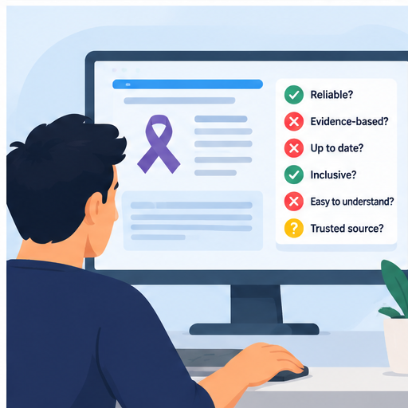
Assessing the resources:
Quality, Reliability and Readability
Notes:
Assessing the resources:
Quality + Reliability: quality and reliability of the resources were assessed using a modified DISCERN (mDISCERN) which comprises of five questions: [47] 1. Is the response/video clear, concise, and understandable, 2. Are valid sources cited, 3. Is the response provided balanced and unbiased, 4. Are additional sources of information listed for patient reference, 5. Does the response address areas of controversy/uncertainty. A ‘yes’ response denoted a value of 1. Total score for each resource was scored out of a maximum of 5.
The Global Quality Score (GQS) was used to assess for overall quality of the whole resource. [47,48] GQS is a 5-point scale ranging from 1-5, with 1 indicating poor quality and 5 excellent quality. One statement of the following statements is applied to the resource; 1. Poor quality, poor flow, most information missing, not helpful for patients. 2. Generally poor, some information given but of limited use to patients. 3. Moderate quality, some important information is adequately discussed. 4. Good quality good flow, most relevant information is covered, useful for patients. 5. Excellent quality and excellent flow, very useful for patients. The higher the score the higher the quality of the resource. Both the mDISCERN and GQS scales were worded appropriately within the extraction sheets for the source type: website, AI response or video.
Readability – the NHS Document Readability Tool – to determine the reading age

Slide 20
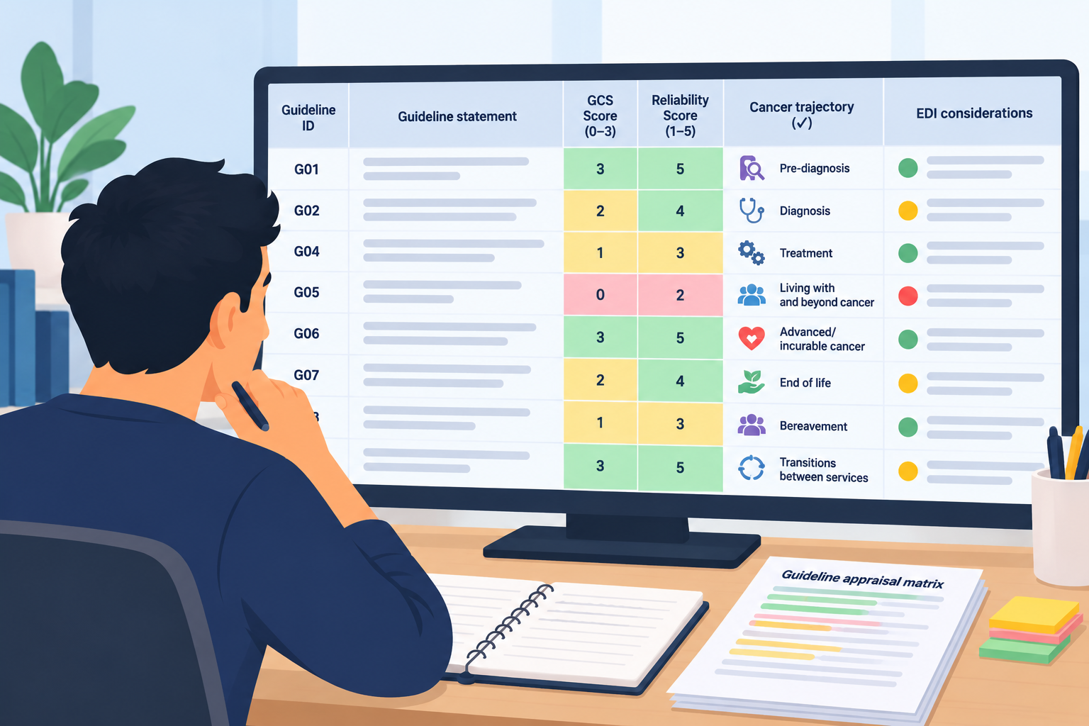
Assessing the resources:
Mapping the content to the needs of families
Notes:
Content was mapped from empirical studies based on the needs of families across the cancer trajectory (from end of life).
We specifically searched for how inclusive resources were for families (to include families with children who are neurodivergent, from a range of cultural backgrounds)

Slide 21

Reflections as a PPI Co-Applicant
Notes:
Lisa – reflections of being part of the team. Doing the scoring. How it felt? Length of time it took too

Slide 22
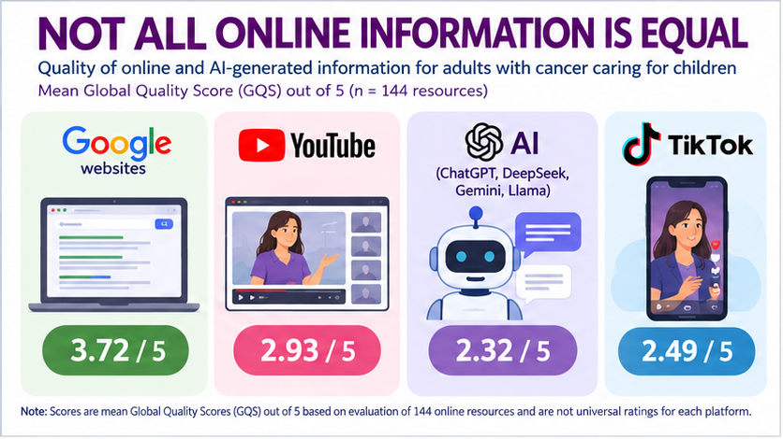

Slide 23
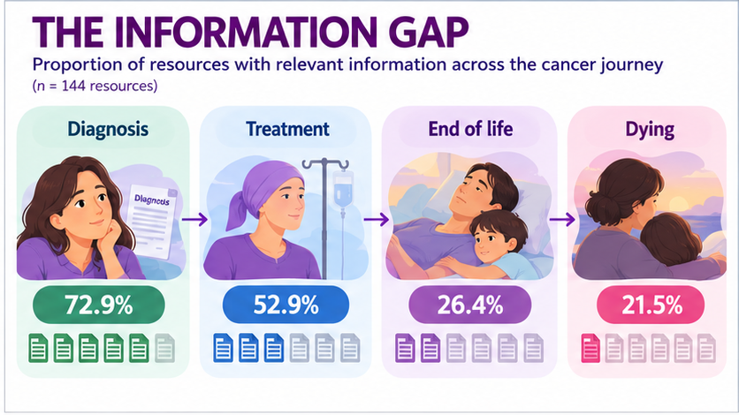

Slide 24
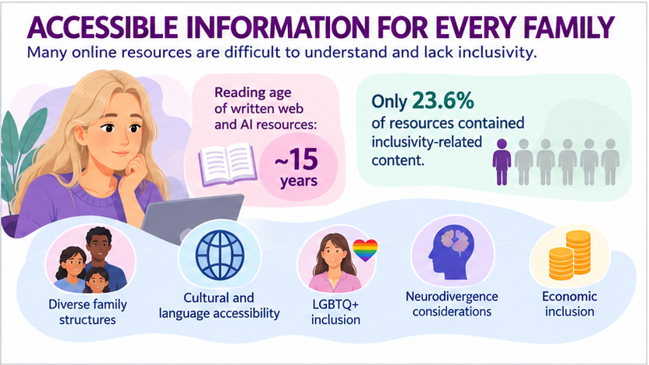

Slide 25
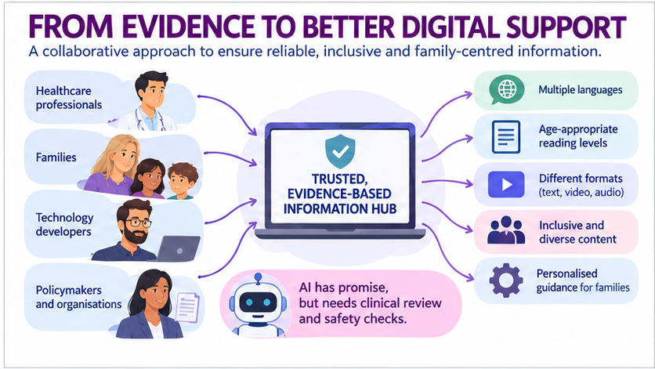

Slide 26
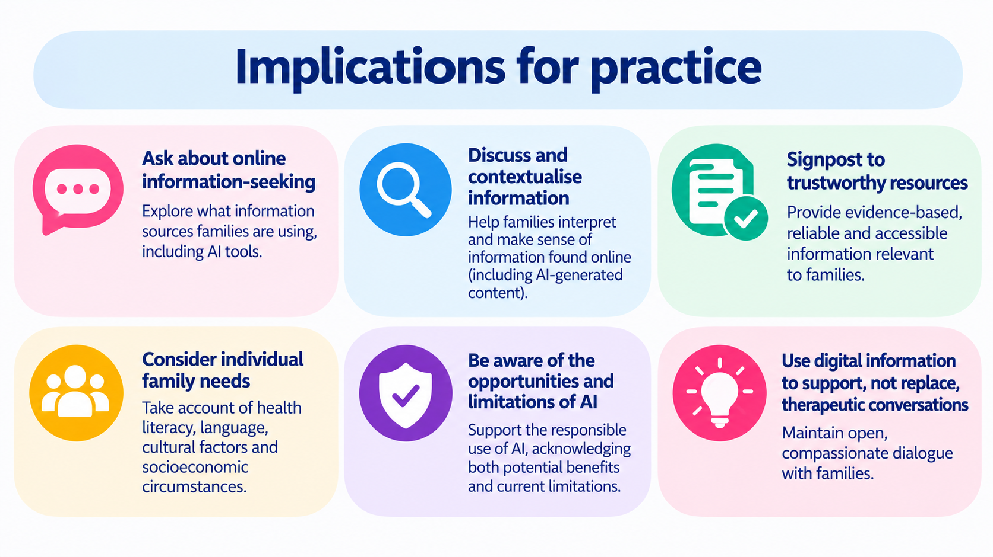

Slide 27
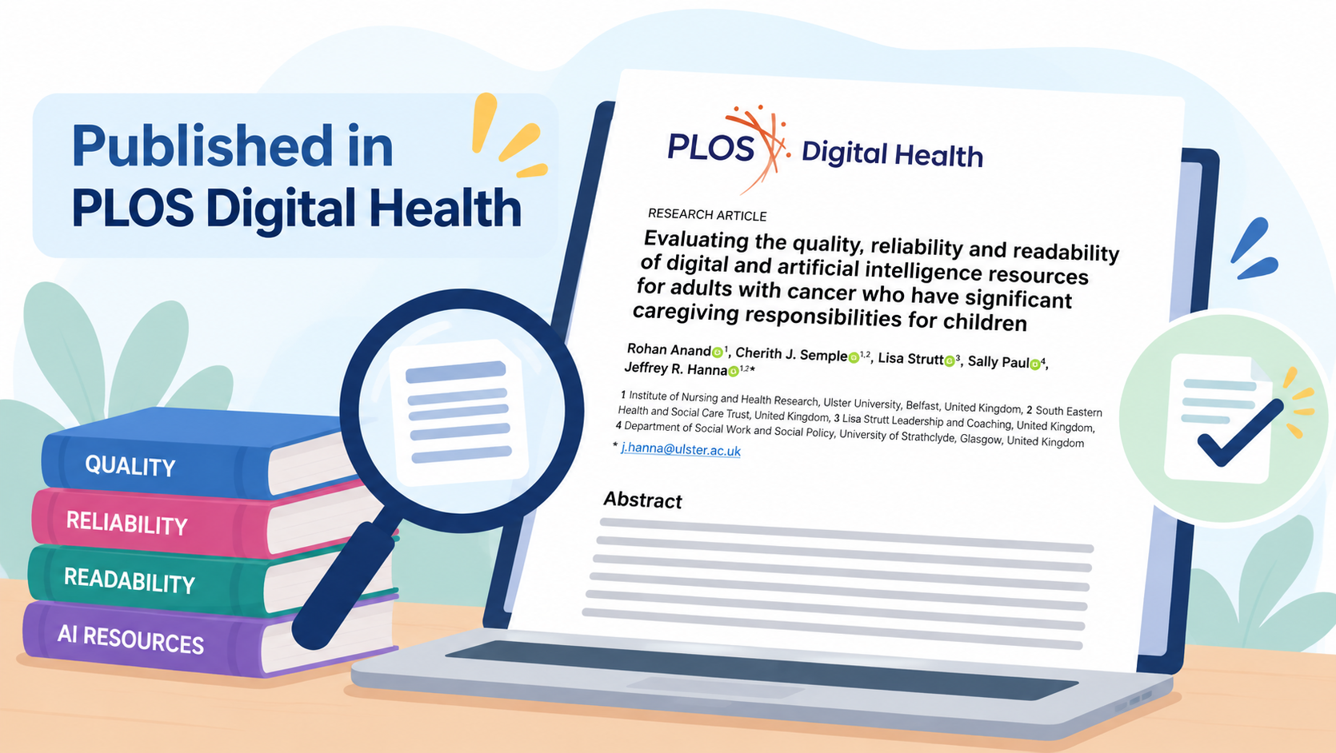

Slide 28
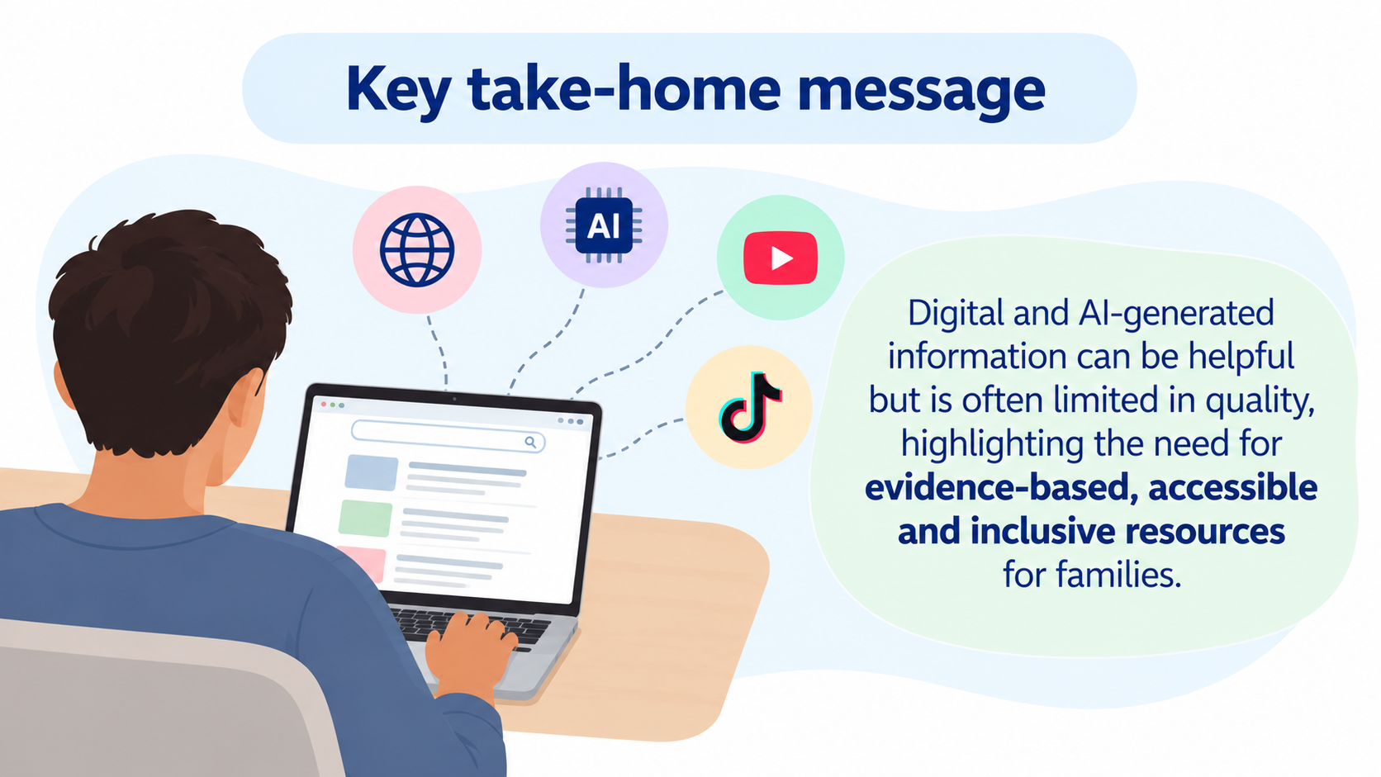

Slide 29


Slide 30

Files will be available on
Past Events - The Palliative Hub Professional (professionalpalliativehub.com/events)
)
Thank you for your time

