Slide 1

‘From Protocol to Bedside: Maximising Research Impact in Chronic Illness and Palliative Care’
Presented by
Prof. Loreena Hill, Ulster University
professionalpalliativehub.com/research/

Slide 2


From Protocol to Bedside: Maximising Research Impact in Chronic Illness and Palliative Care.
Prof. Loreena Hill,
School of Nursing & Paramedic Science, Ulster University
17th September 2026

Slide 3

Prof Loreena Hill, Prof Jim McLaughlin, Prof Raymond Bond & Prof Frank Casey 3rd September 2026
Synopsis
Paradigm shift from siloed care to integration
What is meant by impact?
Impact is dependent on the ‘lens’
Considerations for future research
Notes:
On review of the title- I believe it should actually read Bedside to protocol to bedside showing how research should be derived from practice with findings improving and affecting practice.
There is a growing global need for palliative care because of our ageing population and rising chronic disease burden. A key outcome from several international studies is better integration between palliative and chronic illness care. This presentation will examine ‘integration’ as an outcome- so how do we maximise its impact.
What do we mean by impact- on the patient and Caregiver, Health care System Metrics & Clinical Outcomes but it can be dependent on the lens by which it is examined- that of an academic or policy maker. What one person may perceive as important are not relevant for another.
Review some consideration for future research

Slide 4

Global changes
Patients are living longer with multiple chronic conditions¹.
Health inequalities are more pronounced
Underserved populations often have poor quality of life, reduced access to care, and lower rates of early-stage cancer diagnoses²
Health illiteracy, digital inequity, are associated with more reliance on GP and emergency departments³
80% of health spending in the last year of life is on acute care, with <10% on community services
1:Nat Rev Dis Primers. 2022; 14;8(1):48 2: Br J Anaesth. 2025; 135(5):1141–1143 3:Patient and Client Council, 2021
Notes:
Unprecedented healthcare costs with 80% of health spending in the last year of life is on acute care, with less than 10% on community services ( Marie Curie brief)
18% of adults in Northern Ireland exhibit low health literacy

Slide 5

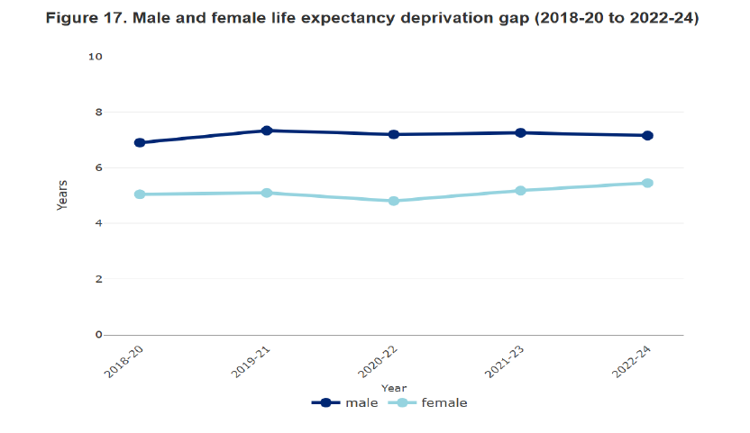
Gender deprivation gap
1: Cardiovascular disease is associated with health inequalities.
~ 30% more likely to die early from CVD depending on where you live.
2: Women living in underserved areas spend >1/3 of their lives in bad health.²
2:https://assets.publishing.service.gov.uk/media/69df5d7261d2e8e9b9e42d2e/renewed-womens-health-strategy-for-england-web-accessible.pdf
Notes:
According to DoH life expectancy at birth is 78.8 years for males and 82.6 years for females.
However examining the deprivation gap which ( between the 20% most deprived and 20% least deprived areas) for males remains 6.9-7.1 years, but the gap is widening for females up to 5.5 years in 2022-2024

Slide 6
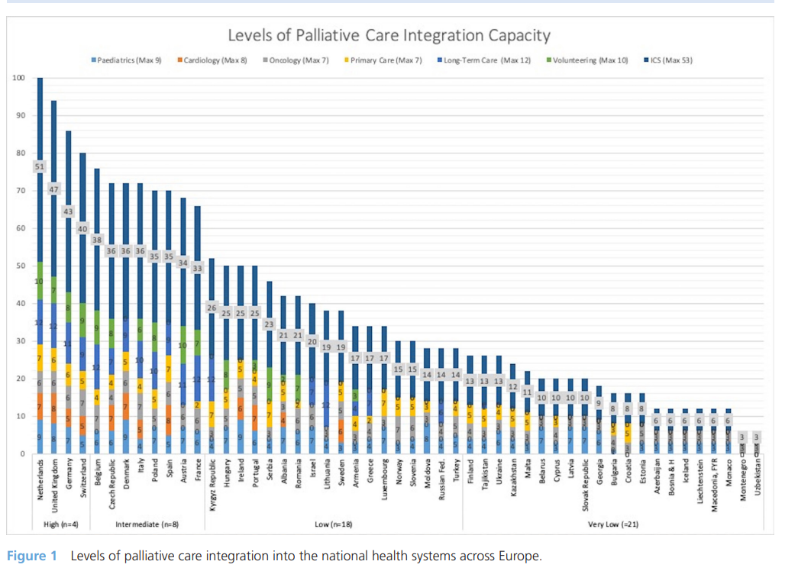
Prof Loreena Hill 17th September 2026
Palliative care
BMJ Supportive & Palliative Care 2024;14:e1041–e1048
Notes:
Equality in the provision of integrated PC- Secondary analysis of survey data from 51 countries with 22 indicators explored the integration of available PC resources
For Ireland- the main area was in long term care.- indicated by the dark blue- while UK it was paediatrics and primary care

Slide 7
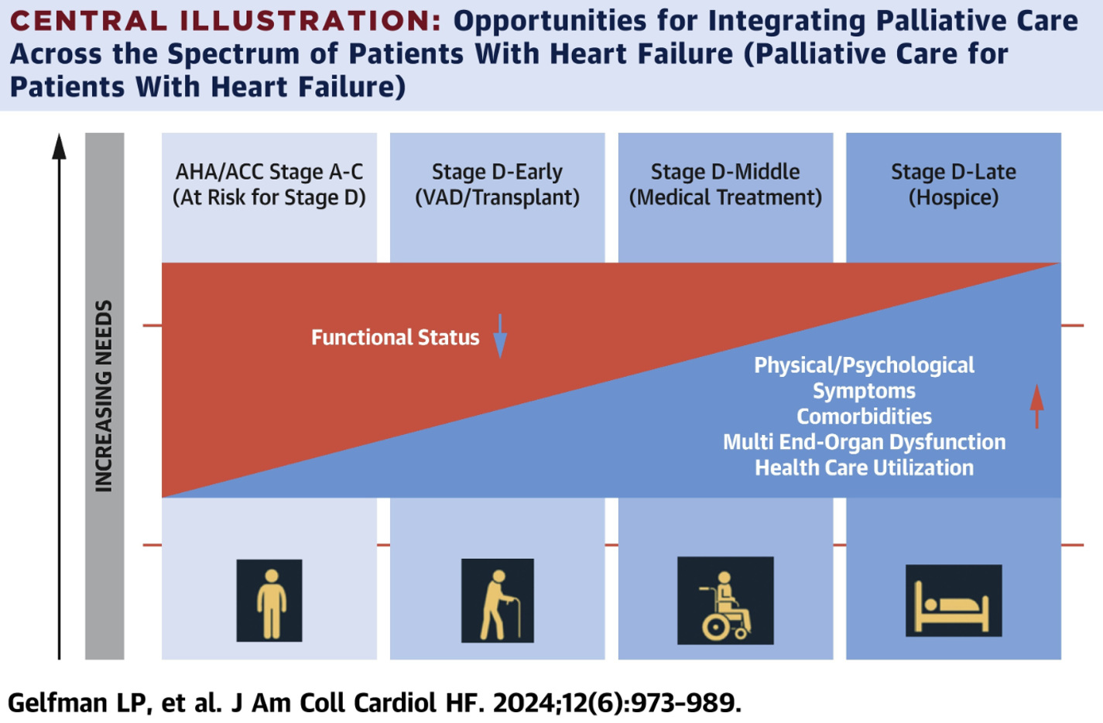
Notes:
Integration model published in 2024- so what is the current context of clinical practice.

Slide 8
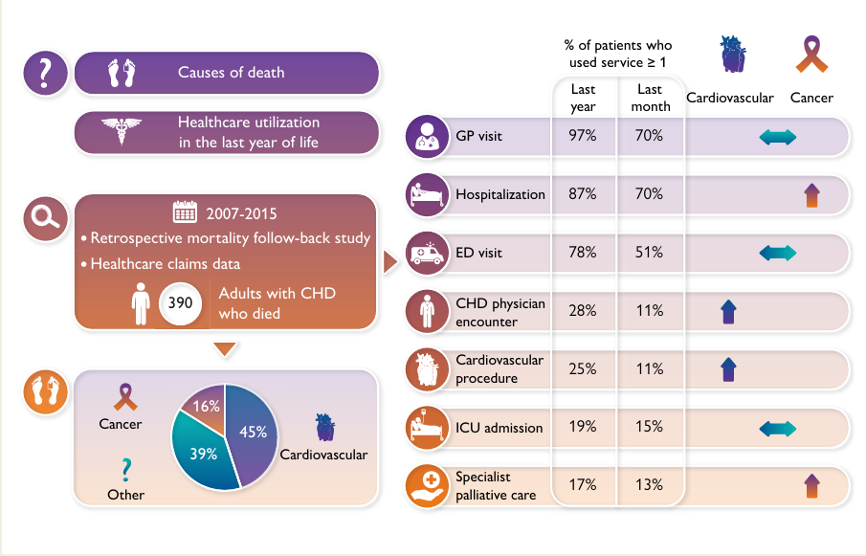
Prof Loreena Hill 17th September 2026
Patients with congenital heart disease
Eur Heart J. 2022; 43: 4483–4492
Notes:
Retrospective mortality data of 390 patients with congenital heart disease in Belgium
Key findings were
In the last year of life: 87% of patients were hospitalized, 19% of patients had an intensive care unit (ICU) admission, and 17% of patients received specialist palliative care.

Slide 9
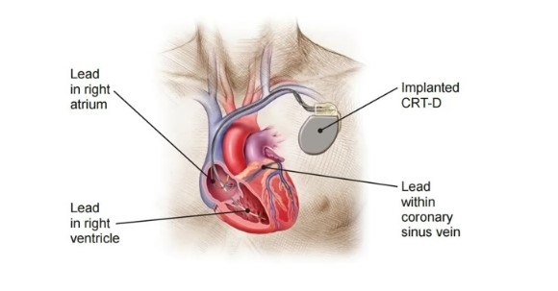
Advanced HF & Implantable Cardioverter Defibrillator
Objective To explore patients’, family members’ and professionals’ attitudes and understanding towards discussing ICD deactivation.
Methods Case study approach- n=29 interviews with patients, family members and healthcare professionals
Results:
Patients and carers had limited understanding of ICD & its functions.
All patients wanted the opportunity to discuss when death was imminent; indecisive if family members should be involved.
Conclusions Patients and family members require improved communication and information concerning their future treatment plan and functionality of an ICD.
BMJ Supportive & Palliative Care 2022;12:e219–e225.

Slide 10
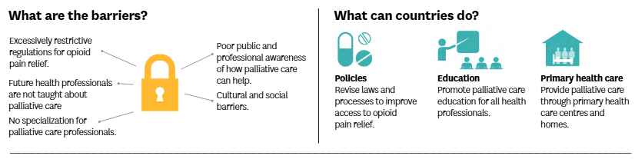
Call for action by WHO
Barriers: Poor public awareness of how palliative care can help.
Cultural & social barriers.
Insufficient skills and capacity of health workers.
Overly restrictive regulations for opioid relief.
http://www.euro.who.int/en/palliativecare

Slide 11
Prof Loreena Hill 17th September 2026
Define impact
Dictionary definition: To have a direct effect or influence on something
Patient’s definition: Understand that experiential knowledge gained by living with a condition is scientifically valuable and intrinsically important¹
Research definition (REF): The effect research has beyond the academic sphere, including its direct or indirect contributions to the economy, society, culture, public policy, health and/or the environment or quality of life²
1: AJKD 2026; 88 (3). 2: Research Evaluation.2013; 1: 21–32
Notes:
4 key words linked to IMPACT: Effect, change contribution and benefit

Slide 12
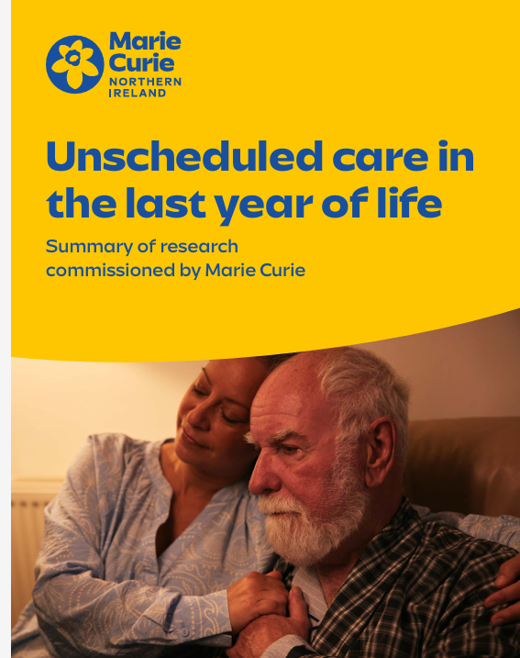
Perspectives on IMPACT
Patient and caregiver: improved quality of life and care experience
Health care systems: reduction in ED admissions, length of hospital stay or cost effectiveness
Clinical practice: Novel pathways, different ways of working.
Society: reduction in risky behaviours- i.e. smoking
Teaching & Research: Inclusion of co-design, value of PPIE
Eur J Cardiovasc Nurs. 2016; 15(1): 20–29, https://doi.org/10.1177/1474515115584248
Notes:
Patient and Caregiver, Health care System Metrics (Reduction in avoidable emergency admissions, decreased length of hospital stays, and cost-effectiveness) Clinical Outcomes ( Advanced Planning/ preferred place of death achieved), dependent on the lens of the individual be that a academic and policy maker
Research Findings
Emergency Department (ED) and Hospital Use:
8 in 10 people had at least one ED attendance in their last year of life. Main reasons: infection, respiratory, cardiac, gastrointestinal issues, and cancer.
Ambulance Service Use:
1 in 5 ambulance calls relate to people in their last year of life.

Slide 13
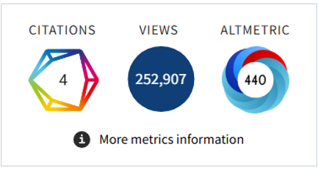

Indicators of impact
Notes:
The metrics for the researcher can be
Journal citations- H index
Social media engagements
Inclusion in prestigious presentations
Position papers/ guidelines/ policy briefings
Colleagues and professional interest in the topic.

Slide 14
Prof Loreena Hill 17th September 2026
Benefits of Impact
Establishing evidence does not mean it will be implemented
  In health, < 50% clinical innovations never make it into practice¹
  An average of 17 years for evidence to be implemented into
  practice yet only 14% of original research will reach patients ²
Gap between evidence and what’s delivered in practice
  Global policy action to protect the ozone layer lagged scientific understanding by ~ 30 years³
1: Bauer and Kirchner 2019 2: Hill et al 2021 3: U.N. Global Sustainable Development Report, 2015

Slide 15
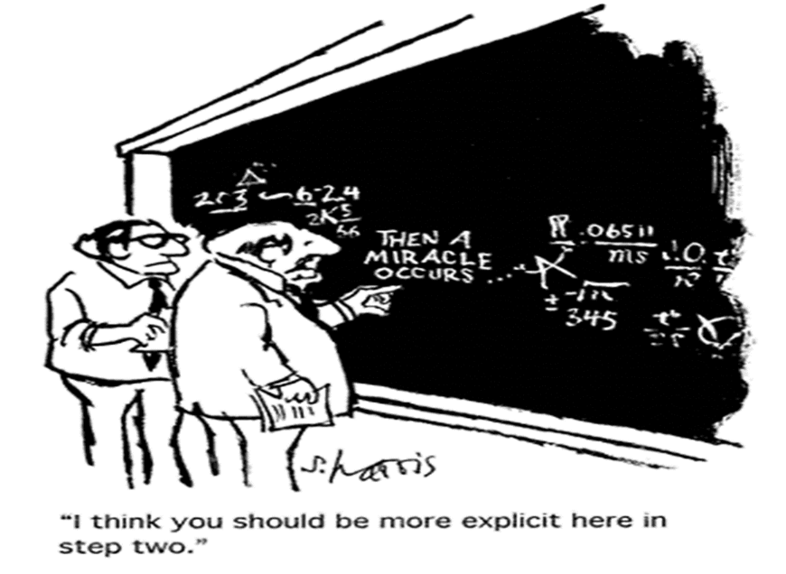
Often an important missing piece
Prof Loreena Hill 17th September 2026

Slide 16
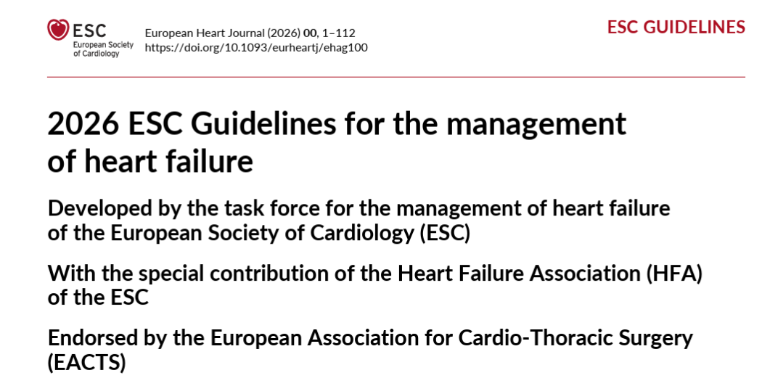
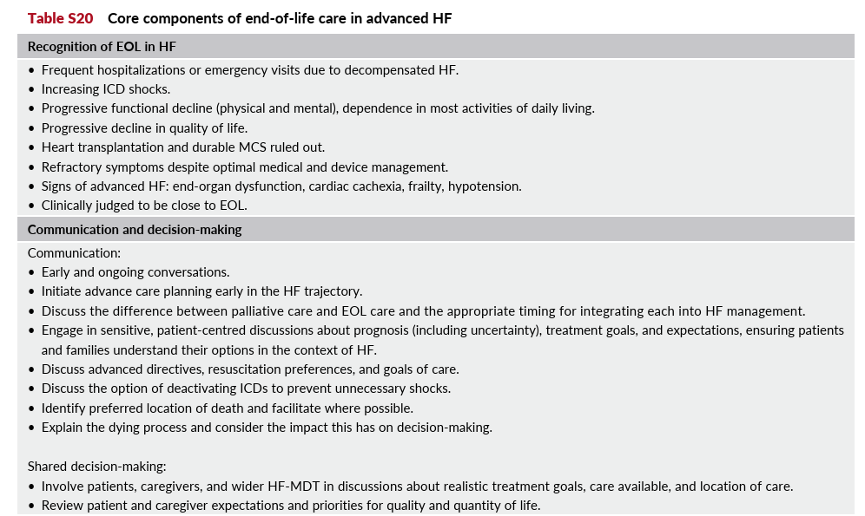
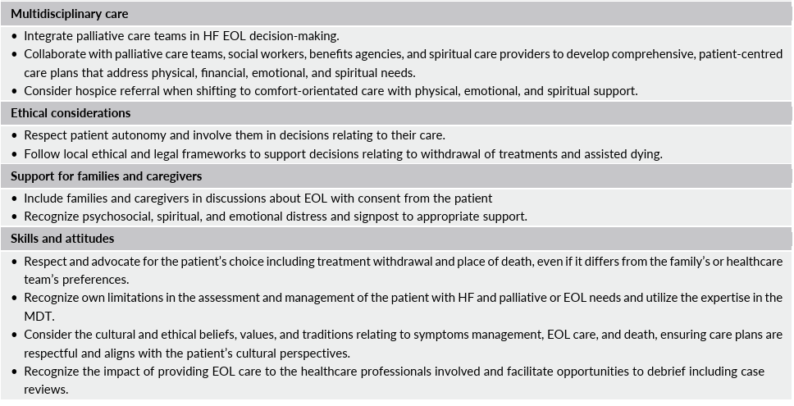
Notes:
Just because findings are published- does that demonstrate impact. … Palliative care position paper.. But challenges exist
Difference between 2021 and the AHA/ACC/HFSA guidelines
Framing of Palliative Care: AHA/ACC/HFSA guideline - Class 1 recommendation that palliative care should be provided to all HF patients to improve quality of life and relieve symptoms.
Distinction of Palliative Care Levels: The AHA/ACC/HFSA guideline explicitly distinguishes between primary palliative care (provided by the primary care team for basic needs) and secondary palliative care (provided by specialists for more challenging needs).

Slide 17
Prof Loreena Hill 17th September 2026
What is an output or outcome or impact
Category | Definition | Examples
Output | Immediate products generated by research activities | Data set, publication,
Outcome | Short – medium term changes in knowledge, attitudes, skills or practice that arise | Clinicians engaging with HF nurse curriculum, or new guideline recommendations are implemented
Impact | Long term benefits for potential research beneficiaries, including society | Improved educational outcomes, optimised patient care, changes in care pathways, change in healthcare policy etc.
The Clinical Teacher 2026; 23: e70382:

Slide 18
Prof Loreena Hill 17th September 2026
For change to occur
Awareness
1
1: Degree the individual will benefit is low
Knowledge
2
2: Varies on the stakeholder
Practice
3
3: Follows from awareness & knowledge
4: Changes can be individual / service level
Policy
4
5: Increase scale of benefit
Results/Impact
5
6: Effect of new policy/practice
7: Demonstrates significant benefits i.e. wellbeing, environment
TIME
Notes:
Researchers describe the clinical protocol as "the thing", clinical research as testing if "the thing" works, and implementation science as evaluating the best ways to get people to do "the thing- then evident change that occurs after ‘the thing’

Slide 19
Prof Loreena Hill 17th September 2026
Additional key terms
Significance: is the intensity of benefit
Reach: is the breadth or level of influence, for example across setting or chronic illness groups
Knowledge mobilisation: Who are your supporters, that will help ensure results make an impact

Slide 20

Who do I tell my results?
Study site: Summary of results to colleagues/staff, present research findings at meetings or education sessions.
Key stakeholders: Presentations at local, national & international
Funder
PPI or community groups
Journal/publication
Social media
Nursing organisations

Slide 21
Considerations for future research
What do I wish to implement or create a change?
Where: understand characteristics of setting
Who is being targeted (what are their motivational factors/ knowledge/ skills/ personality)
How : Implications of the process (ownership/ relationships and network)

Slide 22
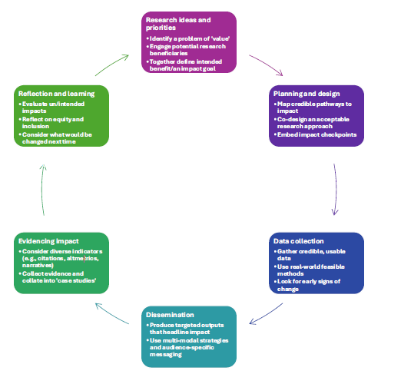
Prof Loreena Hill 17th September 2026
Embedded throughout the research
The Clinical Teacher 2026; 23: e70382:
Notes:
Research ideas and priorities: Define intended benefit/impact goal
Planning and design: Embed impact check points
Data collection: Look for early signs of change
Dissemination: targeted outputs
Evidence impact: Consider diverse indicators ( citations/ narratives) Collect evidence and collate into case studies
Reflection and learning: evaluate intended and unintended impacts

Slide 23


Neighbourhood plan for Health and wellbeing
Focuses on prevention, joined‑up working and understanding the needs of local communities.
Refocusing the system to resource the shifting of more care into communities will help people get support earlier, improve outcomes and reduce the need for avoidable ambulance and hospital use.
Notes:
Returning to where we started in terms of health inequalities and planning long term impact – 1 dedicated theme on implementation and impact

Slide 24
Take home messages
1. Requires engagement and co-design to ensure findings are appropriate, sustainable and scalable.
2. Include success milestones and indicators showing value to funders and stakeholders (patients, caregivers, clinicians & policy makers)
3. Purpose-Driven Knowledge Mobilisation to actively shape, inform and improve clinical practice, education and policy
Notes:
1: Benefits: This upfront alignment prevents "ivory tower" isolation, builds trust, and ensures the ultimate findings are practically applicable to everyone involved.
2: Benefits: Defining success metrics early allows the research team to track progress transparently, pivot when necessary, and objectively demonstrate value to funders and partners.
3: Benefits: Embedding knowledge mobilisation into the project's foundation ensures that findings do not just sit in academic journals, but actively shape, inform, and improve public or organizational policy.

Slide 25

Thank-you for listening
Prof Loreena Hill
Email: l.hill@ulster.ac.uk

Slide 26

Files will be available on
Past Events - The Palliative Hub Professional (professionalpalliativehub.com/events)
)
Thank you for your time

