Slide 1


Session Two
PCRN Members’ Presentations
Chair: Dr Geraldine Foley, TCD
Vice Chair of PCRN Strategic Scientific Committee
@aiihpc
#PCRNSymposium

Slide 2



Dying on the margins: Palliative care in the shadows of justice.
Audrey Roulston
Professor of Social Work in Palliative Care
Programme Director for MSc/PG Diploma in Palliative Care for Social Workers at Queen’s
Email. a.roulston@qub.ac.uk

Slide 3
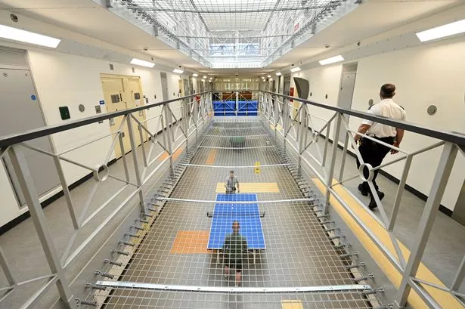
VV
Background
It is vital to promote social justice when working with and on behalf of individuals and groups who are oppressed or experience discrimination.
People in prison face social injustice through health inequalities, bureaucratic delays, poor living conditions, and lack of privacy.
NORTHERN IRELAND

Slide 4

VV
Background
Dying from natural causes in prison custody is a reality, due to:
Longer prison sentences (Bromley Briefing, 2018)
More chronically sick prisoners (Williams et al., 2014)
An ageing prison population (Van Zyl Smit and Appleton, 2019) and
older people being sentenced for historical crimes (Bellas et al., 2024).

Slide 5

VV
Environmental & Regulatory Barriers in Prison
Inflexible regulations for locking cells, restraints, ERCG or family visiting.
Children not allowed into prison cells.
Limited access to equipment & restricted space in cells for equipment.
Limited number of specialist wings/beds.
Long distances people need to walk.
Dying in prison perceived as additional punishment & humiliating.

Slide 6


Research Questions
Do people diagnosed with a life-limiting or chronic illness in UK prisons have equitable access to palliative care services?
Nature of Data
Published reports of independent investigations into deaths in prison custody between 1 January 2017 and 31 December 2020 in England, Wales, Scotland, and Northern Ireland.
Ethical Considerations
All data were publicly available online.
Formal ethical approval was not required.
Data Collection & Analysis
Prison Ombudsmen reports on anticipated deaths from natural causes in prison were examined and data were extracted and analysed using SPSS.

Slide 7
Key Findings
21.2% aged 80+years
830 deaths from natural causes (2017-2020)
343 sudden / unexpected deaths excluded
487 included
99.2% males
81.6% aged 60+ years
45.2% died from cancer
80% had more than 1 health care condition
In 48 cases care not equivalent
384 cases (83.7%) care was deemed equivalent
England = 443
Wales = 14
Scotland = 28
Northern Ireland = 2

Slide 8
Examples of non-equivalent care
Poor care planning & coordination
Poor communication (patient, staff, family and GPs)
Poor record keeping (not meeting NMC codes)
Delayed assessments, blood tests, admissions…diagnosis & access to treatment (including delayed access to palliative care / pain relief)
System failures & not adhering to protocols to manage chronic health conditions or not making urgent referrals using NHS pathways
Lack of specialist equipment, incorrect dosages of meds, etc.

Slide 9
Reference to Palliative Care in Reports
Palliative care was mentioned in 193/220 deaths where cancer was the primary cause of death.
Palliative care was mentioned in 122/267 (45.7%) deaths from non-cancer causes.
Palliative care not mentioned in 50/80 cases of COPD/ pneumonia.
Palliative care not mentioned in 60/105 cases of cardiovascular disease.
ERCG was mentioned in 183/220 cases where the primary cause of death was cancer.
Palliative care was mentioned in 99/267 deaths from non-cancer causes.
ERCG was not mentioned in 46/80 cases of COPD/pneumonia.
ERCG was not mentioned in 76/105 cases of cardiovascular disease.

Slide 10

In summary …
805 recommendations were made across 487 reports.
Main recommendations were for improved:
Clinical care, palliative & end of life care
Communication & documentation
Contact with families
Risk assessments for using restraints/frailty/falls/ACP
Decision times for ERCG.
This Photo by Unknown Author is licensed under CC BY-NC-ND

Slide 11
Acknowledgements
This research was funded by Marie Curie.
The research team consisted of:
Prof. Audrey Roulston (QUB)
Dr. Mary Turner (University of Huddersfield)
Dr. Emma Carduff (Marie Curie, Edinburgh)
Thank You

Slide 12






Integrating Findings to Inform Multi-Level and Inclusive Interventions for Advance Care Planning
Mixed-Methods Study
Pilch^{1,2}, M., Doyle³, F., Hayes¹, C., Thomas¹, S., Hogan⁴, M.
¹Trinity College Dublin, ²University College Dublin, ³Royal College of Surgeons in Ireland, ⁴University of Galway
Presenter: Monika Pilch, PhD
School of Psychology, University College Dublin
monika.pilch@ucd.ie

Slide 13
Background
Ageing Population
1 in 6 over 60 years old by 2030. Most deaths will follow prolong illness.
Advance Care Planning (ACP) & Person-centered Care
Care preferences unexplored, poor ACP implementation, low engagement
ACP: Gaps & Persistent Challenges
ACP – behavioural complexity
Multilevel influences
Lack of theoretical grounding
Research Questions
[Inspired by design thinking & universal design principles]
Why is ACP still low? [What is the problem?]
What would a theory-informed, multilevel ACP intervention look like? [What is the solution?]

Slide 14
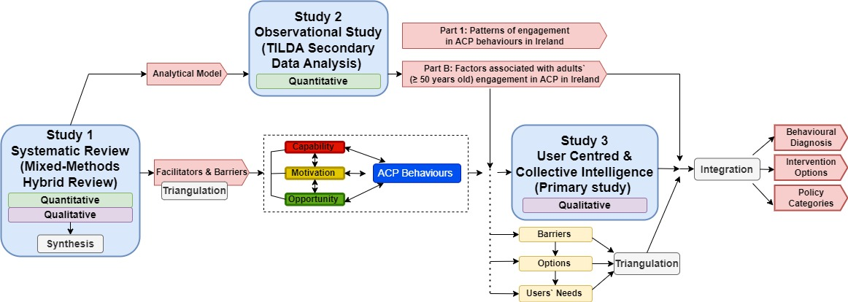
Design
Dataset 2
(n = 2,884)
Dataset 1
(n = 117)
Dataset 3
(n = 22)
Fig. 1. Exploratory sequential mixed-methods design

Slide 15
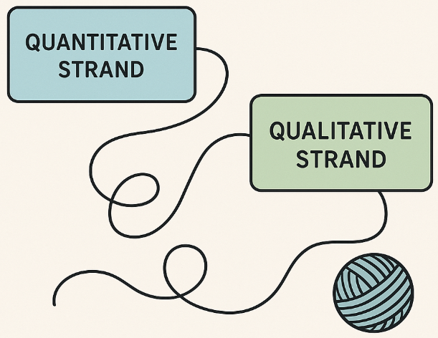
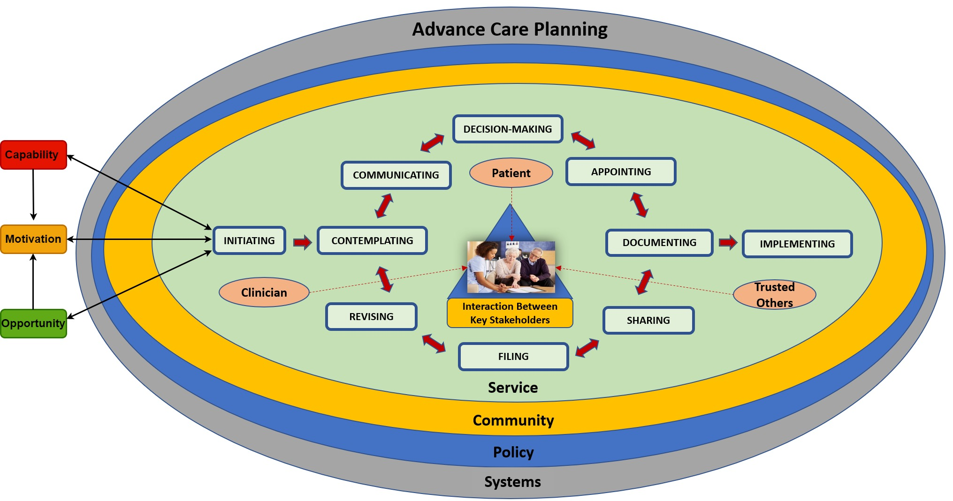
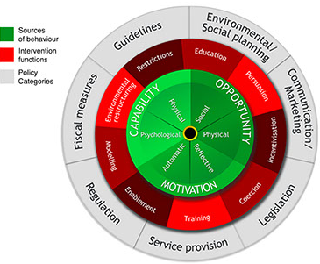
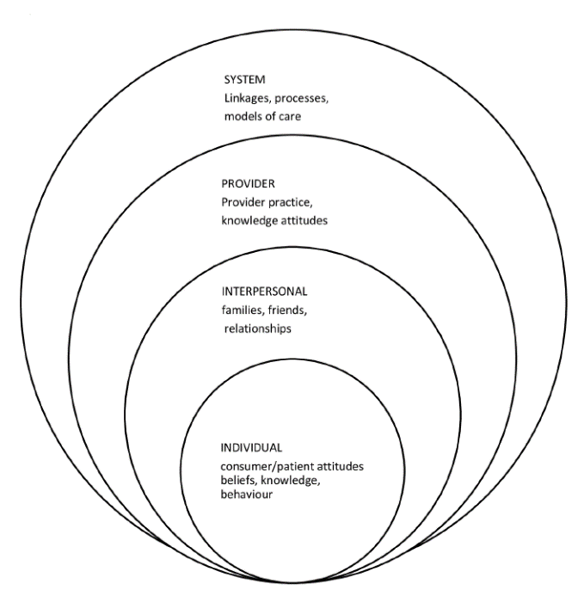
Integration Framework
Technique: Following the Thread
Agreement?
Adapted “Integration Framework for Mixed Methods Study”
Complementarity?
Dissonance?
Six Stages
Silence?
1
Reduction
2
Transformation
3
Comparison
4
Integration
5
Mapping
6
Credibility Check
Behaviour Change Wheel
Socioecological Perspective
Fig. 2: ACP Behaviours Embedded in Context

Slide 16
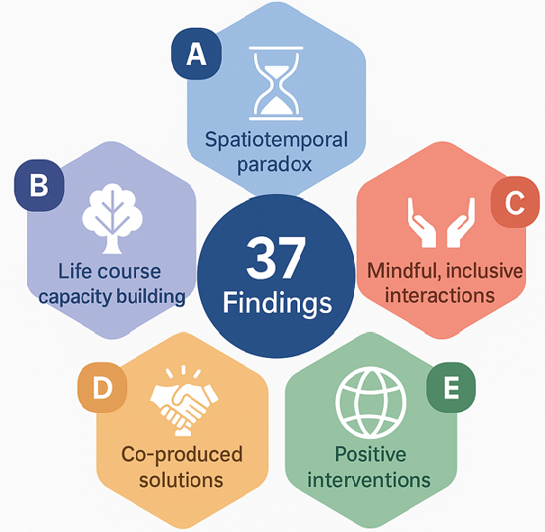
Findings
2
1
3
4
5
Fig. 3: Relational and Multilevel Dimensions of Advance Care Planning

Slide 17


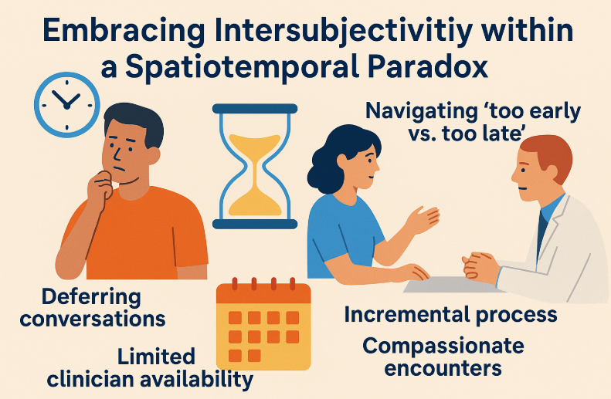
Meta-theme 1
Meta-theme 2
Meta-theme 3
INDIVIDUAL
INTERPERSONAL

Slide 18
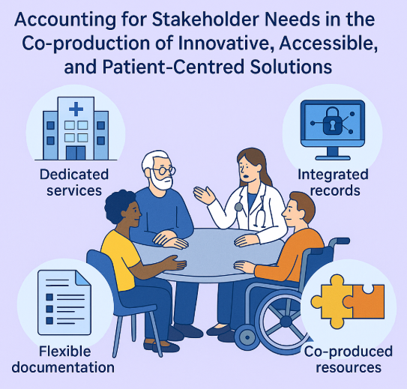

Meta-theme 4
Meta-theme 5
SERVICE
SYSTEM

Slide 19
Environmental / Social Planning
Guidelines
Environmental / Social Planning
Guidelines
Education
Restrictions
Education
Persuasion
Persuasion
Communication / Marketing
Communication / Marketing
Environmental restructuring
Fiscal Measures
Environmental restructuring
Incentivisation
Incentivisation
Modelling
Modelling
Coercion
Legislation
Legislation
Training
Regulation
Enablement
Training
Enablement
Service Provision
Service Provision

Slide 20


Strengths
Limitations
Systematic review: studies from 1987 – 2020.
Focus on middle-aged and older adults.
Heterogeneity and data transformation.
Need for cautious interpretation.
Systematic approach
Integration of heterogeneous evidence
Triangulation of stakeholders’ perspectives
→ ensured depth & breath.
Theoretical grounding
→ Mapping facilitated clear roadmap.
Practical, solution-focused synthesis.
A strong foundation for multilevel intervention design

Slide 21



Implications
Practice, Policy & Research
Practice
Policy
Research
Ensue:
Compassionate, trauma-informed delivery,
Recognition of relational & emotional complexity,
Design of culturally tailored tools,
Life-long training,
Readiness scaffolds.
Need for:
Supportive legal frameworks,
Integrated digital infrastructure,
Processes informed by behavioural perspectives, system science & universal design.
Co-design, participatory research & PPI
Explore new outcomes:
Psychological readiness
Surrogate burden
Decisional conflict
Values alignment
Coordinated policy - practice - research agenda, grounded in behavioural & system science

Slide 22
Thank You
Presenter: Monika Pilch, PhD
School of Psychology, University College Dublin
Pilch^{1,2}, M., Doyle³, F., Hayes¹, C., Thomas¹, S., Hogan⁴, M.
¹Trinity College Dublin,
²University College Dublin,
³Royal College of Surgeons in Ireland,
⁴University of Galway
Contact: monika.pilch@ucd.ie

Slide 23

14th Annual PCRN Symposium
20th November 2025
Samantha Smith, Tara Delamere, Joanne Balfe & ECHPI collaboration

Slide 24
How many children in Ireland have life-limiting conditions?
Estimating the prevalence of life-limiting conditions amongst children in Ireland using Irish data
Motivation
  Context: specialist children’s palliative care in Ireland
  Aim: strengthen evidence base for policy, planning & delivery in CPC in Ireland
  Focus:
    How many children need specialist children’s palliative care?
    Defining population-level need for specialist CPC is complicated
      Combination of diagnosis and care complexity
    First step: focus on number of children with life-limiting diagnoses in Ireland
    Progress from available estimates based on international data

Slide 25
Hospital discharges by LLC group, age, and year

Slide 26
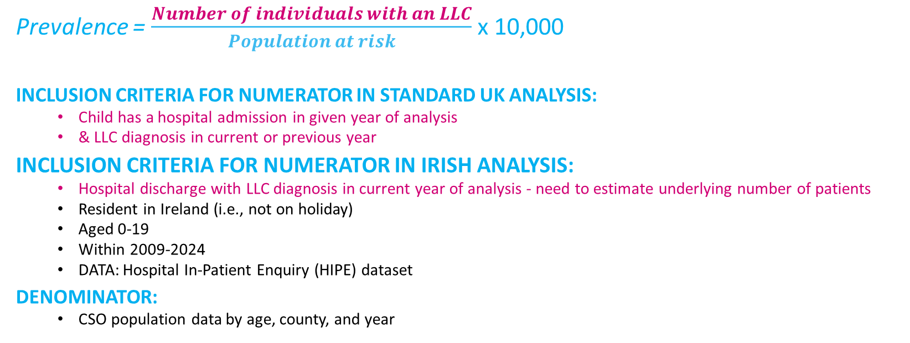
Prevalence Methods
This number is estimated using 3 alternative methods
Prevalence = $\frac{Number of individuals with an LLC}{Population at risk}$ x 10,000
INCLUSION CRITERIA FOR NUMERATOR IN STANDARD UK ANALYSIS:
  Child has a hospital admission in given year of analysis
  & LLC diagnosis in current or previous year
INCLUSION CRITERIA FOR NUMERATOR IN IRISH ANALYSIS:
  Hospital discharge with LLC diagnosis in current year of analysis - need to estimate underlying number of patients
  Resident in Ireland (i.e., not on holiday)
  Aged 0-19
  Within 2009-2024
  DATA: Hospital In-Patient Enquiry (HIPE) dataset
DENOMINATOR:
  CSO population data by age, county, and year

Slide 27
Estimating number of patients…
n = 7,361 discharges with LLC diagnosis
Inpatient discharges aged 0-19 from acute public hospitals in 2019
E1 Estimated number of patients (7,361 – 677)
E1n = 6,684 patients
Exclude transfers out to other hospitals
n = 677 discharges
E2 Estimated number of patients
E1 + adjustment for multiple admissions: 12% of discharges, average 2 admissions per year
E2n = e5,968 patients
E3 Estimated number of patients
E1+ adjustment for multiple admissions: discharges with 2/more chronic conditions, average 2 admissions per year
E3n = e4,656 patients
Sources:
12%: 30-day readmission rate amongst adult discharges in Ireland (HSE, 2024; Pham et al., 2024)
2 admissions per year: case study evidence (SPIRE study)
Sources:
2/more chronic conditions associated with paed. readmissions (Zhou et al., 2019, Tiller et al., 2021, Niehaus et al., 2022)
Chronic conditions: list compiled by Hardelid et al. 2014
Notes:
Example from 2019

Slide 28
Prevalence finding 1:
Estimated prevalence per 10,000 population of LLCs amongst children aged 0-19 by year
 | E1 |  |  |  | E2 |  |  |  | E3
 | Number of patients | Prevalence per 10,000 | 95% Confidence Interval |  | Number of patients | Prevalence per 10,000 | 95% Confidence Interval |  | Number of patients | Prevalence per 10,000 | 95% Confidence Interval
2009 | 7,226 | 59 | 57 | 60 | 6,452 | 52 | 51 | 54 | 5,115 | 42 | 40 | 43
2010 | 7,238 | 58 | 57 | 59 | 6,463 | 52 | 51 | 53 | 4,870 | 39 | 38 | 40
2011 | 7,543 | 60 | 59 | 61 | 6,735 | 54 | 52 | 55 | 5,169 | 41 | 40 | 42
2012 | 7,611 | 60 | 59 | 61 | 6,796 | 54 | 52 | 55 | 5,276 | 42 | 40 | 43
2013 | 7,279 | 57 | 56 | 58 | 6,499 | 51 | 50 | 52 | 5,091 | 40 | 39 | 41
2014 | 7,436 | 58 | 56 | 59 | 6,639 | 52 | 50 | 53 | 5,123 | 40 | 39 | 41
2015 | 7,430 | 57 | 56 | 59 | 6,634 | 51 | 50 | 52 | 5,074 | 39 | 38 | 40
2016 | 7,455 | 57 | 56 | 58 | 6,656 | 51 | 50 | 52 | 5,096 | 39 | 38 | 40
2017 | 7,305 | 55 | 54 | 57 | 6,522 | 49 | 48 | 51 | 4,960 | 38 | 37 | 39
2018 | 7,010 | 53 | 51 | 54 | 6,259 | 47 | 46 | 48 | 4,883 | 37 | 36 | 38
2019 | 6,684 | 50 | 49 | 51 | 5,968 | 45 | 43 | 46 | 4,656 | 35 | 34 | 36
2020 | 5,400 | 40 | 39 | 41 | 4,821 | 36 | 35 | 37 | 3,746 | 28 | 27 | 29
2021 | 5,609 | 42 | 41 | 43 | 5,008 | 37 | 36 | 39 | 3,902 | 29 | 28 | 30
2022 | 5,962 | 44 | 43 | 45 | 5,323 | 39 | 38 | 40 | 4,230 | 31 | 30 | 32
2023 | 5,927 | 44 | 42 | 45 | 5,292 | 39 | 38 | 40 | 4,214 | 31 | 30 | 32
2024 | 6,094 | 45 | 43 | 46 | 5,441 | 40 | 39 | 41 | 4,420 | 32 | 31 | 33

Slide 29
Prevalence finding 2:
Estimated prevalence of LLCs amongst children in Ireland…by age group, sex, and year [E1]

Slide 30
Prevalence finding 3:
Estimated prevalence of LLCs amongst children in Ireland
…by disease group (ICD10 chapter), 2019 [E1]
Note
  A child may have more than 1 LLC, number of children in this graph > total number of children with LLCs
Notes:
Not aligned with UK prevalence:
Wales 2019
Congenital: 24
Neurology: 8
Oncology: 7
England 2017/18
Congenital: 27.2
Neurology: 10.8
Further adjustments for multiple visits for specific conditions?
Other adjustments (early neonatal deaths, cystic fibrosis)

Slide 31
Prevalence finding 4:
Estimated prevalence of LLCs amongst children in Ireland…international comparisons, 2019
Interpret with caution:
Wales & England: different age groupings
Wales data = estimated from graph

Slide 32
Prevalence finding 5:
Estimated prevalence of LLCs amongst children in Ireland
…national & international comparisons, 2019
*Wales aged 0-17
**Queensland aged 0-21
Notes:
But, different methodologies here – so interpret with caution

Slide 33
Prevalence finding 6:
…with sensitivity analysis
*Wales aged 0-17
**Queensland aged 0-21
Notes:
But, different methodologies here – so interpret with caution

Slide 34

Summary & next steps
Highlights
  Estimated 4,400-6,000 children with LLCs in Ireland in 2024
    First-ever estimates based on Irish hospital data
    Prevalence highest in infants < 1 year of age
    Prevalence highest in neoplasm and congenital disease groups
    Distribution of prevalence by age matches international trends
Further analysis
  Which children with life-limiting conditions need specialist children’s palliative care?
  What about children not in hospital (‘stable’ phase)
  Triangulation using other data sources?

Slide 35





Funders and Partners

