Slide 1


Session One
ECRF Members’ Presentations
Chair: Kasia Patynowska, Ulster University
ECRF Committee member
@aiihpc
#PCRNSymposium

Slide 2





Personal and Professional Perspectives on Advance Care Planning
Among Palliative Care Staff:
An Observational Study
Tadhg Gleeson
Clinical Supervisor: Dr Regina McQuillan
Academic Supervisor: Dr Monika Pilch

Slide 3

Background
Community-dwelling older adults in Ireland rarely discuss ACP with their healthcare professional (≤ 2%)
(Pilch, 2023).
  Advance Care Planning (ACP) involves the exploration and documentation of an individual’s future care preferences.
  It involves reflection, discussion, creation of an advance healthcare directive, and assignment of an Enduring Power of Attorney.
  Despite its benefits, ACP awareness and uptake are low both globally and in Ireland.
The Assisted Decision Making (Capacity) Act 2015 and the Advance Care Planning Policy (Northern Ireland) 2022 regulate ACP in Ireland.

Slide 4

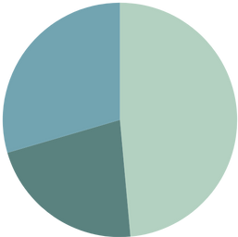


Methodology
Allied Health Professionals
Nursing Staff
Design: Cross-sectional study + Qualitative Component
Data Collection: An online survey
Population: Palliative care staff in Ireland (n = 105, female = 90, Age range = 25-64)
Analysis: Quantitative (Group-comparisons, Correlations, Regression)
+ Qualitative (Thematic Analysis)
29.5%
48.6%
21.9%
Doctors and Consultants
1. ACP Engagement | 2. Psychological variables and ACP | 3. Open-ended qualitative question
Explore relationships between ACP engagement and psychological states and traits:
Measure and compare engagement in ACP across three contexts:
Enriching understanding of parts 1 and 2 with responses to:
Perspective Taking
Self
For Self
“In your view, how does planning for future care for YOURSELF differ from planning for future care for OTHERS in terms of requirements, benefits and challenges?”
Compassion Fatigue
For Loved Ones
Palliative Care Self-efficacy
Fear of Death
Compassion Fatigue
For Patients
Religious Beliefs

Slide 5

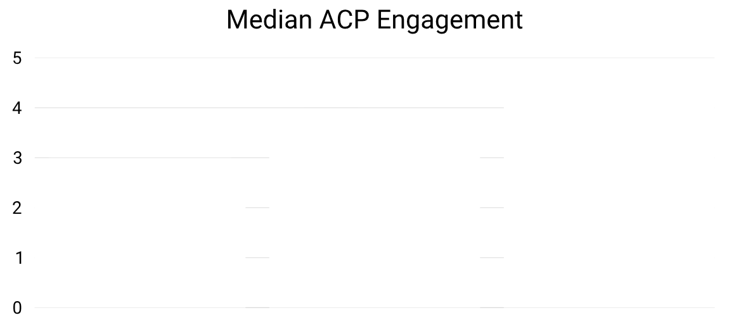




Results
Palliative care staff frequently discussed future care preferences (80.4%) and surrogate decision makers (74.5%) with patients.
4.67
3.67
3
Doctors and consultants engaged in ACP for patients more frequently than nurses and allied health professionals.
Discussions of future care were more common than documentation completion across contexts.
Self
Loved Ones
Patients
I think it makes sense to plan for future care if you are sick or elderly, however, it is not something I dwell on while I am young and healthy. (Participant 82)
Planning for others as part of work is a very important role as a palliative care CNS in the community.
(Participant 11)
Fear of death negatively correlated with ACP for loved ones and patients.
Palliative care self-efficacy positively correlated with ACP for patients.

Slide 6
Discussion and Implications
High levels of ACP in palliative care compared to other settings in Ireland.
Perception among participants that ACP is only for older individuals and those with life-limiting conditions, contrasting legislation.
Interventions targeting both awareness and the psychological factors underpinning non-engagement may be beneficial.
Further research needed.

Slide 7
Thank you!
Contact:
tadhg.gleeson@ucdconnect.ie

Slide 8


Slide 9
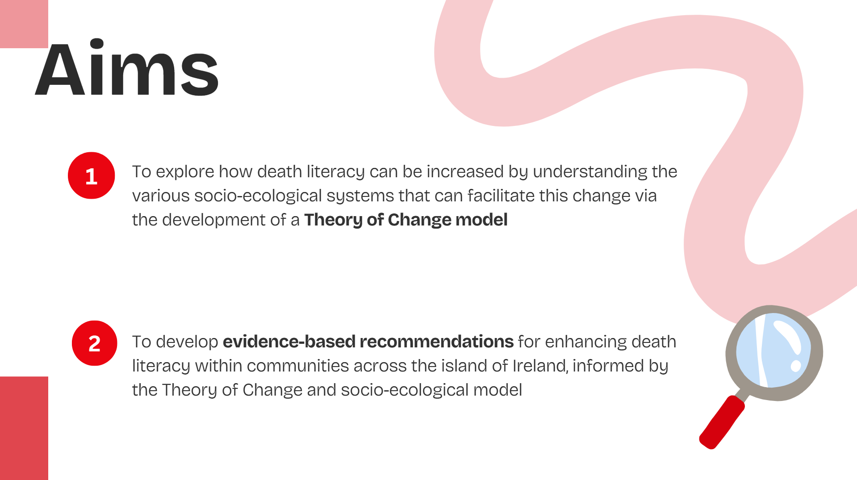

Slide 10
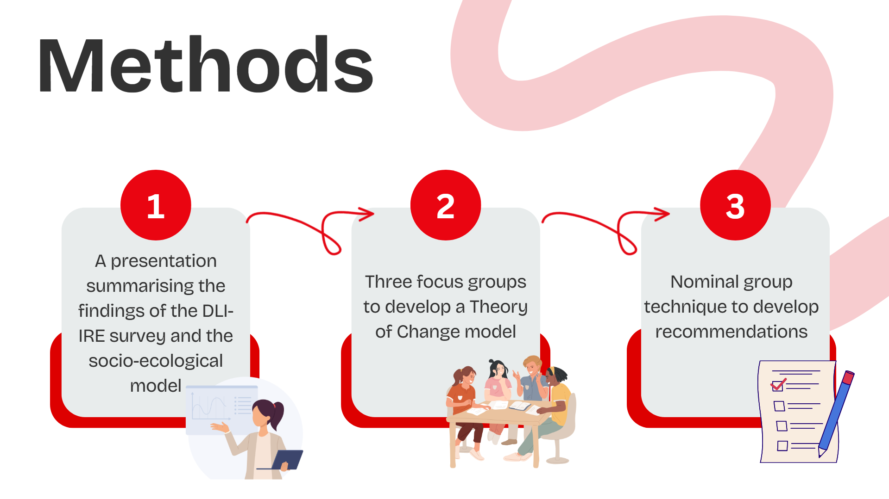

Slide 11
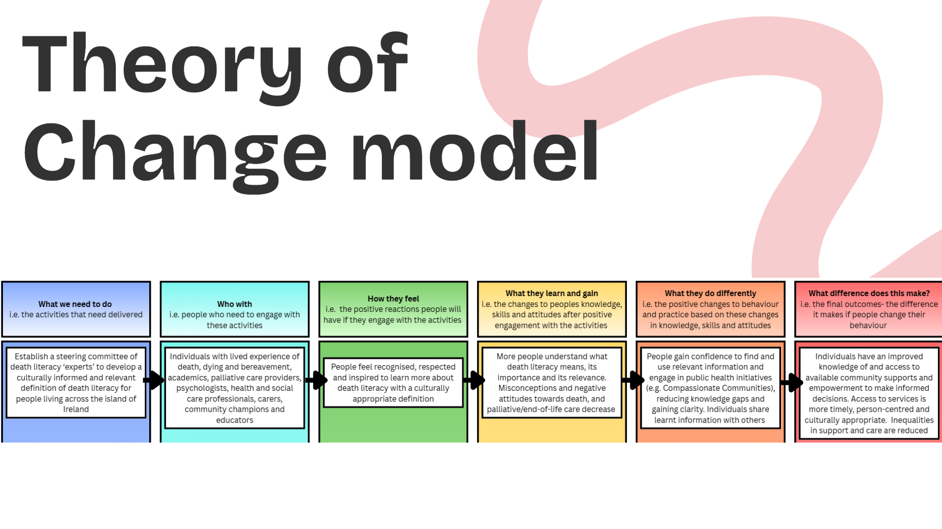

Slide 12
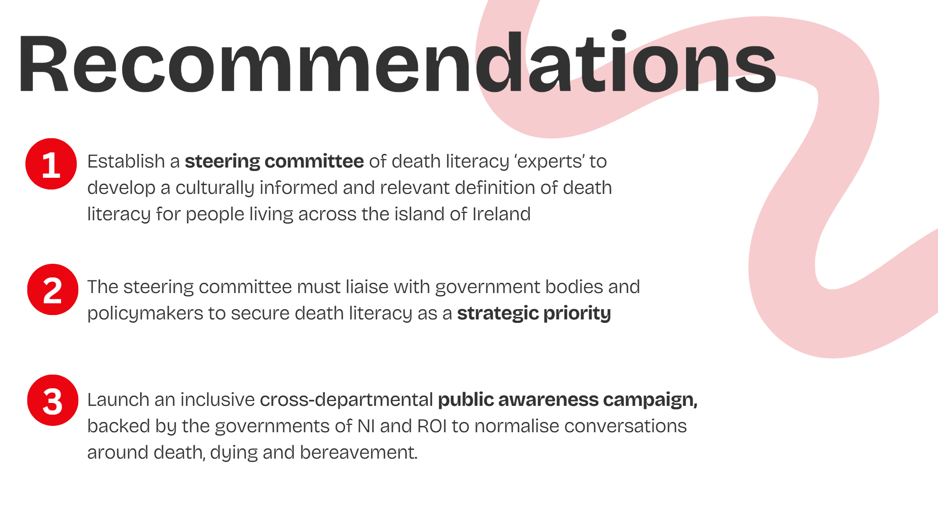

Slide 13
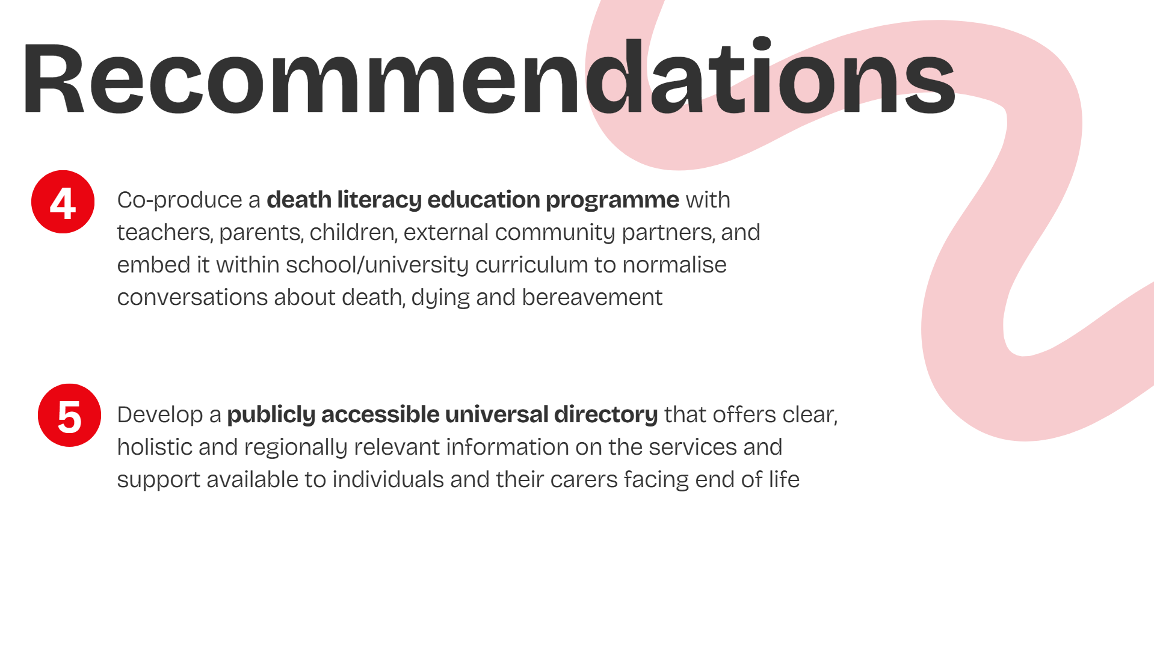

Slide 14


Slide 15




Development of a Model of Integrated Palliative Heart Failure Care: A Regional Proof of Concept
Niall Manktelow
Research Manager
Galway and Mayo Hospice
Emer Burke, Dr. Julien O’Riordan, Dr. Alison Cran, Dr. Nuria Farre, Prof. Loreena Hill

Slide 16





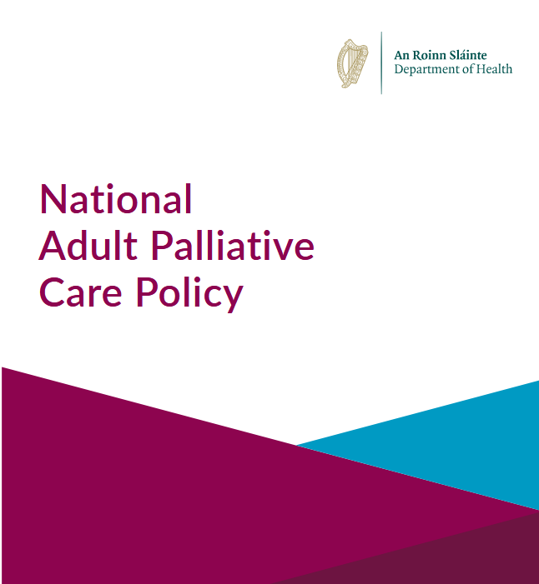

Policy Informed Care Delivery
Necessity of research into models of integrated care¹
Facilitate palliative care provision by non-specialists²
Horizontal and vertical co-ordination between services³
Integrated fora and networks of specialist/non-specialist providers⁴
Integrated, community-based management of palliative needs of patients with heart failure⁵
Notes:
It has been important for us to ensure that our approach is guided by existing policy, so that our evidence can build on the work previous completed in this area.
International policy recognises that integrated models must focus on facilitating delivery of palliative care by non-specialists where possible, and that we must conduct research to capture the efficacy of these models.
Nationally, Slaintecare outlines that the delivery of integrated care requires both horizontal co-ordination through interdisciplinary collaboration and interservice working, as well as vertical coordination between primary, secondary and tertiary care domains.
We knew also that our model of care must fit within the recommendations of our national adult palliative care policy, we believe that the creation of an integrated forum model allows specialists to support non-specialist providers in assessing palliative care needs effectively, empowering them to meet these needs where appropriate and providing a clear referral pathway when necessary, thereby ensuring that the right care is delivered at the right time.
We needed to also keep in mind the recommendations of the National Heart Failure Model of Care, and how it advocates for a community-based approach to management of palliative needs, and that we therefore needed to ensure that those at that level of service delivery were centrally involved in our collaborations.

Slide 17
A Collaborative Interservice Model
  Interdisciplinary regional forum created to guide collaboration between services (mid 2021)
Objectives:
To enhance the quality of life of those living with advanced heart failure
Develop an integrated service
Promote reciprocal education between services
Foster good working relationships
Perform retrospective and prospective research to support concept
Empower Heart Failure services in identifying, assessing, and meeting general palliative care needs
Notes:
In Mid 2021 the local Heart failure service in Galway approached our hospice seeking guidance in addressing palliative care needs of patients with advanced heart failure and an Interdisciplinary regional forum was established to guide the collaboration between the services.
Our aim was to enhance the QoL of AHF pts by developing an integrated service featuring joint management, educational initiatives, and supportive frameworks to help ensure effective assessment and treatment of palliative care needs for this population.

Slide 18
Implementation to date
  Initial membership: Different Palliative and Heart Failure services from Galway, Mayo, and Roscommon – Integration horizontally between services and vertically across settings
  Expansion of forum:
    Geographical (Sligo, Leitrim and Donegal representation)
    Further interdisciplinary involvement (E.g. psychologist, cardiac physiologist, GPs)
Bimonthly joint multidisciplinary meetings
Development of “Cause for concern trigger tool”
Electronic palliative symptom management prescribing document⁷
PCOC (Palliative Care Outcomes Collaboration) tool integration⁶
Two-year retrospective cohort study (PAIR HF) ⁸
Notes:
When designing our model we concentrated on incorporating vertical and horizontal integration as recommended by Slaintecare, with representation from each discipline and service involved in care across acute inpatient, community and outpatient settings.
Our forum has expanded since its creation, both geographically and in terms of the range of disciplines involved. The involvement of GPs has been particularly beneficial and given us greater
understanding of the challenges of primary care management for these patients.
The foundation of our model is a Bimonthly joint multidisciplinary meeting focused on case discussion and reciprocal education, this has facilitated the growth of professional relationships and supported further communication between services outside of the formal format.
We developed a ‘Cause for concern trigger tool’ based on existing literature and expert consensus, to prompt patient referral for discussion at our bimonthly meeting. This tool is supported by the integration of PCOC (Palliative Care Outcomes Collaboration) tool within community HF services to help support these nurses in their recognition and assessment of PC needs and we are seeking to assess the impact and acceptability of this integration and further validate the use of our tool.
We have developed an Electronic palliative symptom management prescribing guidance document to facilitate appropriate management of palliative HF patients by non- specialist prescribers in the acute setting and this has been shared through education sessions delivered across this setting and is now available on the HospitalBuddy app.
Our main research output has been the two-year retrospective cohort study (PAIR HF), completed earlier this year. This was an analysis of ACP and PC referral rates amongst 164 patients who died under the care of the regional HF services and has given us a baseline picture of how care needs were being met prior to the introduction of our model.

Slide 19
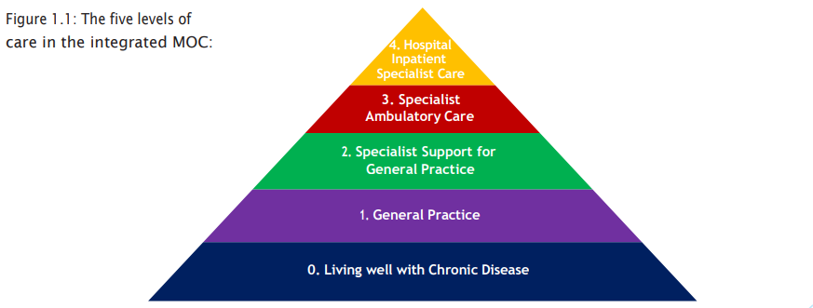
Next Steps
Patient involvement
Further research – prospective
Model transferability? - Template for integration (Renal/Respiratory)
Influence policy through support
for integrated model
Notes:
Clinicians identified the necessity for a collaborative model within the region but we feel that it is crucially important that we embed the patient voice within our research as we move forward to ensure that we are focused on what is most important for our patients and their families.
We are planning to design prospective research to assess how the interventions to date have impacted our services and patients.
We hope to assess how this model may be applicable as a shared care approach to other non-malignant, life-limiting conditions where similar challenges around management can occur.
We aim to influence policy through support for earlier integration of a palliative care approach, ensuring that advanced heart failure patients at levels 2 and 3 of the national model of care have their needs met when required. Too often palliative care only becomes part of the discussion as a patient with heart failure imminently approaches EoL in an acute setting and we believe this can result in a missed opportunity for support and planning

Slide 20
References
World Health Organization, Quality Health Services and Palliative Care: Practical Approaches and Resources to Support Policy, Strategy and Practice. 1st ed.; 2021.
World Health Organization. Integrating Palliative Care and Symptom Relief into Primary Health Care: A WHO Guide for Planners, Implementers and Managers. World Health Organization; 2018. Accessed September 2, 2025. https://iris.who.int/handle/10665/274559
An Coiste um Chúram Sláinte sa Todhchaí - Tuarascáil maidir le Cúram Sláinte - Bealtaine 2017 | Committee on the Future of Healthcare - Sláintecare Report - May 2017. Available at: https://data.oireachtas.ie/ie/oireachtas/committee/dail/32/committee_on_the_future_of_healthcare/reports/2017/2017-05-30_slaintecare-report_en.pdf
Health Service Executive (HSE), 2021. National Heart Failure Model of Care 2021. [pdf] Dublin: HSE. Available at: https://www.hse.ie/eng/about/who/cspd/icp/chronic-disease/moc/national-heart-failure-model-of-care-2021.pdf
Health Service Executive (HSE), 2024. National Adult Palliative Care Policy. [pdf] Dublin: HSE. Available at: https://www.hse.ie/eng/about/who/cspd/ncps/palliative-care/care-policy/national-adult-palliative-care-policy.pdf [
University of Wollongong, 2025. Assessment tools and forms – Palliative Care Outcomes Collaboration (PCOC). [online] Available at: https://www.uow.edu.au/australasian-health-outcomes-consortium/pcoc/accreditation-standards-quality/assessment-tools-and-forms/
Minogue, R., Manktelow, N., Cran, A., et al., 2024. Prescribing Guidance for Symptom Management in Advanced Heart Failure. Poster presentation at: Irish Association of Palliative Care 23rd Annual Education & Research Seminar, 2024.
Heart Failure Congress ESC, 2025. PAlliative IntegRation in Heart Failure (PAIR-HF): Retrospective analysis of advanced care planning and palliative care referral among heart failure services in Ireland. Poster presentation at: Heart Failure Congress ESC 2025, Belgrade. Available at: https://esc365.escardio.org/presentation/300184

Slide 21

Acknowledgements
Dr Julien O’Riordan
Ms Emer Burke
Dr John Barton
Dr Nuria Farre
Dr Alison Cran
Prof. Loreena Hill
Yvonne Muldowney
Catherine Nolan
Helen Moran
Grace Gannon
Dr Ronan McClernon
Rosemary Thorpe
Theresa O’Connor
Email: nmanktelow@galwayhospice.ie

Slide 22



Experiences of care co-ordination at end of life:
Findings from Ireland’s National End of Life Survey
Presentation to 14th Annual Palliative Care Research Network Symposium, 20 November 2025
Dr Lorna Sweeney

Slide 23
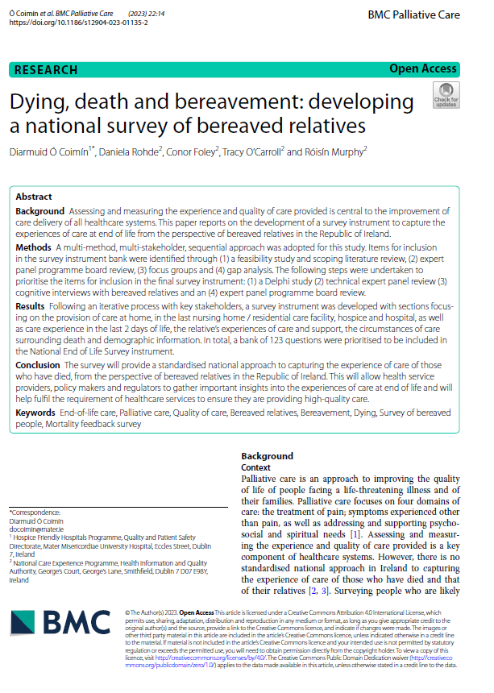







How was the survey developed?

Slide 24
About the survey
Aim: identify areas of good experience and areas needing improvement, inform policy and the development of standards and guidance.
Model and Methodology: 110 item questionnaire (107 tick box and three open-ended), mixed modal postal/ online.
Scope:
  care provided at home, in nursing homes, hospitals and/ or hospices in last three months of life
  overall experiences of care in the last three months of life, last two days of life, end of life
  participants’ own experiences of care and support.
Eligibility: 9,500 people bereaved between September to December 2022; Contact details sourced from the General Register Office

Slide 25
Who participated in the survey?
4,570 bereaved people responded (48% response rate)
Place of death
Relationship to the person who died

Slide 26

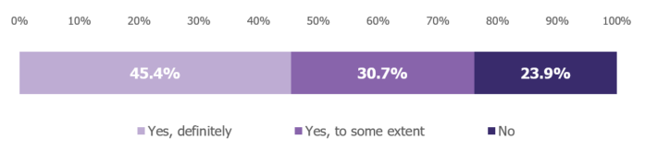
Coordination of care: last 3 months
Q.64: Did you feel that there was good coordination between different services (e.g. GP, hospital or hospice) and healthcare staff who cared for your relative or friend in the last three months of their life?
One of the lowest-scoring questions in the survey (6.1 out of 10).
Question was moderately correlated with overall rating of care experience (r=0.55)

Slide 27
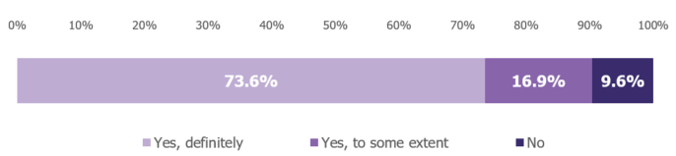
Coordination of care: last 2 days
Q.76: During the last two days of your relative or friend’s life, did you feel that there was good coordination between the healthcare staff?
Question scored 8.2 out of 10.
Strongly correlated with overall rating of care experience (r=0.89)

Slide 28
Participants’ comments
“The integrated care team model ensured excellent co-ordination of services in the last three months (and earlier) of my wife’s care.”
Open-ended questions asked what was good about the care received and what could be improved.
Participants highlighted issues relating to co-ordination of care:
  Communication from hospital to palliative care nurse about medical issues
  Communication between different disciplines and teams within the hospital
  Communication between different hospitals
  Co-ordination between hospital and community care for discharge
  Co-ordination between different community care teams
  Access to out-of-hours medical help when GP unavailable
“Co-ordination between nurses, carers, doctors and consultants. We found this aspect to be scandalous. Nobody knew what the other 'team' was doing etc. Different staff gave different information.”
“When he came home for 6 weeks his care was distributed to all different teams in the community. This was very hard on my husband and I.
I spent all my time trying to contact them.”

Slide 29

Response to the survey
Specific quality improvement plans for individual hospitals around coordination of care in the last 3 months of life.
Significant media and public interest in the findings of the survey.

Slide 30
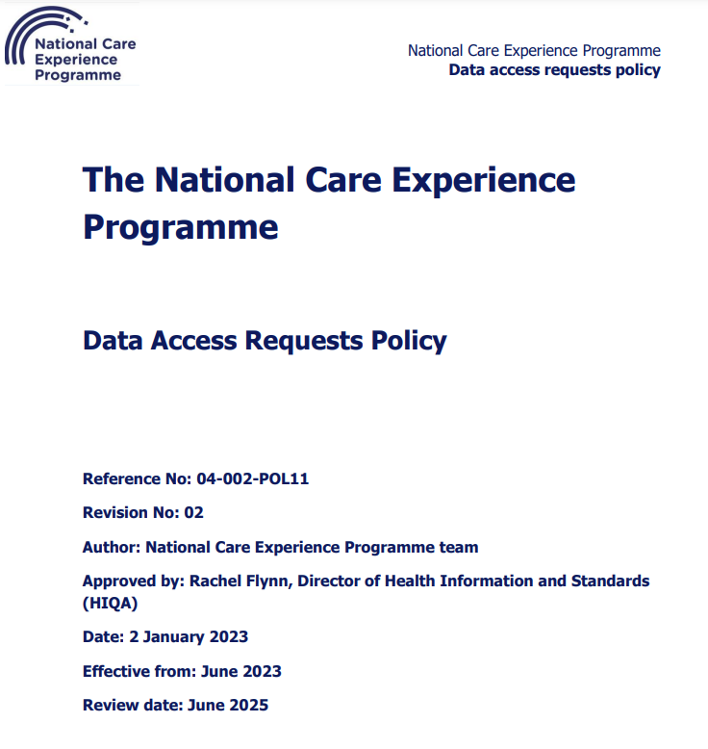
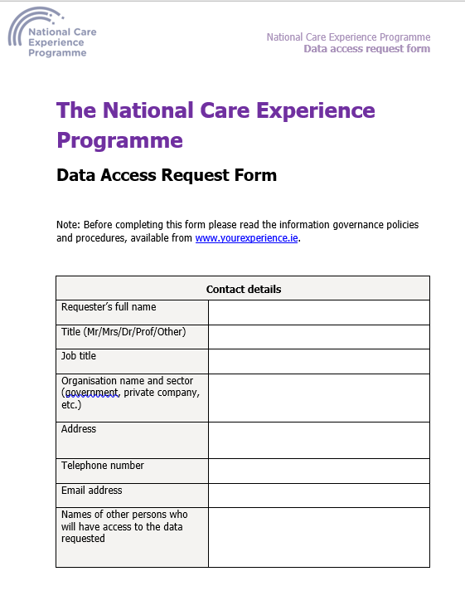


Further information
For further information about the survey:
Website: www.yourexperience.ie
Email address: info@yourexperience.ie
@CareExperience
@CareExperience
@CareExperience

