Slide 1

AIIHPC Palliative Care Research Network and
Early Career Researcher Forum
Members 2025 Update
Jane Clare, AIIHPC Palliative Care Research Network Project Manager
Dr Busra Ertugrul, AIIHPC Research Support and Knowledge Translation Lead

Slide 2
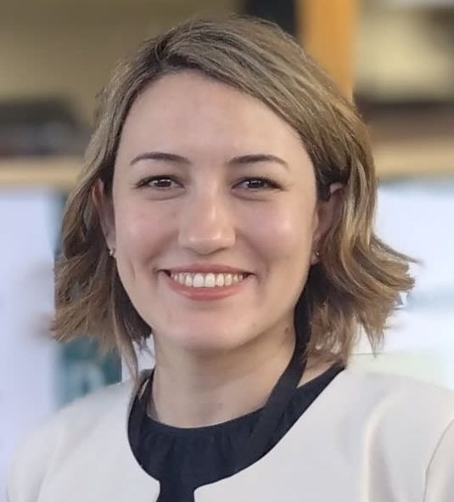
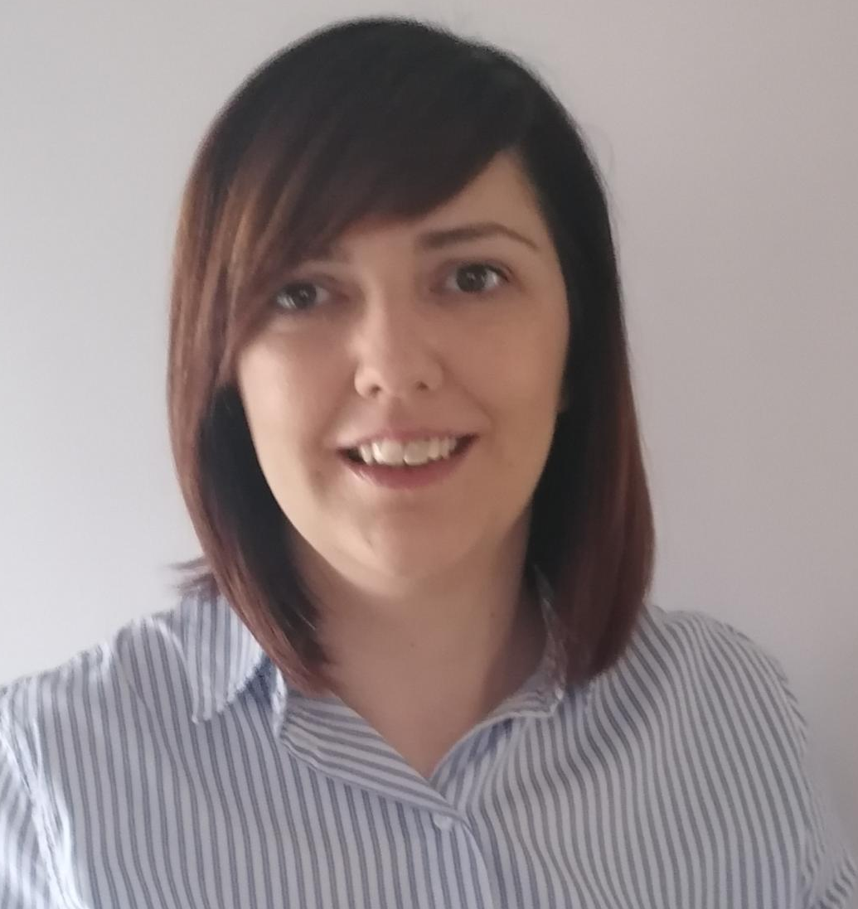



Strengthen and Expand Collaboration
Welcome 5 New Palliative Care Research Network Members
Dr Duygu Sezgin
Lecturer in Nursing and Midwifery, University of Galway
Dr Julie Doherty
Lecturer in Clinical Cancer Nursing,
Ulster University
Dr Monika Pilch
Lecturer/Assistant Professor in Psychology,
University College Dublin
Dr Martin McMahon
Associate Professor, Head of Discipline Intellectual Disability Nursing,
Trinity College Dublin
Dr Elizabeth Weathers
Associate Professor in General Nursing,
University College Dublin

Slide 3

Strengthen and Expand Collaboration
Welcome 81 Early Career Researcher Forum Members
Thank You to Early Career Researcher Forum Steering Committee Members
Stephanie Crawford (Chair) Queens University Belfast
Dr Kumaresan Cithambaram (Vice Chair) Technological University of the Shannon
Rebecca Crothers Ulster University
Dr David Byrne Royal College of Surgeons in Ireland
Dr Claire Kruger Our Lady’s Hospice & Care Services
Niall Manktelow Galway Hospice Foundation
Kasia Patynowska Ulster University
Dr Lauren Boland St Francis Hospice (on leave)

Slide 4










Develop Palliative Care Researchers and Support Career Paths
Hosted 8 Webinars (PCRN/Expert Topic/ECRF), 1 Workshop (ECRF) and
Annual PCRN Symposium
335 Participants and 723 views video recordings to-date

Slide 5



Involve People with Life-limiting Conditions, Family Carers, and Communities Across Research Cycle
Launch AIIHPC PPI Impact Evaluation Framework May 2025
22 opportunities for Voices4Care members to contribute to research
AIIHPC local partner in PPI Ignite for Dublin City University and University College Cork
PPI webinar October 2025 during PPI Ignite Festival and promote greater involvement of Voices4Care in PCRN/ECRF research

Slide 6
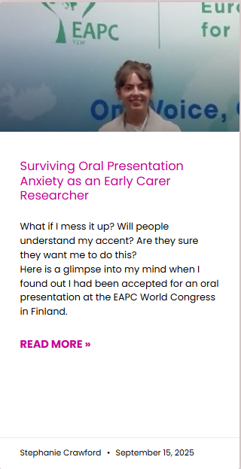
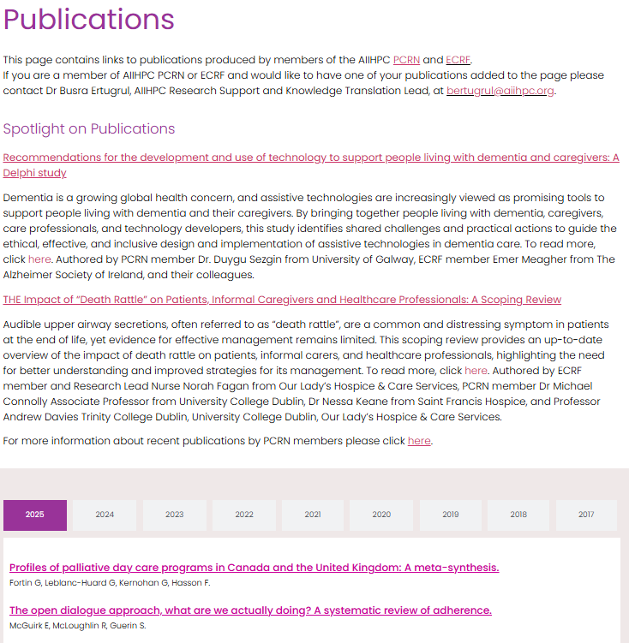
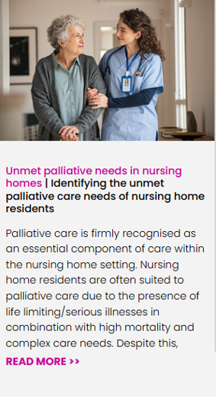
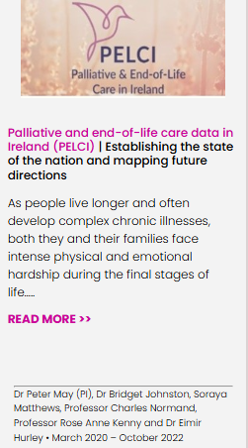
Maximise Research Impact on Policy and Practice
123 PCRN and ECRF peer-reviewed publications
  Monthly Publications Spotlight in the AIIHPC Newsletter
  Bi-weekly publications update to members
Blog articles
Research Study Pages

Slide 7

147 Special Interest Group Members
Facilitated 9 Special Interest Group Meetings and 9 Subgroup Projects
Maximise Research Impact on Policy and Practice

Slide 8

Thank You
Email Contact
Jane Clare
jclare@aiihpc.org
Busra Ertugrul
bertugrul@aiihpc.org
More Information
professionalpalliativehub.com/research/

Slide 9


Special Interest Groups
Should this be included in Busra’s presentation
Dementia and Palliative Care
9 new members (34 members), 2 full group meetings, next meeting tbc
Named collaborator ‘Dementia and Palliative Care’ postdoctoral fellowship HEA North South proposal.
3 Subgroups
  Dementia on death cert
  TILDA data to explore health utilization
  Review of dementia in ED
Psychological, Social and Spiritual Care
22 new members (59 members), 1 full group meeting, next meeting 6 August
3 Subgroups
  Service user survey
  Publications All Ireland survey results
  Webinars for health and social care professionals based on survey results

Slide 10
Special Interest Groups
Technology and Palliative Care
14 new members (49 members), 1full group meeting, next meeting 22 October
Guest speaker Dr. Amara Callistus Nwosu, Senior Clinical Lecturer Palliative Medicine Lancaster University, Research Lead Marie Curie Hospice Liverpool
3 Focus Areas
  Energy hardship at home for palliative care
  AI and palliative care
  Co-creation of technology-enabled palliative care solutions
Deliverables to End of Year
Establish 2 new groups, Children's Palliative Care and Undeserved Populations
Annual Meeting Schedule and New Chair Dementia and Palliative Care Group (maternity cover)
Posters PCRN Annual Symposium and Update at PCRN SSC December 2025

