Slide 1
Supporting Policy and Practice Through Research
Dr Bridget Johnston
  Assistant Professor in Health Research
  School of Nursing and Midwifery, Trinity College Dublin
    20th November 2025

Slide 2






Presentation outline
SLÁINTECARE
SUMMARY
BACKGROUND
PALLIATIVE CARE POLICY

Slide 3
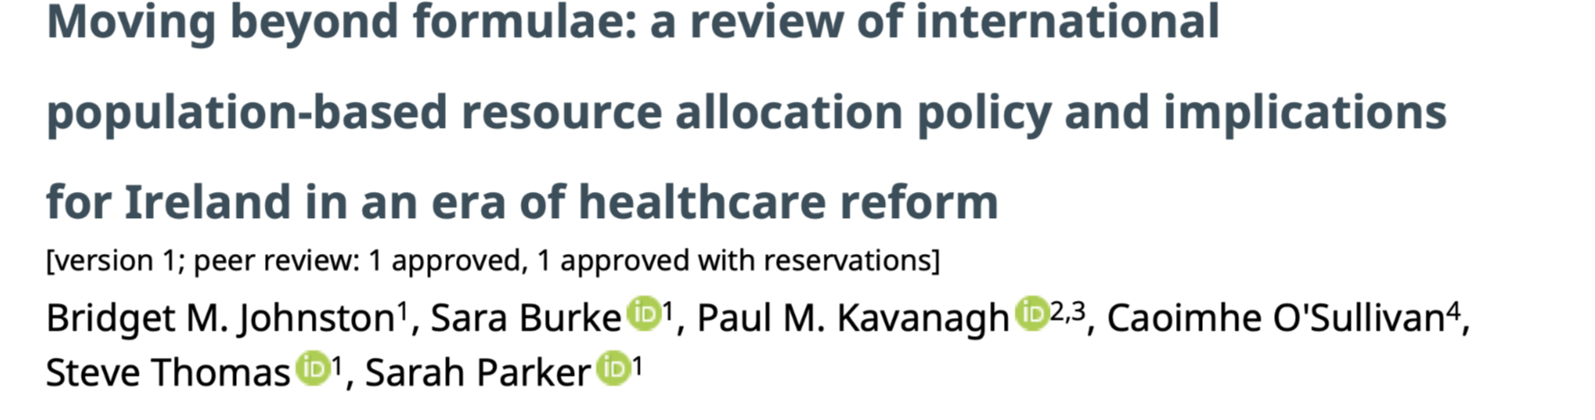
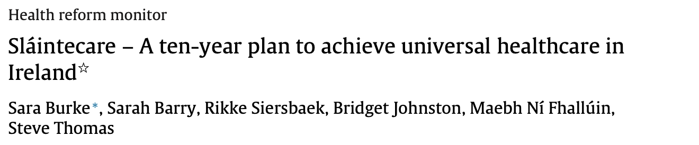


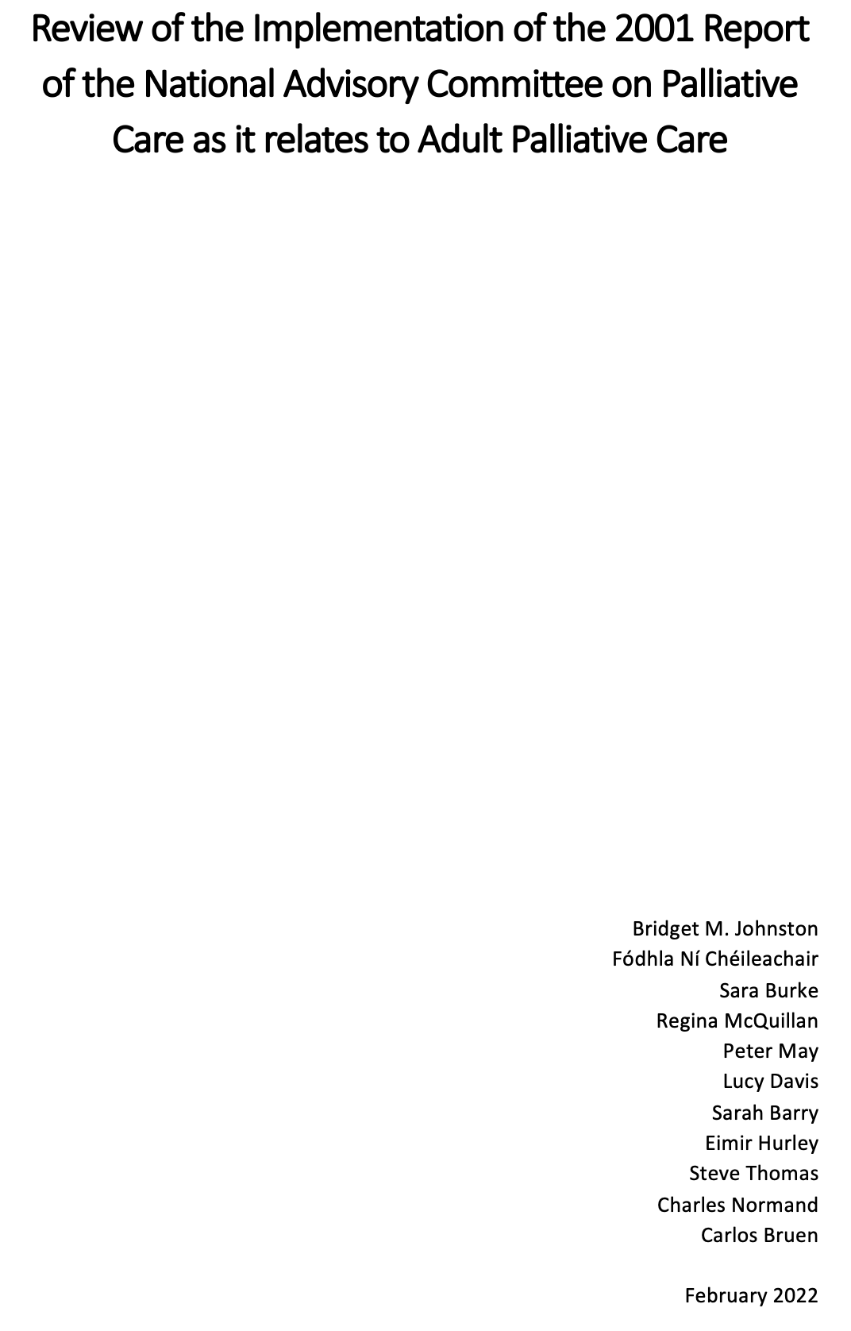
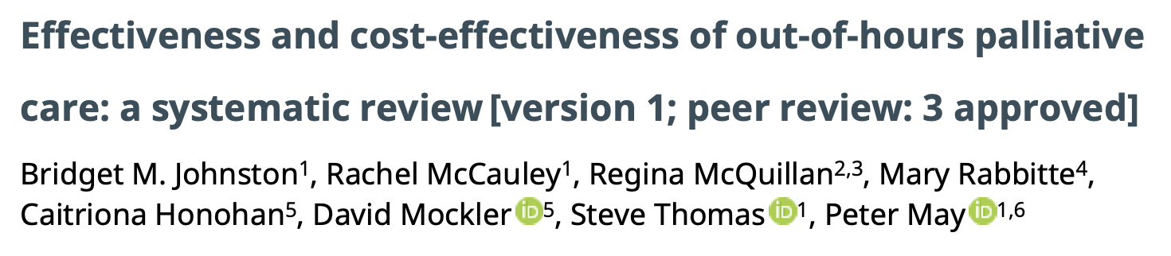








Acknowledgements

Slide 4




What is health policy?
...courses of action (and inaction) that affect the sets of institutions, organisations, services and funding arrangements of the health system [health & social care]
actions and intended actions of organisations external to the health system which has an impact on health, e.g. food, tobacco or pharmaceutical industries (Buse, Mays & Walt, 2005:6).
Strong cultural component (normative): principles, ideas, rules and boundaries that provide the foundation on which individual policies are structured

Slide 5
What is the aim of health policy?
‘decisions, plans, and actions (and inactions) undertaken to achieve specific healthcare goals within a society…’ (WHO, 2011).
It is about many things, all at once:
  Protecting populations from risks to their health (e.g. introducing anti-tobacco policies, hospital hygiene practices).
  Strengthening health systems (e.g. investing in the health workforce or digital health policies).
  Improving the prevention and care pathways for specific conditions (e.g. models of care, clinical guidelines).
  Ensuring care is equitable, responsive, accessible and of high quality (e.g. setting quality standards or accountability mechanisms for healthcare organisations).

Slide 6
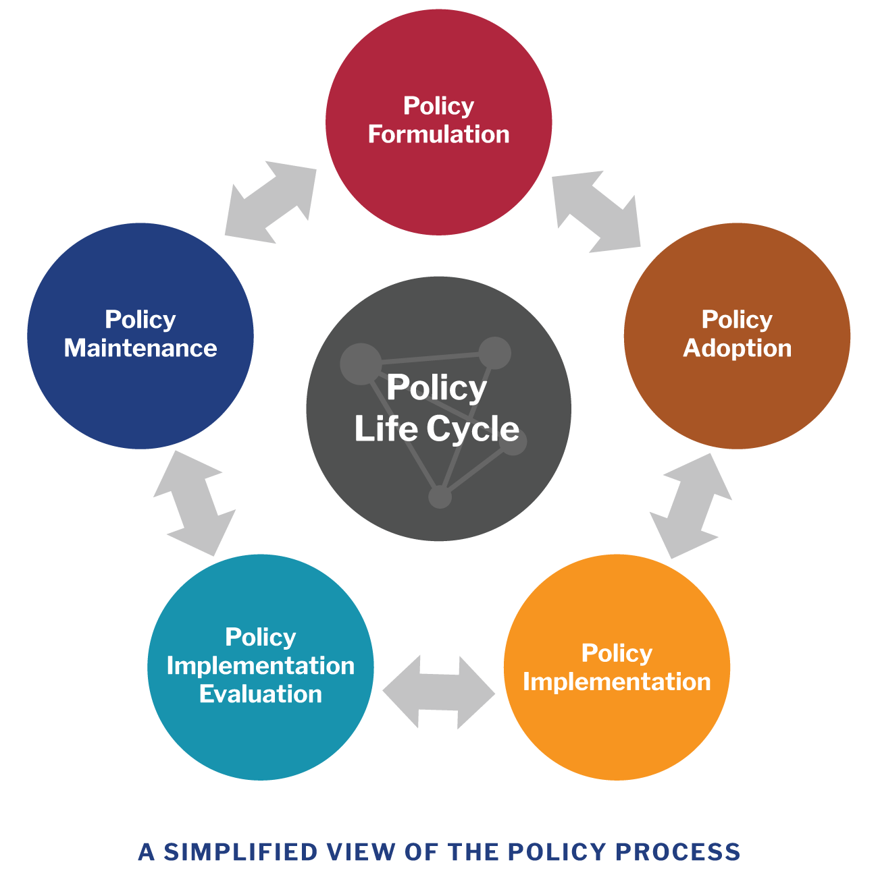

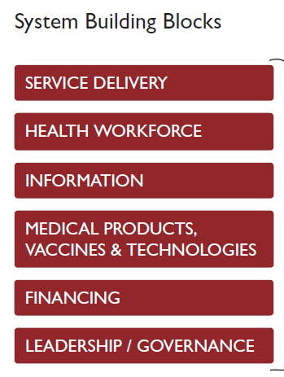

The reality of health policy making and engagement
Messy and complex – systems thinking
Requires good information
Usually incremental – few ‘big bangs’
Interests, ideas and ideology
To choose to do nothing is still a decision…
  Understanding the politics of the policy process is arguably as important as understanding how medicine improves health (Buse, Mays & Walt, 2012)
  Not everything that is faced can be changed, but nothing can be changed until it is faced

Slide 7



Health policy-making: The role of research(ers)
Clear and strong evidence can influence decisions about health policy and practice. Research evidence is only one piece in the puzzle.
Translating evidence into policy is a persistent challenge for researchers and policy makers alike.
The interaction between policy and research flows in both directions

Slide 8

Sláintecare
Sets out a ten-year programme to transform existing health and social care services to a universal single-tier health and social care system
The Committee engaged an academic team from Trinity College Dublin to provide technical support throughout the development process
Included a commitment to providing universal palliative care within the first five years of the policy’s implementation

Slide 9

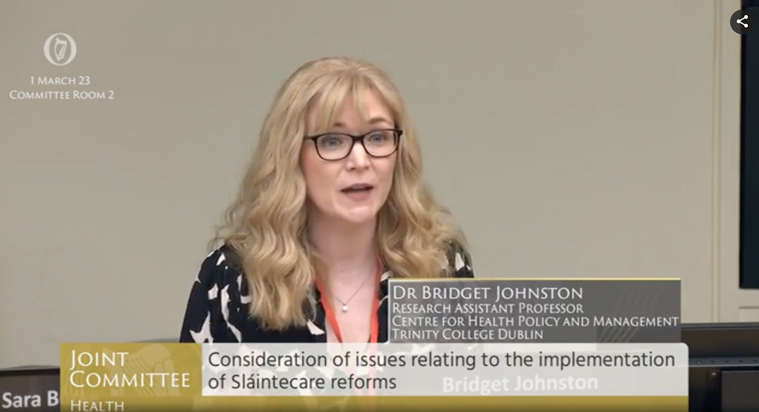
Sláintecare: Reflections on process and learnings
Compelling narrative
The role and nature of evidence
Systems thinking
Vested interests
Build trust

Slide 10
Out-of-Hours Evidence Brief
Models of Care
Costs and Outcomes
Key Performance Indicators
Implementation

Slide 11



Out-of-Hours Evidence Brief
UNCERTAINTY
IMPLEMENTATION
NETWORKS
Advising when there is limited evidence
How to move from paper to practice?
Facilitated interactions; provided feedback & advice

Slide 12
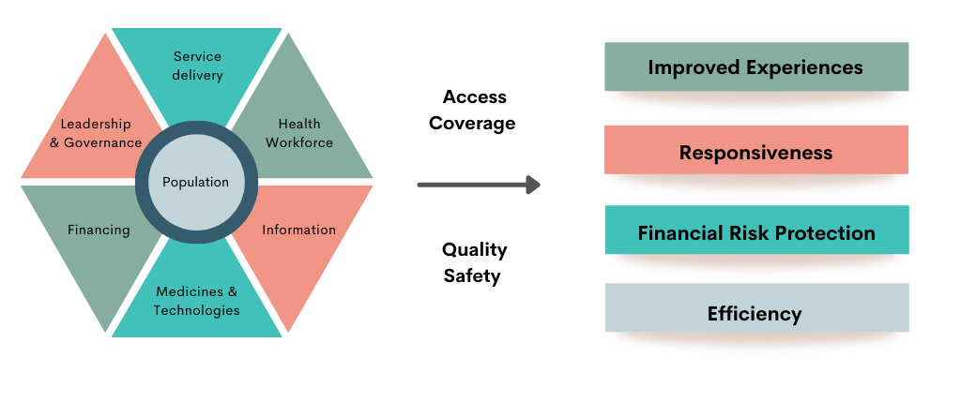
Evaluation of the 2001 National PC Policy
Inputs
Process
Outcomes

Slide 13








Evaluation of the 2001 National PC Policy
Coproduction
Funding
Align your interests
Solutions

Slide 14
National Palliative Care Policy
  Collaborative approach, guided by a steering group comprising stakeholders within palliative care
  Consensus building
  Implementation and evaluation
  Costings for initiatives
  Addressing gaps identified during the policy evaluation

Slide 15

Image Slide
COMMUNICATION
MENTORSHIP
CO-PRODUCTION
Trinity College Dublin, The University of Dublin

Slide 16
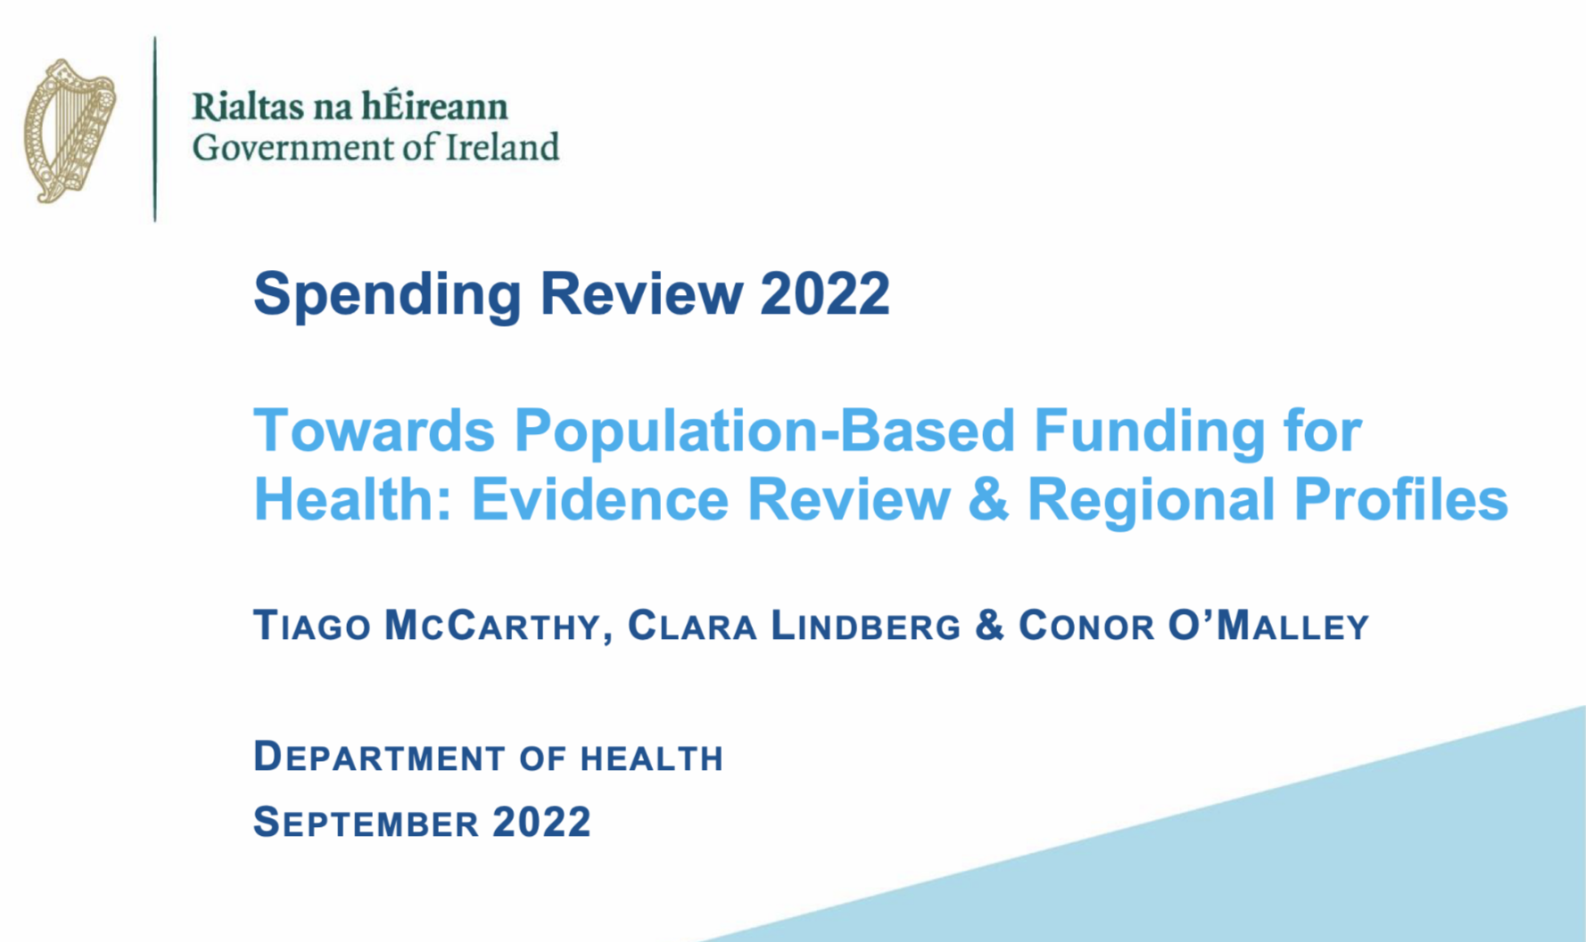






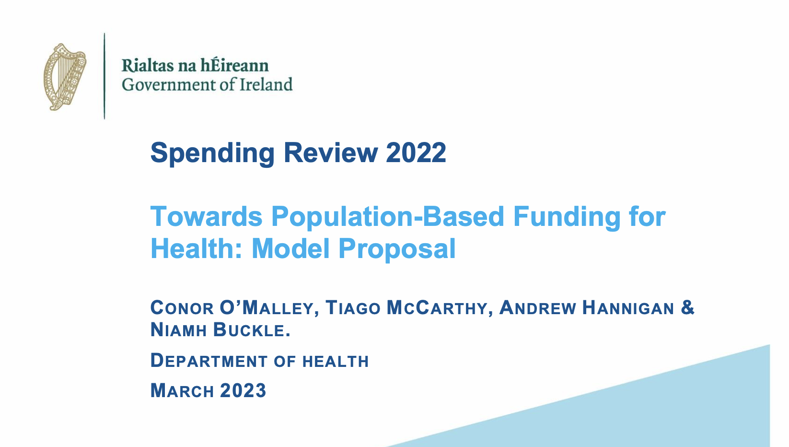
Healthcare Finance
Rapid review of international experience with implementing population-based resource allocation models across six countries

Slide 17

Take Home Messages
Align with national needs and strategic direction
Identify priority areas related to your research interests. Define the problems but also prioritise solutions and their impact.
Communicate a compelling narrative
Concise, appealing and relevant to current health policy.
Take the path less travelled
Consider funding streams such as tenders or collaborative partnerships
Put yourself out there
Build networks, participate in public consultations, share your work.

Slide 18
Quote Slide Option 1
’The most powerful driver of policy change is people – not only those with the ability to change policy, but also those who can influence it by challenging the governing values and interests and communicating a compelling, evidence-based case for change. ‘
Suzanne Wait: The Health Policy Partnership

Slide 19
References
Department of Health, National Palliative Care Policy, September 2024. Dublin.
Johnston BM, Ní Chéileachair F, Burke S, McQuillan R, May P, Davis L, Barry S, Hurley E, Thomas S, Normand C, Bruen C. (2022) Review of the Implementation of the 2001 Report of the National Advisory Committee on Palliative Care as it relates to Adult Palliative Care. Dublin: Department of Health.
Johnston BM, Burke S, Kavanagh PM et al. Moving beyond formulae: a review of international population-based resource allocation policy and implications for Ireland in an era of healthcare reform. HRB Open Research, (2021) doi: 10.12688/hrbopenres.13453.1.
Johnston BM, McCauley R, McQuillan R, Rabbitte M, Honohan C, Mockler D, Thomas S, May P. Effectiveness and cost-effectiveness of out-of-hours palliative care: a systematic review. HRB Open Research, (2020) doi: 10.12688/hrbopenres.13006.1 .
Johnston BM, May P, McCauley R, McQuillan R, Rabbitte M, Honohan C, Mockler D, Thomas S. (2019) Out-of-hours specialist and generalist palliative care provision: An evidence review. Dublin: Health Research Board.
Burke S, Barry S, Siersbaek R, Johnston BM, Ní Fhallúin M, Thomas S. Sláintecare – A ten-year plan to achieve universal healthcare in Ireland. Health Policy 122, 12:1278-1282 (2019) doi: 10.1016/j.healthpol.2018.05.006
Houses of the Oireachtas Committee on the Future of Healthcare, Houses of the Oireachtas Committee on the Future of Healthcare Sláintecare Report, May 2017. Dublin.
Buse K, Mays N, Walt G. (2012) Making Health Policy. Open University Press: London.

Slide 20
Thank You

