Slide 1



All Ireland Perspectives on Adult’s Palliative Care Research and Policy
Dr Esther Beck
Ulster University
PCRN Member
Chair IAPC

Slide 2

The Northern Perspective
Let’s focus on what unites us as an Island
Palliative care services are stretched across the Island
Aging populations with more complex needs
Workforce challenges
A changing policy landscape

Slide 3

The State of Flux in the North
Current regional strategy, Living Matters, Dying Matters (2010).
Marie Curie identified the clear need for an updated regional Palliative Care Strategy for Northern Ireland that aligns with projected demand.
Health Inquiry took place in 2025.
Key priorities to be set, funding, education, implementation of ACP.

Slide 4


Policy Drivers
All Party Parliamentary Group on Terminal Illness (Marie Curie Policy initiative)
Palliative Care in Partnership
Public Health Agency
Policy Research Clinical Practice

Slide 5


Joint Research
An Evaluation of Single Point of Access for Palliative and End of Life Care (UU Lead; QUB; BHSCT; Marie Curie and Northern Ireland Hospice)
R & D Fellowship- (Dr Felicity Hasson PI and Dr Tracey McConnell)

Slide 6
Ulster University
Workforce
Public Health and Palliative Care – Public Awareness
Advance Care Planning
Underserved Populations
Family Centered Oncology

Slide 7
Service delivery and workforce
Lead Dr Felicity Hasson
Hospice at Home:
Exploration of 24/7 lone working practices, support, and educational needs of Marie Curie Healthcare Assistants (HCAs) providing palliative care in the community across the UK.
Wellbeing of lone working Healthcare Assistants (HCAs) delivering palliative care in the community and its impact on staff retention.
Co-development of a peer-to-peer intervention to support healthcare assistants' delivery of hospice care at home
Hospice at home out of hours models of care: evidence Synthesis
Prehospital Emergency Care
ParAmedic delivery of end-of-life care (ParAid) (UK/Finland)
Community Care
Development and Implementation of the Community Palliative Care Key Worker
Community Palliative Care Hub, Single Point of Contact

Slide 8
Public Health and Palliative Care – Prof Sonja McIlfatrick
PHA – NILTs over 2 timepoints
Policy link – informed regional ACP policy in 2022
EAPC White Paper: What are the European priorities for Public Health Palliative Care research in the coming decade? Results from an International Delphi study – Under review

Slide 9
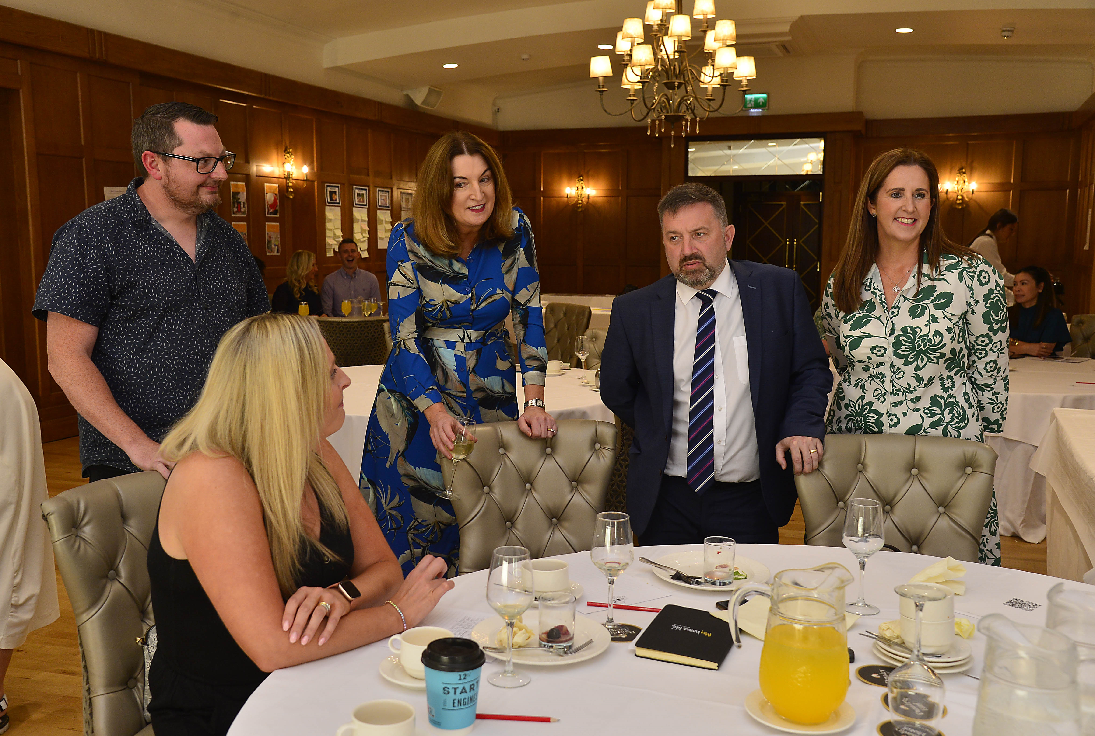
“Ulster University’s delivery of the My Home Life (MHL) Leadership Support Programme for Care Homes on behalf of the Department, has been one of the key drivers in improving the quality of life for care home residents, relatives and staff across NI since 2013” (Mike Nesbitt, Minister for Health, 2025)
“The My Home Life programme will contribute to the rebuilding of health and social care services for those residing in a care home setting” (Robin Swann, Minister for Health, 2022).
Between 2020 - 2022, MHL cited as example of good practice and catalyst for change in five of the six evidence reports from CPEA’s independent review into safeguarding and care, Dunmurry Manor Care Home.
Recommendation in the ‘Reform of Adult Social Care Consultation Evaluation and Summary Report (DoH, 2023) to continue the ‘My Home Life’ programme in care homes across NI.
MHL research outcomes included in UU’s submission of top Impact Case Studies in the Research Excellence Framework 2021, 95% rated as internationally excellent / world leading.
2020 DoH funded 6 year implementation of MHL in care homes all across NI (£3.2m)

Slide 10
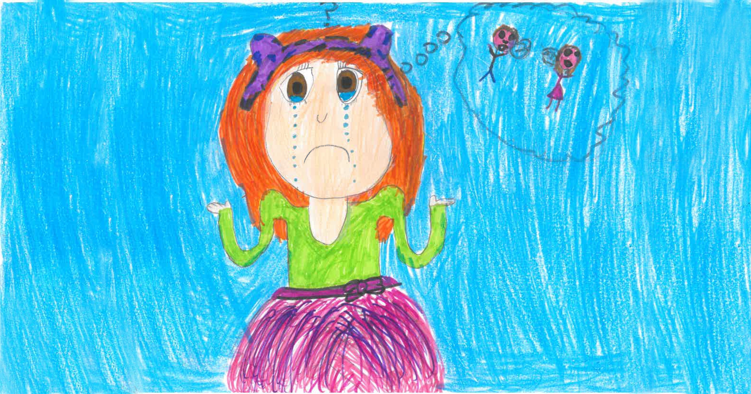


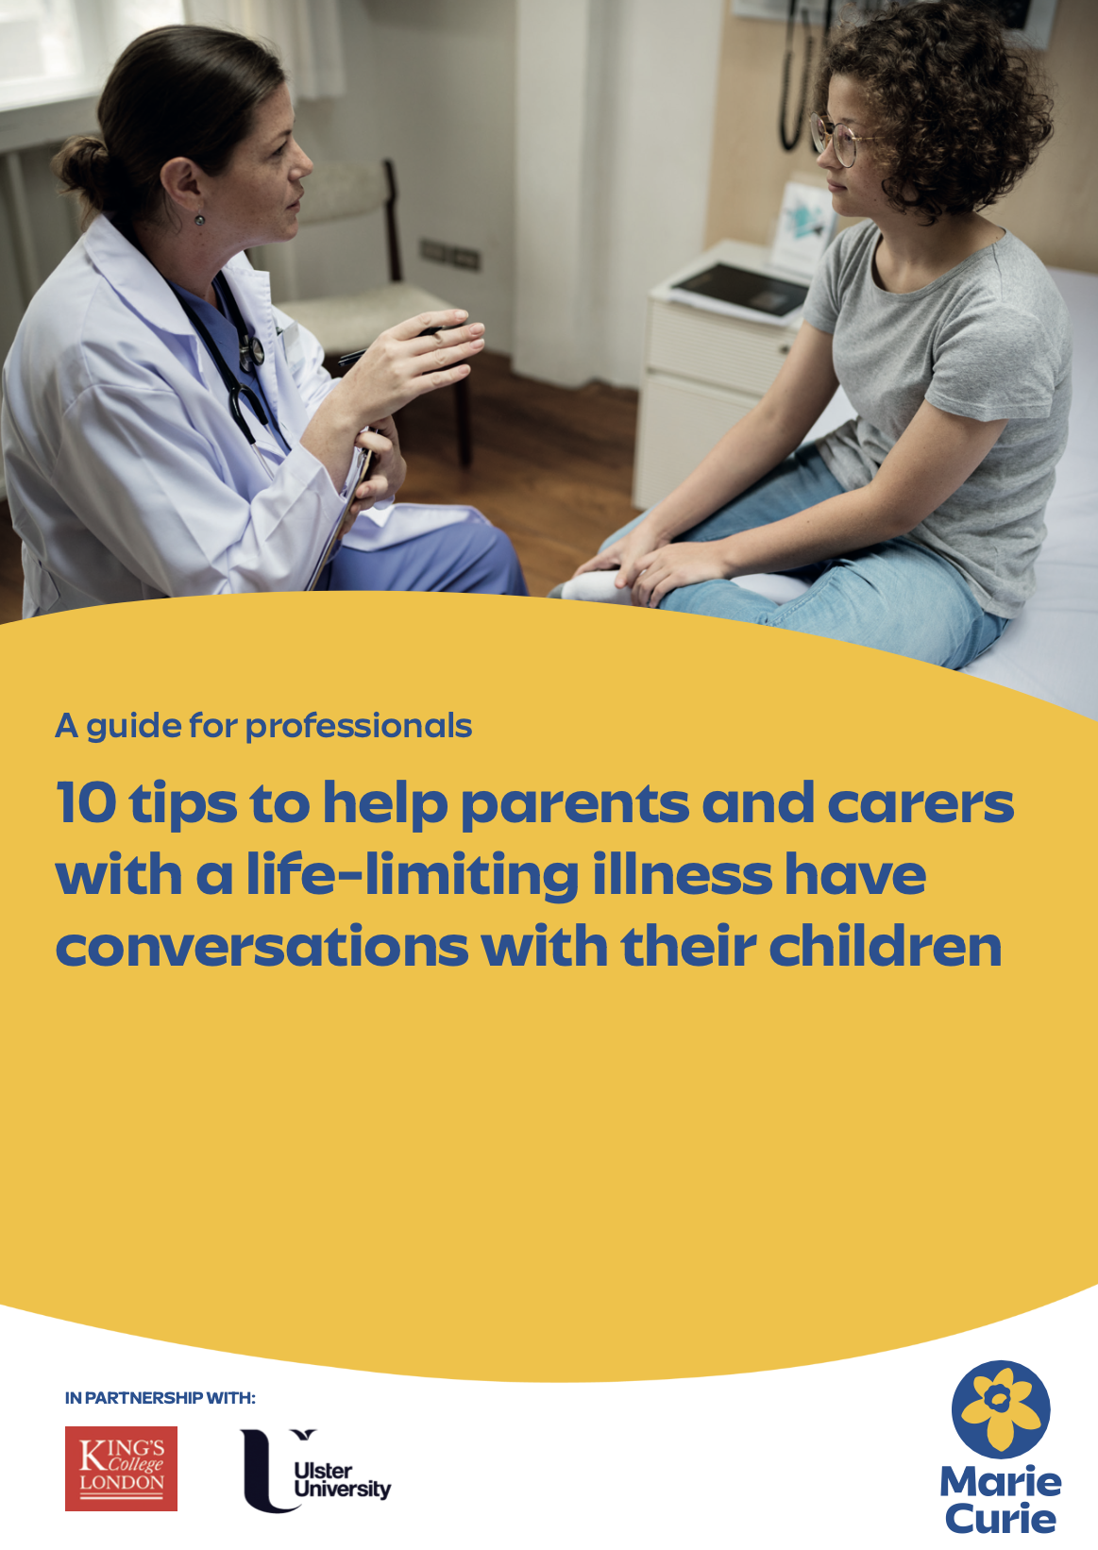
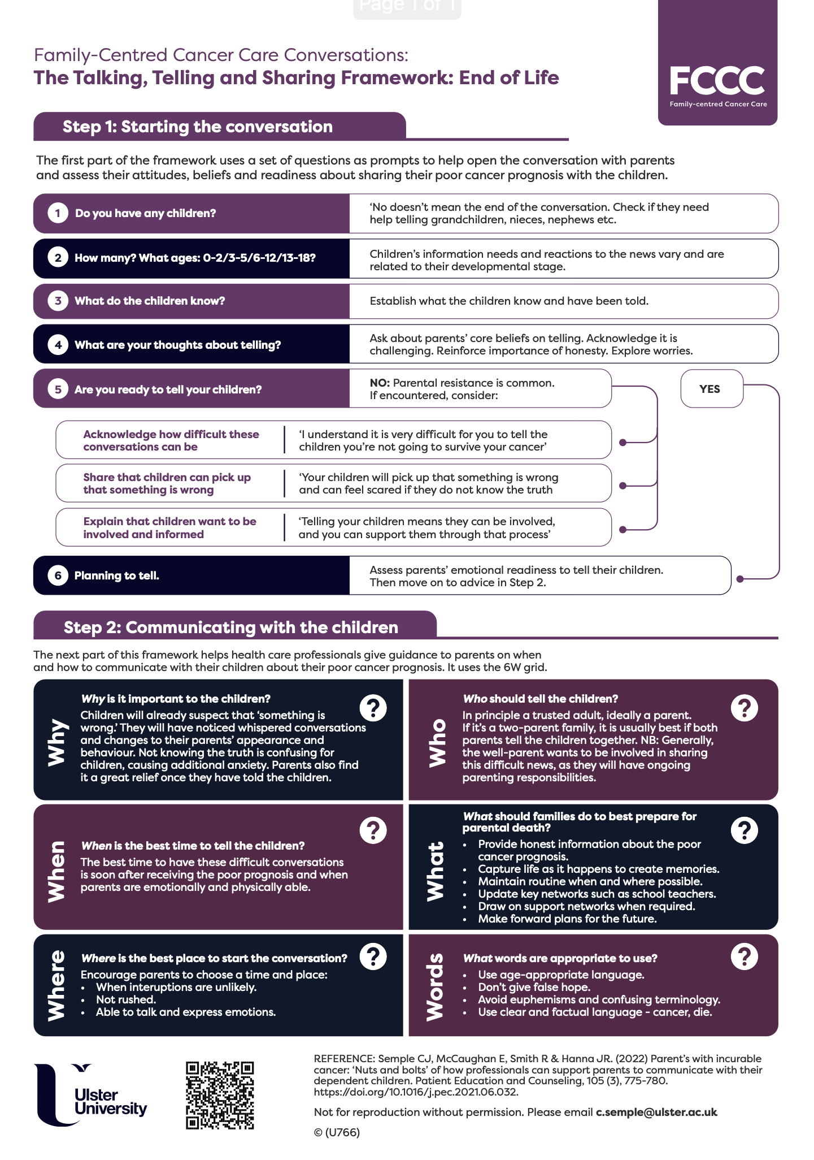
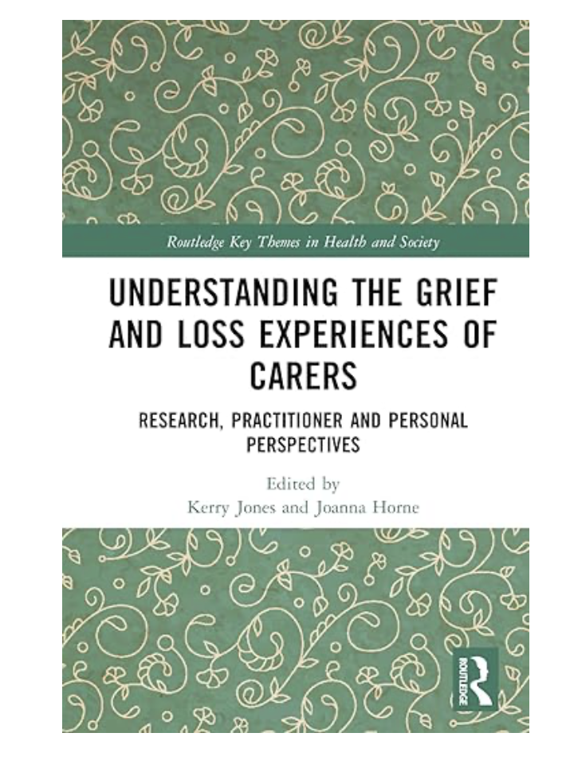


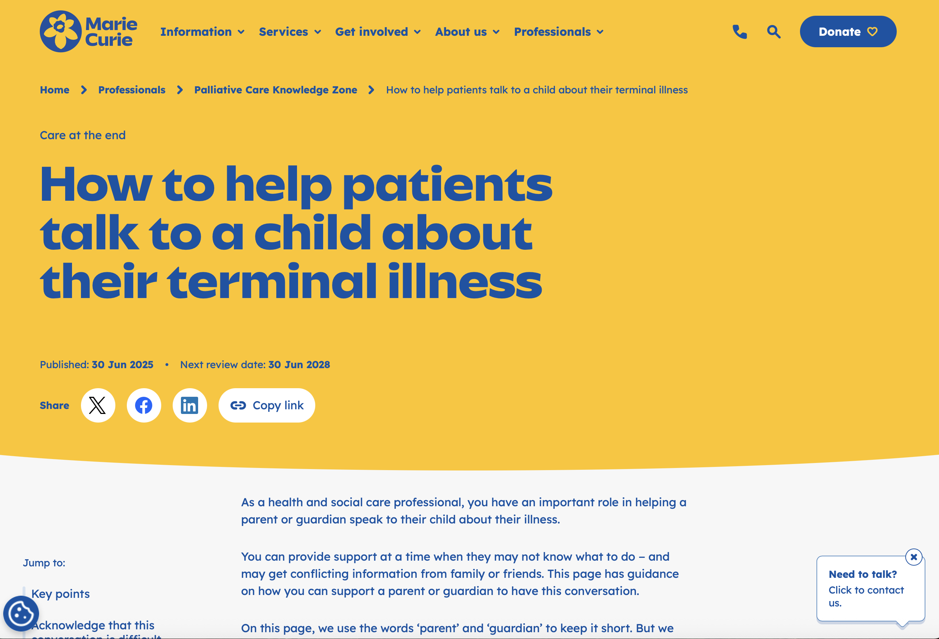
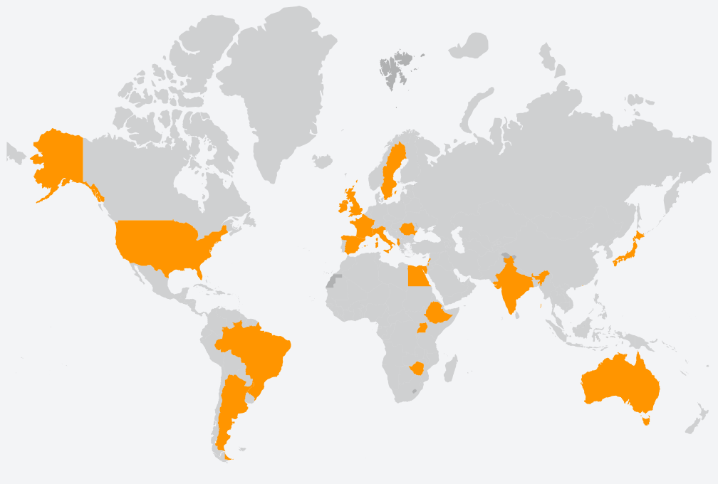
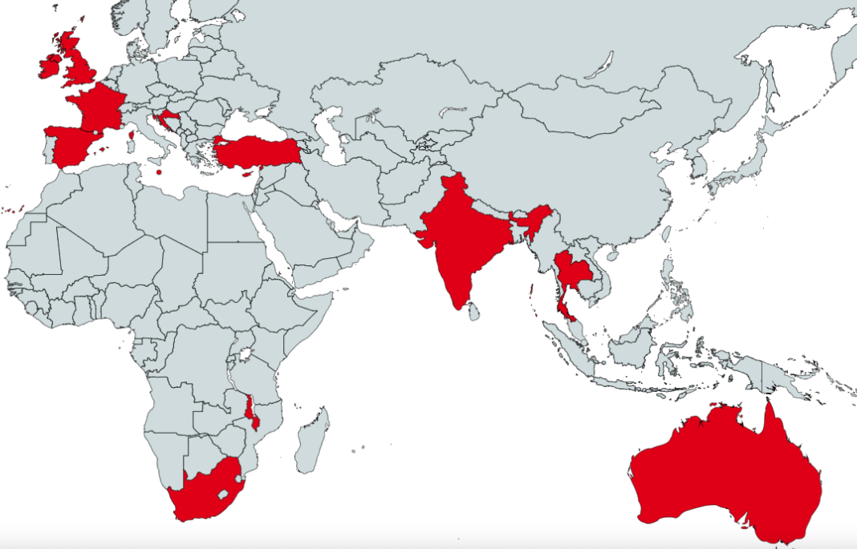
www.fccceoled.com

Slide 11
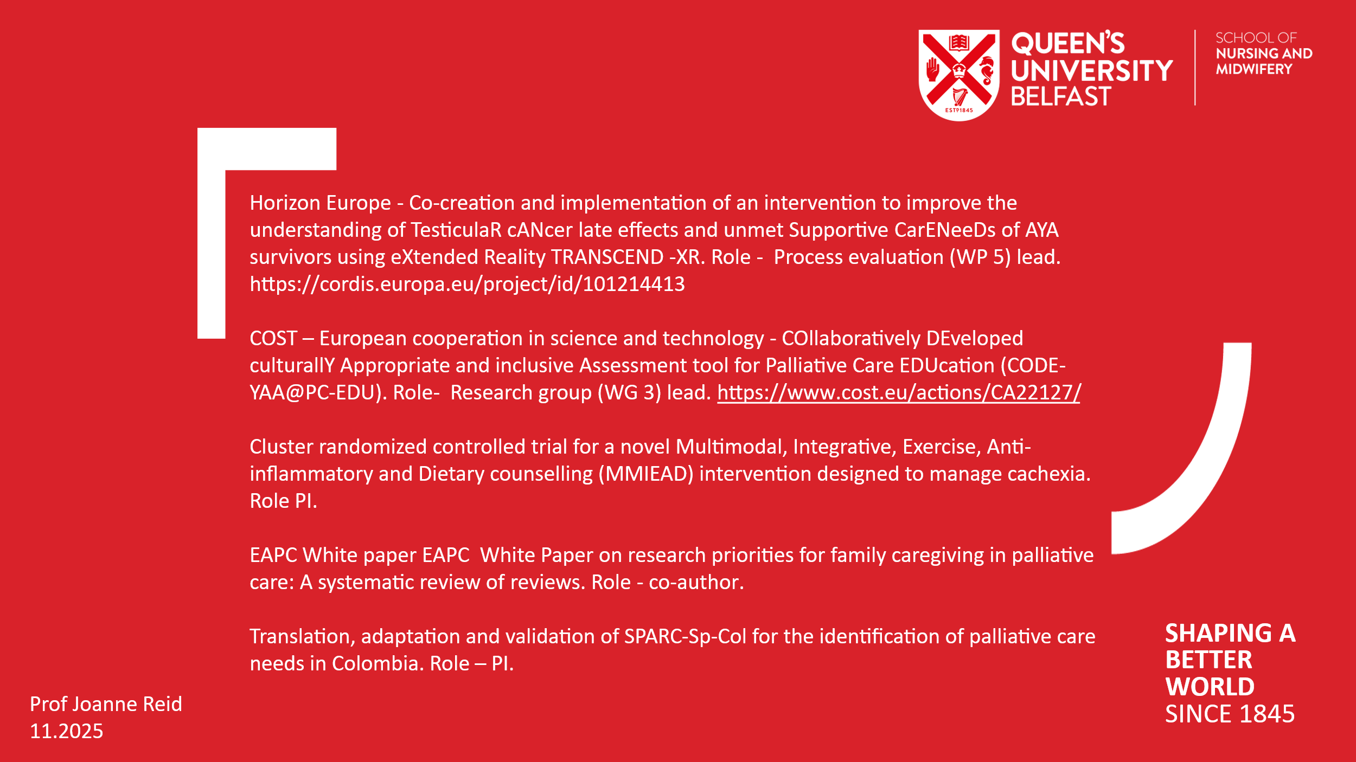
Queens University Belfast

Slide 12
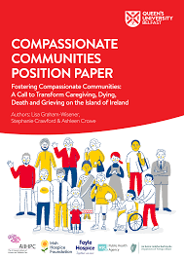
Compassionate Communities Lead Dr Lisa Graham Wisener

Slide 13

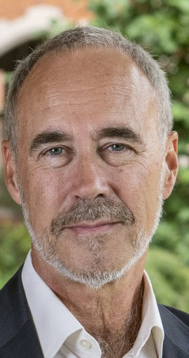
Underserved Populations
Prof Audrey Roulston – Lead on Palliative Care in Prison and Social Justice System
Prof Kevin Brazil – World leading expert in palliative care for people living and dying with dementia.

Slide 14

Questions

