Slide 1

All Ireland Perspectives on Adult’s Palliative Care Research and Policy
Prof. Karen Ryan, UCD Full Clinical Professor and Consultant in Palliative Medicine, Mater Hospital and St Francis Hospice

Slide 2

Disclaimer
  This presentation is for educational purposes only.
  Opinions or points of view expressed in this presentation represent the view of the presenter.
  I have no current or past relationships with commercial entities.

Slide 3


Slide 4



UNIVERSAL PALLIATIVE CARE MEANS THAT ALL PEOPLE HAVE ACCESS TO THE FULL RANGE OF QUALITY PALLIATIVE CARE SERVICES THEY NEED, WHEN AND WHERE THEY NEED THEM, WITHOUT FINANCIAL HARDSHIP
Access
Quality
Financial protection

Slide 5



1 goal
4 Strategic objectives
25 recommendations
100+ activities

Slide 6

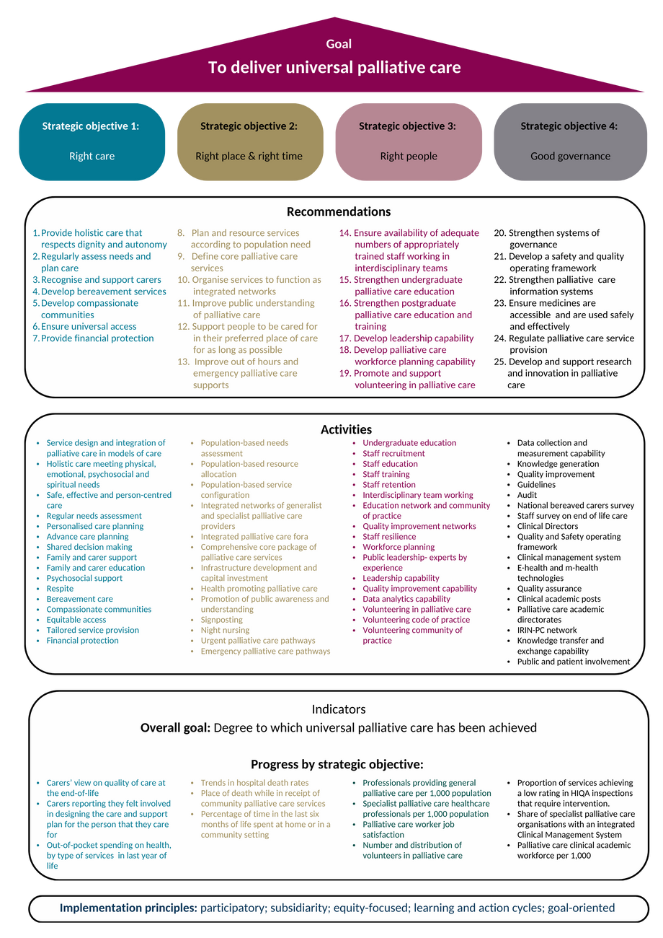

Slide 7






Right people
Developing a workforce that is appropriately resourced, skilled, supported, and valued to provide palliative care.
Right care
Ensuring the provision of safe, effective, and person-centred palliative care
Governed well
Right time and place
Strengthening clinical leadership, accountability, culture, coalition building, intelligent use of information, and research, innovation, and QI capability.
Making palliative care available and accessible to all when and where needed

Slide 8
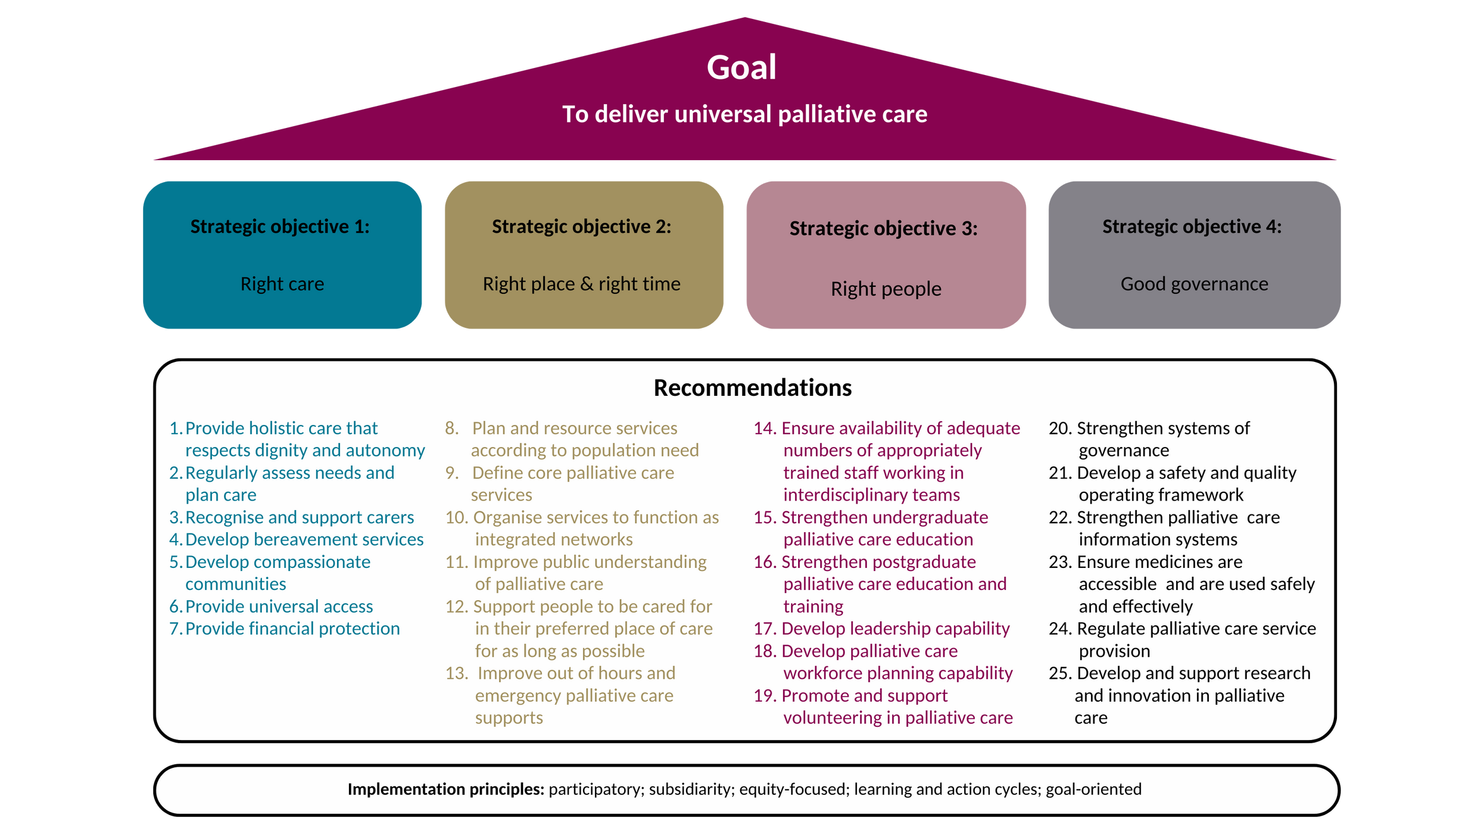

Slide 9








GOOD GOVERNANCE RECOMMENDATIONS
14. Governance systems
15. Quality and Safety
16. Information systems
17. Medicines and Technologies
Governance and systems will be continually strengthened to ensure legitimacy, transparency and trust to achieve results.
A defined quality and safety operating framework will be developed and implemented.
Effective sharing of data and information, knowledge generation and ICT enablement of palliative care provision will be achieved.
Essential medications in palliative care will be easily and safely accessible. Medications will be used in safe and effective ways in order to achieve the best possible outcomes for patients.

Slide 10


GOOD GOVERNANCE RECOMMENDATIONS
18. Accountability
19. Research and Innovation
The Health Information and Quality Authority will be supported to monitor palliative care provision ensuring that services adopt a human rights-based approach to care that promotes safety and wellbeing, responsiveness and accountability.
Research and innovation infrastructure and systems will be developed in academic palliative care, and a sustainable academic workforce will be developed.

Slide 11
Recommendation 25 (Research, Innovation): Activities
Strategic action 25. Develop palliative care research and innovation infrastructure and systems. | Recommendation 14. Palliative care will be provided by interdisciplinary teams with the appropriate training, skill mix and expertise. Staff will be employed in adequate numbers and will be equitably distributed across settings and regions according to population-based needs. | Recommendation 14. Palliative care will be provided by interdisciplinary teams with the appropriate training, skill mix and expertise. Staff will be employed in adequate numbers and will be equitably distributed across settings and regions according to population-based needs.
Activities | Responsibility | Commence before end:
25.1 Develop a strong and supportive environment for palliative care research in Ireland through investment in infrastructure and researchers. | HRB | 2025
25.2 Appoint Integrated Research and Innovation Fellows in Palliative Care (IRIN-PC) to support policy implementation and respond to and meet the needs of local populations and health and care systems. | HSE | 2026
25.3 Develop and maintain a national palliative care research knowledge transfer function to develop a comprehensive knowledge management framework | HSE | 2026
14.4 Support the development of specialist palliative care Education and Research Centres within fully coordinated partnerships between universities and healthcare organisations. | DOH | 2026
25.5 Develop clinical academic posts with an explicit contractual remit for clinical service, research and education across each integrated palliative care network and partner university as part of the academic health science system according to workforce planning models. Include at a minimum a Professor in Palliative Medicine and a Professor in Palliative Care and adequate staffing to support clinical placements in each Health Region. | HSE | 2026
25.6 Conduct a strategic review of palliative care research and innovation capacity, capability and performance in 2026 and use it to inform ongoing implementation of this policy and the work of funding agencies for health in Ireland. | HSE | 2026

Slide 12
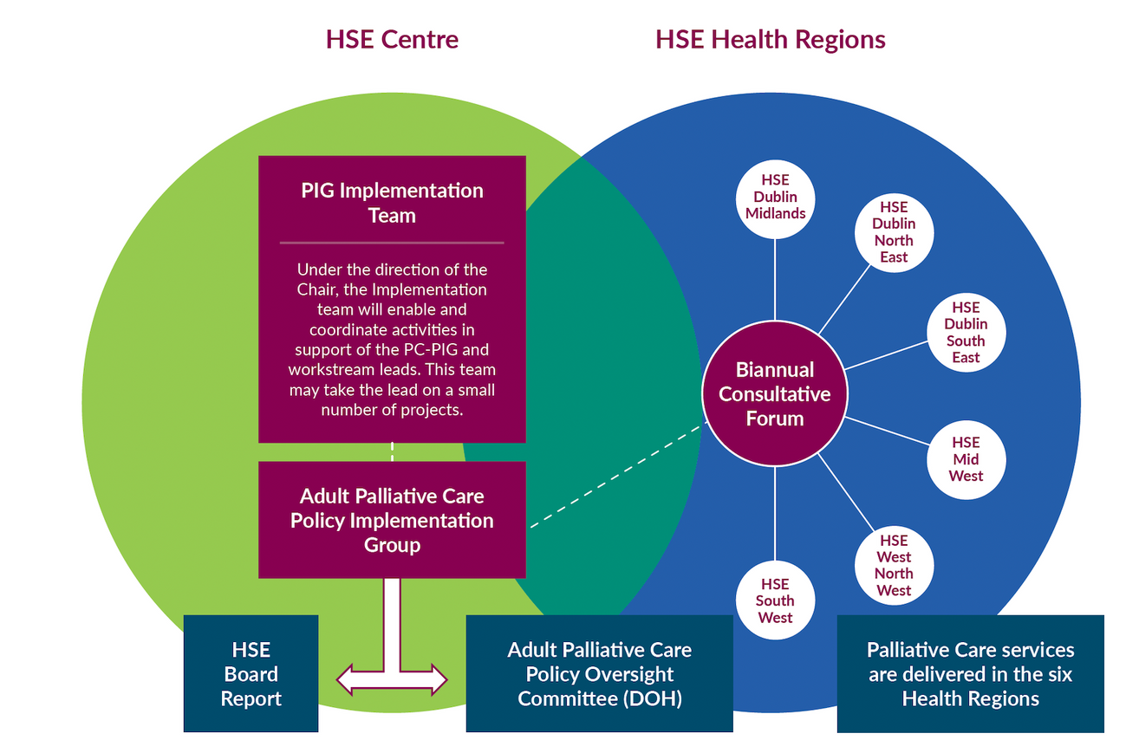
Implementation Roadmap and Structures

Slide 13

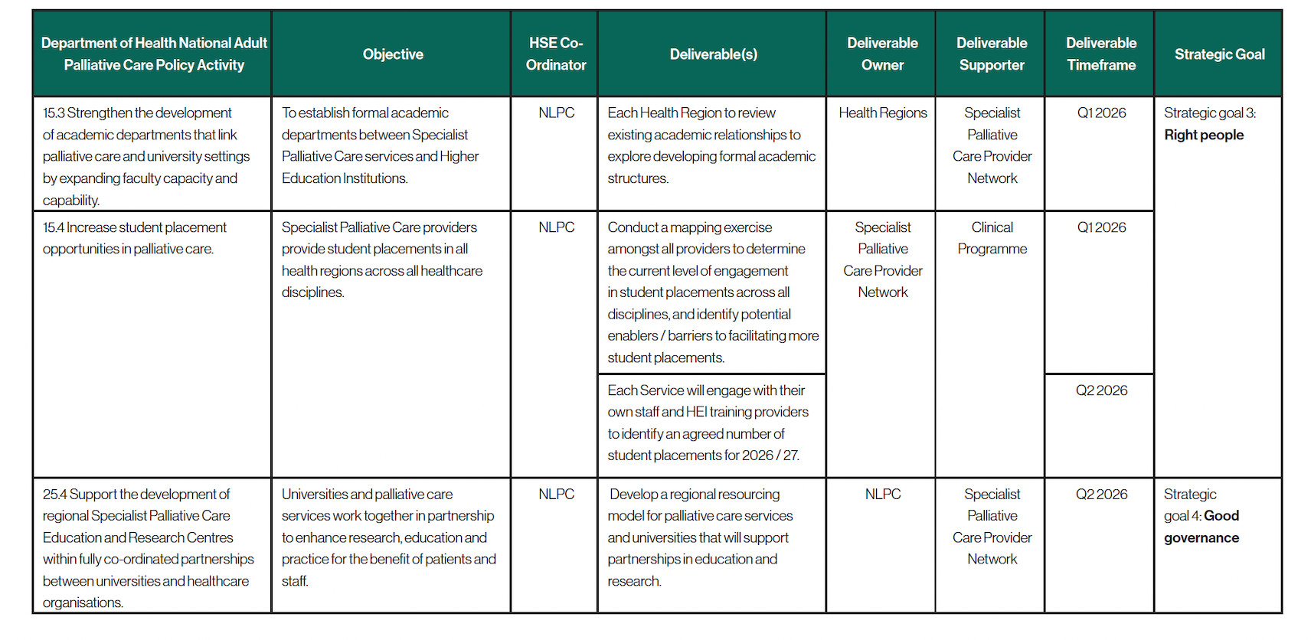

Slide 14
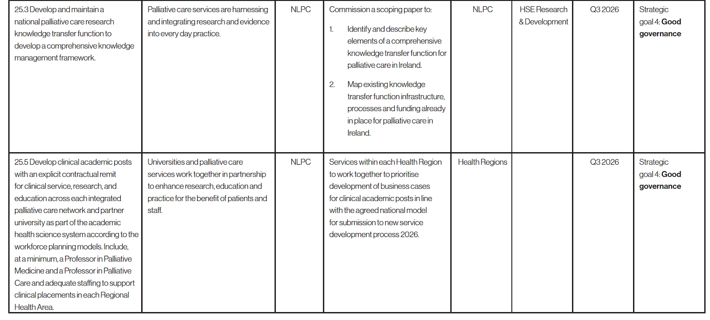

Slide 16









STATE RESEARCH INSTITUTES
TECHNOLOGY TRANSFER & INNOVATION INTERMEDIARIES
UNIVERSITIES
RESEARCH ECOSYSTEM
GOVERNMENT FUNDING & SUPPORT ORGANIZATIONS
INTERNATIONAL COLLABORATION NETWORKS
HEALTHCARE ORGANISATIONS
PRIVATE SECTOR RESEARCH PLAYERS
PATIENT AND PUBLIC INVOLVEMENT

Slide 17

The challenges of policy implementation
  Resource constraints and allocation
  Awareness and understanding
  Stakeholder engagement
  Policy coordination
  Interagency coordination, collaboration and integration across services
  Capacity and infrastructure, including workforce issues
  Data and monitoring
Addressing these challenges requires careful planning, stakeholder engagement, and a commitment to adaptive management throughout the policy implementation process.

Slide 18

Ar scáth a chéile a mhaireann na daoine

Slide 19


