Slide 1

All Ireland Palliative and End-of-Life Care Research Priorities 2025 -2030 Launch
Dr Mary Rabbitte, Research Programme Manager, AIIHPC
Dr Regina McQuillan, Palliative Medicine Consultant, St Francis Hospice and Beaumont Hospital, Dublin, PCRN member
Austin McCracken, AIIHPC Voices4Care Member
Éimear O’Flynn PPI Contributor

Slide 2
Why are we here?
Palliative care effects everyone and has been identified by the World Health Assembly as an “ethical responsibility of health systems”
Palliative care need growing on the island of Ireland with predicted growth estimated as 75% in Ireland by 2046 and 31% in Northern Ireland by 2040
In Republic of Ireland with National Adult Palliative Care Policy move to integrated care requires evidence-based approaches for service delivery and design and guidance for professionals
In Northern Ireland Palliative Care in Partnership Programme and priorities stress critical importance of research evidence-base to design and improve care to support growing demand
Recognised underfunded research area though supported by World Health Organisation (WHO) and other organisations

Slide 3






How were the research questions identified?
James Lind Alliance Priority Setting Partnership Project on Palliative and End-of-Life Care led by Marie Curie UK with additional data collected from Republic of Ireland
Surveys of patients, carers and health and social care professionals across the Republic of Ireland and Northern Ireland
Final All Ireland Prioritisation Workshop with people with lived experience of palliative care and/or professional experience
Funders
Notes:
So how does the JLA psp fit into this?
Given all of the challenges outlined previously, it is vitally important that we hear from people with lived experience of palliative and end of life care, to hear where they think future research should be focused.
This is important so that we can make sure that the limited funds that we do have, are directed towards the areas where they have most potential for impact.

Slide 4
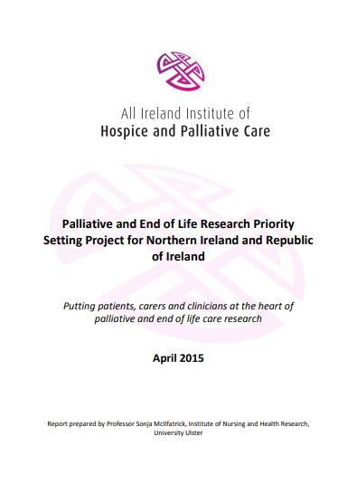


Building on previous priorities identified in 2015

Slide 5
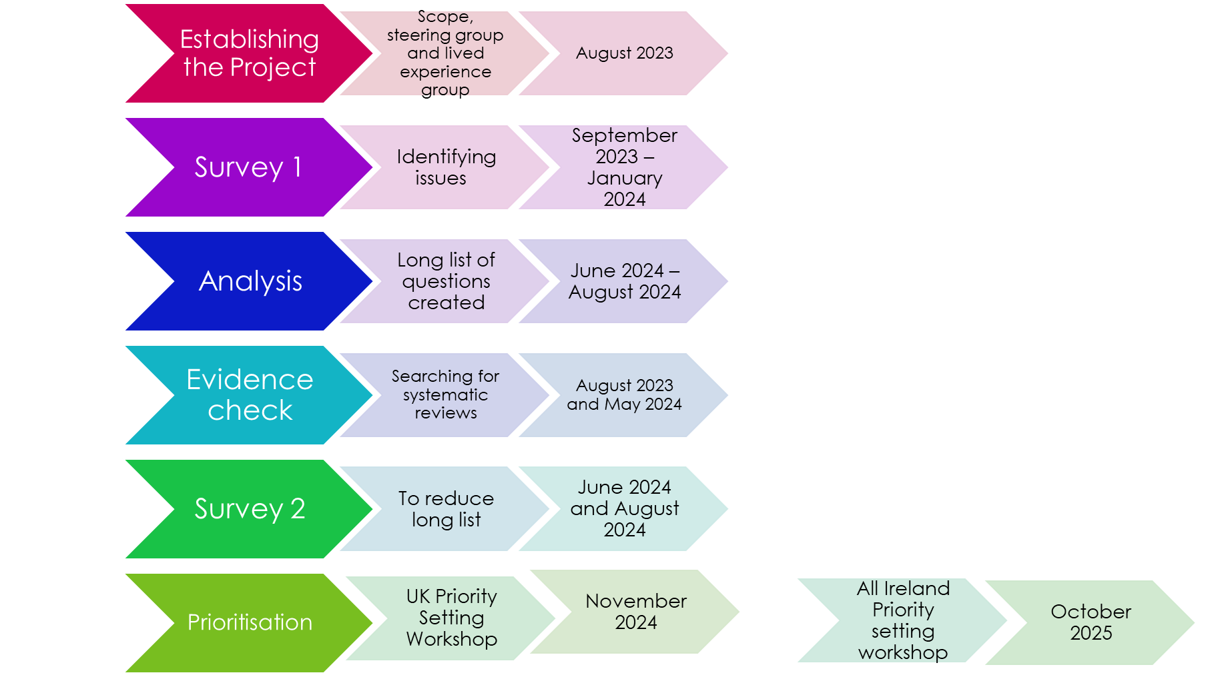
Project steps
1032 responses (13.2% from Island of Ireland)
79 questions identified
626 responses (5.9% from Island of Ireland)
24 questions identified for priority setting workshop

Slide 6
Who participated in the surveys?

Slide 7

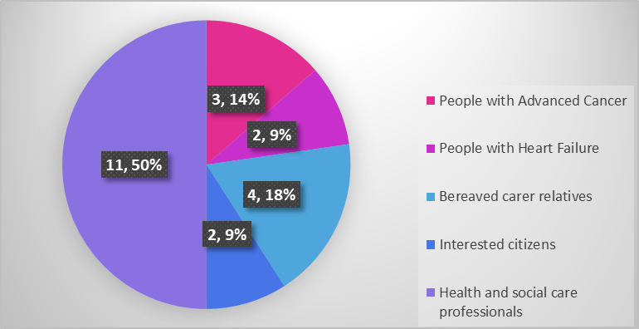




Who participated in the All Ireland Research Prioritisation Workshop?

Slide 8
All Ireland Palliative and End-of-Life Care Priorities 2025-2030

Slide 9

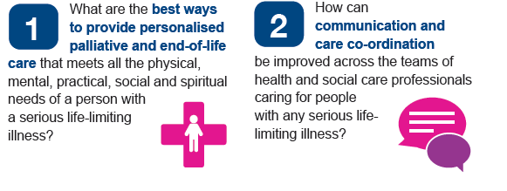
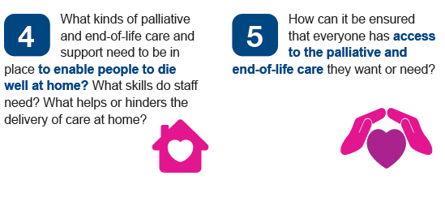

Slide 10
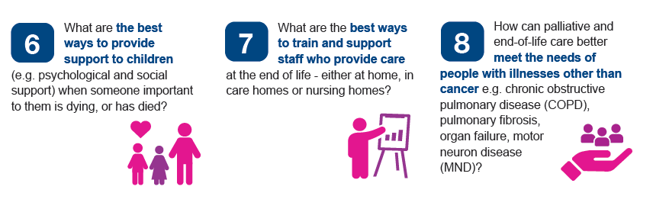
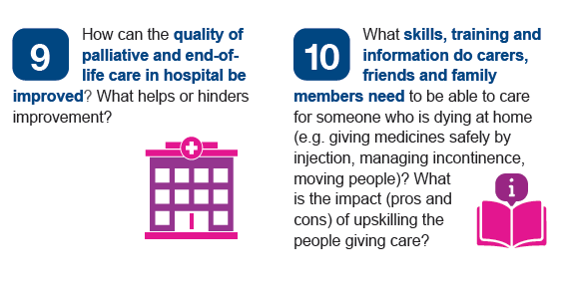

Slide 11
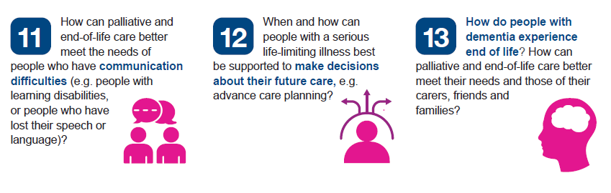
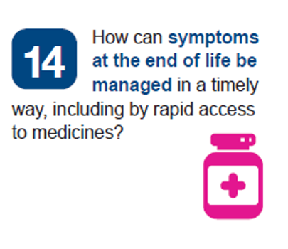

Slide 12
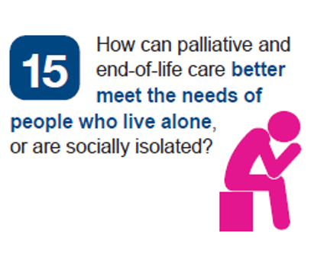

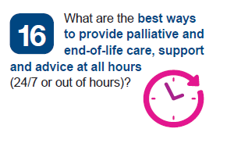

Slide 13

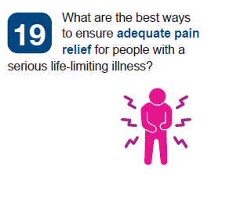
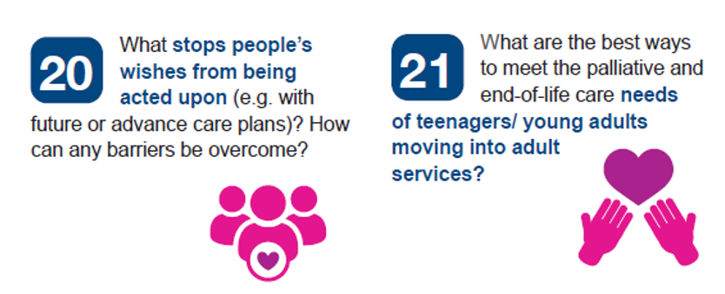

Slide 14
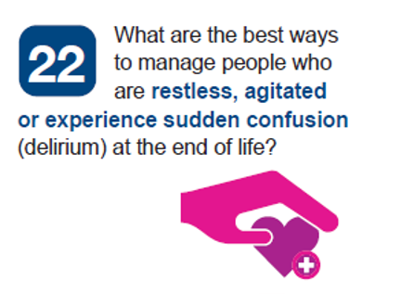
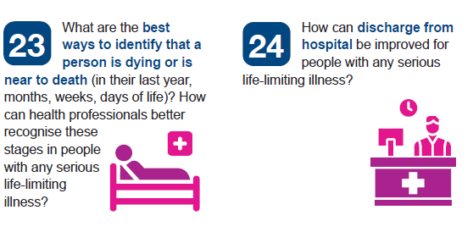

Slide 15

Next Steps and Thank You!
Encourage key stakeholders, funders, researchers, service providers, and policy makers to focus on prioritised research by people with life-limiting conditions, their families, carers, and health and social care professionals

