Slide 1


Getting Palliative Care Economics Research into Policy and Practice: some examples of wins and losses
Charles Normand
King’s College London and Trinity College Dublin

Slide 2
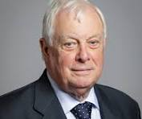
‘Of course I did not read this undoubtedly worthy document’
A government health warning
Chris Patten, Parliamentary Under-Secretary for the Northern Ireland Office 1983-1985

Slide 3
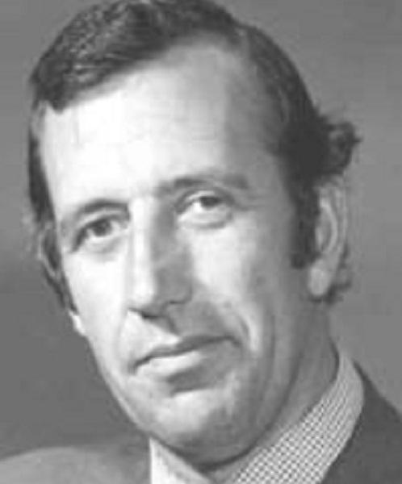
A late very senior doctor of my acquaintance
A clinical health warning
‘ I think you will find the correct answer is…’

Slide 4
Being useful
Understand the problem
Specify the research question
Develop the evidence
Understand the evidence
Review the evidence
Apply the evidence

Slide 5
Understanding the problem
(or why I love data)
Source: Ireland, CSO data
Notes:
Ireland is an interesting example of a young but rapidly ageing population
Overall the population is rising
The population between 20 and 70 will rise bynearly 30%
The population over 70 will rise by over 150%
The population under 20 will fall by 11%
There will be 85,000 more people not 20-70 and 68,000 more who are 20-70
The rise in those over 90 will be over 400%
An interesting feature of the Irish population is the net positive immigration and return migration effects

Slide 6
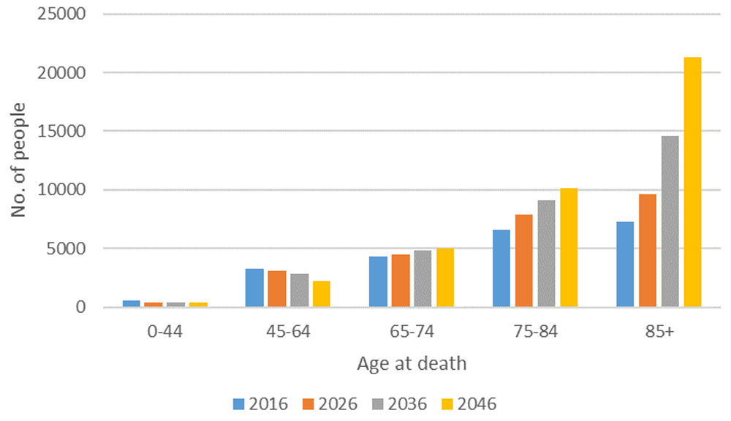
Estimated number of deaths in Ireland from a disease associated with palliative care need 2016–2046
May P, Johnston BM, Normand C et al. Population-based palliative care planning in Ireland: how many people will live and die with serious illness to 2046? [version 2]. HRB Open Res 2020, 2:35 (doi: 10.12688/hrbopenres.12975.2)
Notes:
Figure 3. Estimated number of deaths in Ireland from a disease associated with palliative care need 2016–2046, by age.
May P, Johnston BM, Normand C et al.. Population-based palliative care planning in Ireland: how many people will live and die with serious illness to 2046? [version 2]. HRB Open Res 2020, 2:35 (doi: 10.12688/hrbopenres.12975.2)

Slide 7
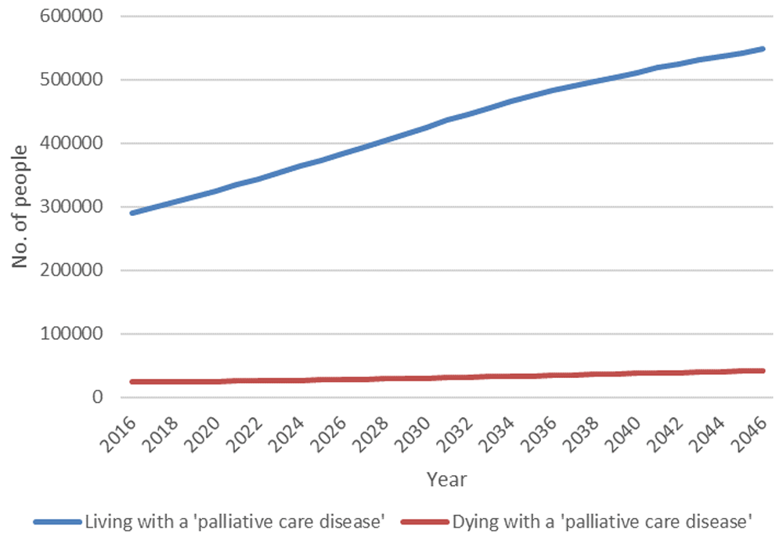
Its not just about dying

Slide 8
Specify the research question
What will happen if we do nothing?
Does the current service provision provide good outcomes?
Is the current service good value for money?
Does a new treatment or service work (and does it work well enough?)
Where is an innovation on the cost-effectiveness plane?

Slide 9
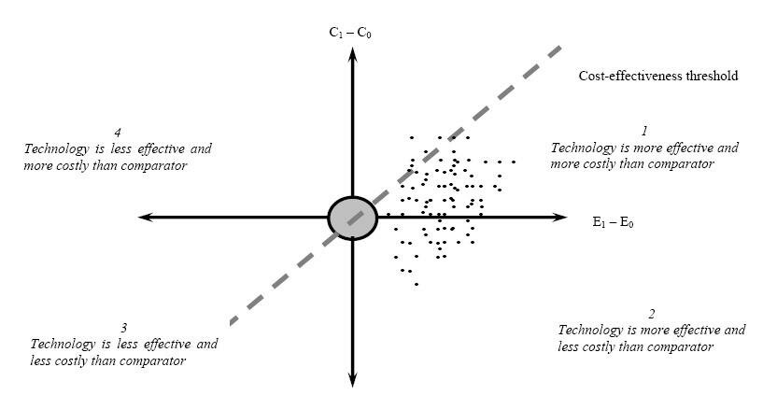

Slide 10
Develop the evidence, understand the evidence
Choice of study type should be fitness for purpose and not hierarchy of evidence
Many important policy and practice questions are not researched because the appropriate study designs clash with research orthodoxy
Some evidence is often better than no evidence
Very few studies tell you nothing – learn how to use the evidence they provide
The World is not dichotomous – the quality and usefulness of evidence lies on a continuum
Don’t allow evidence to be EBMed out of existence

Slide 11
Review the evidence
May P, Normand C, Cassel JB, Del Fabbro E, Fine RL, Menz R, Morrison CA, Penrod JD, Robinson C, Morrison RS. Economics of Palliative Care for Hospitalized Adults With Serious Illness: A Meta-analysis. JAMA Intern Med. 2018 Jun 1;178(6):820-829. doi: 10.1001/jamainternmed.2018.0750. PMID: 29710177; PMCID: PMC6145747.
Smith S, Brick A, O'Hara S, Normand C. Evidence on the cost and cost-effectiveness of palliative care: a literature review. Palliat Med. 2014 Feb;28(2):130-50. doi: 10.1177/0269216313493466. Epub 2013 Jul 9. PMID: 23838378.
This paper reused and combined data to say more (375)
This paper was a conventional literature review (667)
‘Many a mickle makes a muckle’

Slide 12
Apply the evidence: it’s complicated 1
Simplify or embrace complexity?
Evidence on treatments is often affected by multimorbidity
Evidence can be difficult to describe and communicate
Some commonly used research metrics are only partially useful
Need to promote acceptance of fairly strong evidence
Huge organisational differences affect how change is implemented, system capacity and feasible options
Implementation champions may have limited influence

Slide 13
Apply the evidence: it’s complicated 2
#Case 1
Studies of effects of (palliative care led) better decision making on trajectories, outcomes and costs.
Early studies spoilt by some poor design
Evidence generally shows better experiences, better outcomes and lower costs when more resources are used to plan and manage
The evidence has been widely used in policy development and service planning
Despite some slow improvement, most patients with life limiting conditions still experience some high-cost low-value care
Evidence of this type is slow burner and may affect service provision over a longer period.

Slide 14
Apply the evidence: it’s complicated 3
#Case 2
The Better B study of Mirtazapine for Breathlessness
Clinical outcomes showed no evidence of effectiveness
Economic study showed higher costs and worse outcomes with treatment
Dissemination (which is ongoing) through conferences and clinical networks, with early signs of changes in practice
Economic results were helped by the fact that the relevant quality of life effects are well measured by widely used research instruments

Slide 15
Apply the evidence: it’s complicated 3
# Case 3
The Diadic trial of two interventions to support patients and families
Well designed, well conducted (underpowered) study
No or very limited effects shown in main outcome measures
Economic study provided limited additional insights since the outcomes of interest seem not to be sensitive to conventional measures
Recent study (Kinchin et al 2025) provides useful evidence on limitations of conventional measures
Similar limitations may be a problem in other non-medical intervention studies.

Slide 16
Apply the evidence: it’s complicated 4
# Case 4
(Mainly DCE) studies of what people want in palliative care
Support for unpaid caregivers
Barrier free access
Continuity of care
Prioritising clinical benefits of social benefits
Strong emphasis on quality of process
There is also evidence that age and disease trajectory affect preferences and that patient and family preferences are a bit different.
In some cases, those in contact with hospice and palliative care services get what they want, but a long way to go!

Slide 17
Concluding Thoughts
What lessons have I learnt about getting evidence into policy and practice?
Understanding the problem/research question well helps
Understanding policy and service priorities helps
Doing excellent work (regardless of type) helps
Presenting findings in clear and accessible ways helps
Working with key implementers helps
Being patient helps
Being lucky helps a lot.

Slide 18
Thanks for your attention
In case you are interested, I have appended two slides with the main papers/studies that form the basis of this presentation

Slide 19
May P, Normand C, Oluyase May P, Normand C, Oluyase AO, Smith S, Brown ST, Maddocks M, Costantini M, Bajwah S, Kahnert K, Simon ST, Ryan K, Currow DC, Johnson MJ, Hart SP, Krajnik M, Tanzi S, Bolton CE, Janowiak P, Turola E, Jolley CJ, Mather H, Murden G, Ghirotto L, Farsides B, Brown JM, Higginson IJ; BETTER-B consortium. The cost of drug repurposing: parallel economic evaluation of mirtazapine for severe breathlessness in the multinational BETTER-B trial. BMC Health Serv Res. 2025 Nov 4;25(1):1442. doi: 10.1186/s12913-025-13605-9. PMID: 41188835.
De Vleminck A, Matthys O, Turola E, Dierickx S, Dombrecht L, Van Goethem V, Deliens L, Lapeire L, Hudson P, Eecloo K, Brazil K, Groenvold M, Di Leo S, van der Heide A, Normand C, Harding R, Pilch M, Northouse L; DIAdIC Team; Cohen J. Impact of a nurse-led and a web-based psychoeducational program for advanced cancer patients and their caregivers: Results of a three-arm randomized controlled trial. Int J Nurs Stud. 2025 Nov;171:105192. doi: 10.1016/j.ijnurstu.2025.105192. Epub 2025 Aug 19. PMID: 40925214.
Kinchin I, Jiang P, Street D, Norman R, Currow D, Agar M, Normand C, Johnston B, May P, Viney R, Mulhern B. Does context matter? A discrete choice experiment investigating the impact of palliative context on EQ-5D-5L health state valuation. Qual Life Res. 2025 Oct;34(10):2865-2877. doi: 10.1007/s11136-025-04023-9. Epub 2025 Jul 29. PMID: 40728587; PMCID: PMC12535484.
Higginson IJ, Brown ST, Oluyase AO, May P, Maddocks M, Costantini M, Bajwah S, Normand C, Bausewein C, Simon ST, Ryan K, Currow DC, Johnson MJ, Hart SP, Mather H, Krajnik M, Tanzi S, Ghirotto L, Bolton CE, Janowiak P, Turola E, Jolley CJ, Murden G, Wilcock A, Farsides B, Brown JM; BETTER-B consortium. Mirtazapine to alleviate severe breathlessness in patients with COPD or interstitial lung diseases (BETTER-B): an international, multicentre, double-blind, randomised, placebo-controlled, phase 3 mixed-method trial. Lancet Respir Med. 2024 Oct;12(10):763-774. doi: 10.1016/S2213-2600(24)00187-5. Epub 2024 Sep 9. PMID: 39265600.
Kinchin I, Walshe V, Normand C, Coast J, Elliott R, Kroll T, Kinghorn P, Thompson A, Viney R, Currow D, O'Mahony JF. Expanding health technology assessment towards broader value: Ireland as a case study. Int J Technol Assess Health Care. 2023 May 2;39(1):e26. doi: 10.1017/S0266462323000235. PMID: 37129030.
Johnston BM, Daveson B, Normand C, Ryan K, Smith M, McQuillan R, Higginson I, Selman L, Tobin K; BuildCARE. Preferences of Older People With a Life-Limiting Illness: A Discrete Choice Experiment. J Pain Symptom Manage. 2022 Aug;64(2):137-145. doi: 10.1016/j.jpainsymman.2022.04.180. Epub 2022 Apr 29. PMID: 35490993.
Matthys O, De Vleminck A, Dierickx S, Deliens L, Van Goethem V, Lapeire L, Groenvold M, Lund L, Arnfeldt CM, Sengeloev L, Pappot H, Johnsen AT, Guerin S, Larkin PJ, Jordan C, Connolly M, D'Alton P, Costantini M, Di Leo S, Guberti M, Turola E, van der Heide A, Witkamp E, Rietjens J, van der Wel M, Brazil K, Prue G, Reid J, Scott D, Bristowe K, Harding R, Normand C, May P, Cronin C, Northouse L, Hudson P, Cohen J. Effectiveness of a nurse-delivered (FOCUS+) and a web-based (iFOCUS) psychoeducational intervention for people with advanced cancer and their family caregivers (DIAdIC): study protocol for an international randomized controlled trial. BMC Palliat Care. 2021 Dec 28;20(1):193. doi: 10.1186/s12904-021-00895-z. PMID: 34963453; PMCID: PMC8713043.
De Vleminck A, Matthys O, Turola E, Dierickx S, Dombrecht L, Van Goethem V, Deliens L, Lapeire L, Hudson P, Eecloo K, Brazil K, Groenvold M, Di Leo S, van der Heide A, Normand C, Harding R, Pilch M, Northouse L; DIAdIC Team; Cohen J. Impact of a nurse-led and a web-based psychoeducational program for advanced cancer patients and their caregivers: Results of a three-arm randomized controlled trial. Int J Nurs Stud. 2025 Nov;171:105192. doi: 10.1016/j.ijnurstu.2025.105192. Epub 2025 Aug 19. PMID: 40925214.
Kinchin I, Jiang P, Street D, Norman R, Currow D, Agar M, Normand C, Johnston B, May P, Viney R, Mulhern B. Does context matter? A discrete choice experiment investigating the impact of palliative context on EQ-5D-5L health state valuation. Qual Life Res. 2025 Oct;34(10):2865-2877. doi: 10.1007/s11136-025-04023-9. Epub 2025 Jul 29. PMID: 40728587; PMCID: PMC12535484.
Higginson IJ, Brown ST, Oluyase AO, May P, Maddocks M, Costantini M, Bajwah S, Normand C, Bausewein C, Simon ST, Ryan K, Currow DC, Johnson MJ, Hart SP, Mather H, Krajnik M, Tanzi S, Ghirotto L, Bolton CE, Janowiak P, Turola E, Jolley CJ, Murden G, Wilcock A, Farsides B, Brown JM; BETTER-B consortium. Mirtazapine to alleviate severe breathlessness in patients with COPD or interstitial lung diseases (BETTER-B): an international, multicentre, double-blind, randomised, placebo-controlled, phase 3 mixed-method trial. Lancet Respir Med. 2024 Oct;12(10):763-774. doi: 10.1016/S2213-2600(24)00187-5. Epub 2024 Sep 9. PMID: 39265600.
Kinchin I, Walshe V, Normand C, Coast J, Elliott R, Kroll T, Kinghorn P, Thompson A, Viney R, Currow D, O'Mahony JF. Expanding health technology assessment towards broader value: Ireland as a case study. Int J Technol Assess Health Care. 2023 May 2;39(1):e26. doi: 10.1017/S0266462323000235. PMID: 37129030.

Slide 20
Johnston BM, Daveson B, Normand C, Ryan K, Smith M, McQuillan R, Higginson I, Selman L, Tobin K; BuildCARE. Preferences of Older People With a Life-Limiting Illness: A Discrete Choice Experiment. J Pain Symptom Manage. 2022 Aug;64(2):137-145. doi: 10.1016/j.jpainsymman.2022.04.180. Epub 2022 Apr 29. PMID: 35490993.
Matthys O, De Vleminck A, Dierickx S, Deliens L, Van Goethem V, Lapeire L, Groenvold M, Lund L, Arnfeldt CM, Sengeloev L, Pappot H, Johnsen AT, Guerin S, Larkin PJ, Jordan C, Connolly M, D'Alton P, Costantini M, Di Leo S, Guberti M, Turola E, van der Heide A, Witkamp E, Rietjens J, van der Wel M, Brazil K, Prue G, Reid J, Scott D, Bristowe K, Harding R, Normand C, May P, Cronin C, Northouse L, Hudson P, Cohen J. Effectiveness of a nurse-delivered (FOCUS+) and a web-based (iFOCUS) psychoeducational intervention for people with advanced cancer and their family caregivers (DIAdIC): study protocol for an international randomized controlled trial. BMC Palliat Care. 2021 Dec 28;20(1):193. doi: 10.1186/s12904-021-00895-z. PMID: 34963453; PMCID: PMC8713043.
Tobin K, Maguire S, Corr B, Normand C, Hardiman O, Galvin M. Discrete choice experiment for eliciting preference for health services for patients with ALS and their informal caregivers. BMC Health Serv Res. 2021 Mar 9;21(1):213. doi: 10.1186/s12913-021-06191-z. PMID: 33750360; PMCID: PMC7941893.
Tiernan E, Ryan J, Casey M, Hale A, O'Reilly V, Devenish M, Whyte B, Hollingsworth S, Price O, Callanan I, Walsh D,
Normand C, May P. A quasi-experimental evaluation of an intervention to increase palliative medicine referral in the emergency department. J Health Serv Res Policy. 2019 Jul;24(3):155-163. doi: 10.1177/1355819619839087
Peter May, Charles Normand, J. Brian Cassel, Egidio Del Fabbro, Robert L. Fine, Reagan Menz, Corey A. Morrison, Joan D. Penrod, Chessie Robinson, R. Sean Morrison. Economics of palliative care for hospitalized adults: a meta-analysis. JAMA Intern Med. 2018 Jun 1;178(6):820-829. doi: 10.1001/jamainternmed.2018.0750.
Irene J Higginson, Barbara A Daveson, R Sean Morrison, Deokhee Yi, Diane Meier, Melinda Smith, Karen Ryan, Regina McQuillan, Bridget M Johnston, Charles Normand. Social and clinical determinants of preferences and their achievement at the end of life: prospective cohort study of older adults receiving palliative care in three countries. BMC geriatrics 17 (1), 271
Tobin K, Maguire S, Corr B, Normand C, Hardiman O, Galvin M. Discrete choice experiment for eliciting preference for health services for patients with ALS and their informal caregivers. BMC Health Serv Res. 2021 Mar 9;21(1):213. doi: 10.1186/s12913-021-06191-z. PMID: 33750360; PMCID: PMC7941893.
Peter May, Melissa M. Garrido, Lee Stefanis, Amy S. Kelley, Diane E. Meier, Charles Normand, R. Sean Morrison. Prospective cohort study of hospital palliative care teams for inpatients with advanced cancer: earlier consultation is associated with larger cost-saving effect. Journal of Clinical Oncology 33, (25), 2015, p2745 – 2752
May, P., Normand, C. & Morrison, R. S., Economic impact of hospital inpatient palliative care consultation: review of current evidence and directions for future research. , Journal of Palliative Medicine, 2014 Sep;17(9):1054-63. doi: 10.1089/jpm.2013.0594
Smith, Samantha; Brick, Aoife; O'Hara, Sinead; Normand, Charles, Evidence on the Cost and Cost-effectiveness of Palliative Care: A Literature Review, Palliative Medicine, 2014, Vol 28(2) 130–150
Hannah-Rose Douglas, Charles Normand, Irene Higginson, Danielle Goodwin. A new approach to eliciting patients’ preferences for palliative day care: the choice experiment method. Journal of Pain and Symptom Management. J Pain Symptom Manage. 2005 May;29(5):435-45.

