Slide 1





20 November 2025
All Ireland Position Paper on Rehabilitative Palliative Care
14th Annual Palliative Care Research Network Symposium, Dublin Ireland
Prof Mary Lynch & Dr Elizabeth Morrow
Faculty of Nursing & Midwifery, RCSI University of Medicine and Health Sciences

Slide 2
Acknowledgements
Funder
Health Service Executive (HSE) and the Public Health Agency (PHA)
Commissioners
Ms Karen Charnley, Chief Executive Officer, AIIHPC
Ms Melanie Nugent, Programme Manager for Education and Practice, AIIHPC
Steering Group members
Members of the Steering Group contributed knowledge and expertise to inform the project design and development of the position paper:
Karen Charnley, AIIHPC
Melanie Nugent, AIIHPC
Martina O’Reilly, HSE National Clinical Programme for Palliative Care
Lisa McGirr, St Francis Hospice Dublin
Niamh Donnelly, St Francis Hospice Dublin
Expert Advisor to the Research Team
Prof Fiona Ross CBE, Professor Emerita Health and Social Care, Kingston University, former Chair of Princess Alice Hospice, former Chair of Hospice UK Chairs Forum for London Hospices, and Trustee Great Ormond Street Hospital Charity

Slide 3
Presentation
Context: Why rehabilitative palliative care?
Approach to the research
Key findings
Overview of the Position Paper recommendations

Slide 4

Context
Why rehabilitative palliative care? Provides the type of care and outcomes that people want Reduces deconditioning and unplanned admissions Improves healthcare effectiveness and use of resources Supports inclusion e.g., people with non-malignant disease and younger adults

Slide 5

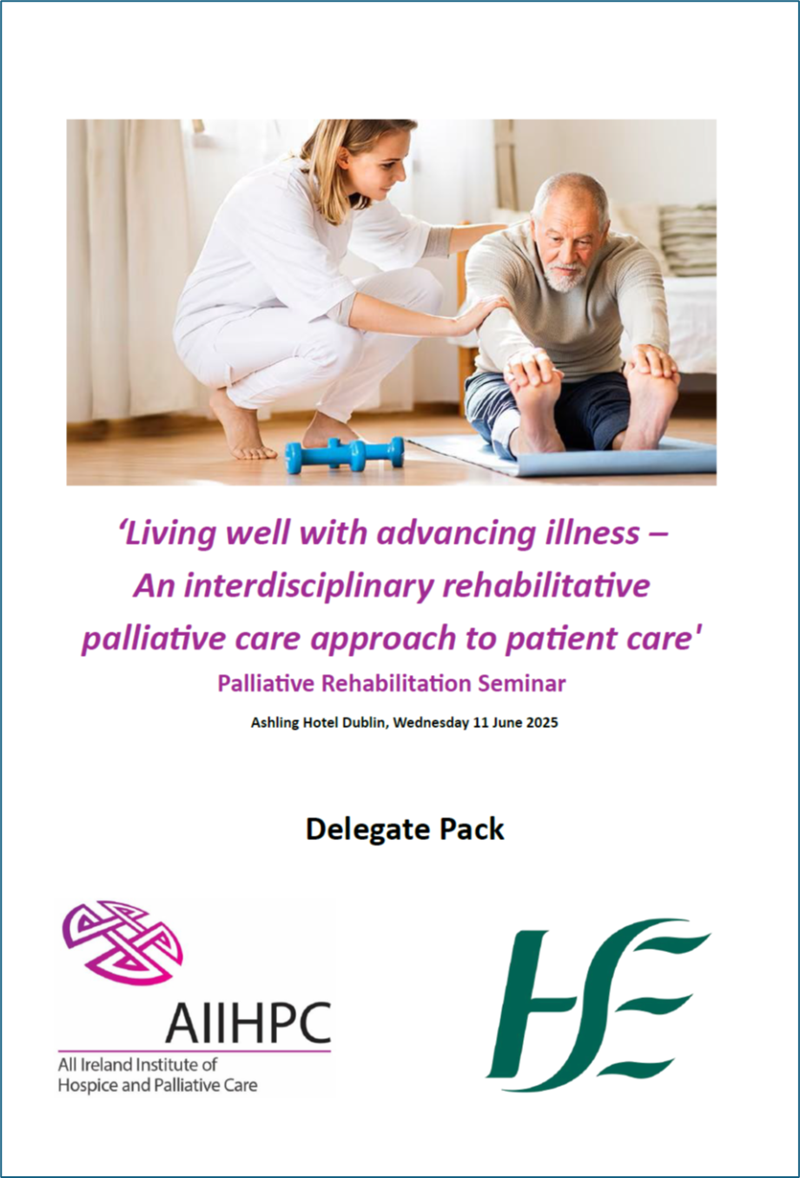



Approach
March 2025
1) Scoping review (JBI Approach) 2015-2025 (157 articles)
2) Seminar and workshop stakeholder expertise
3) Post-seminar discussion groups (6 groups, 18 people)
Development and refinement with Steering Committee members
September 2025

Slide 6
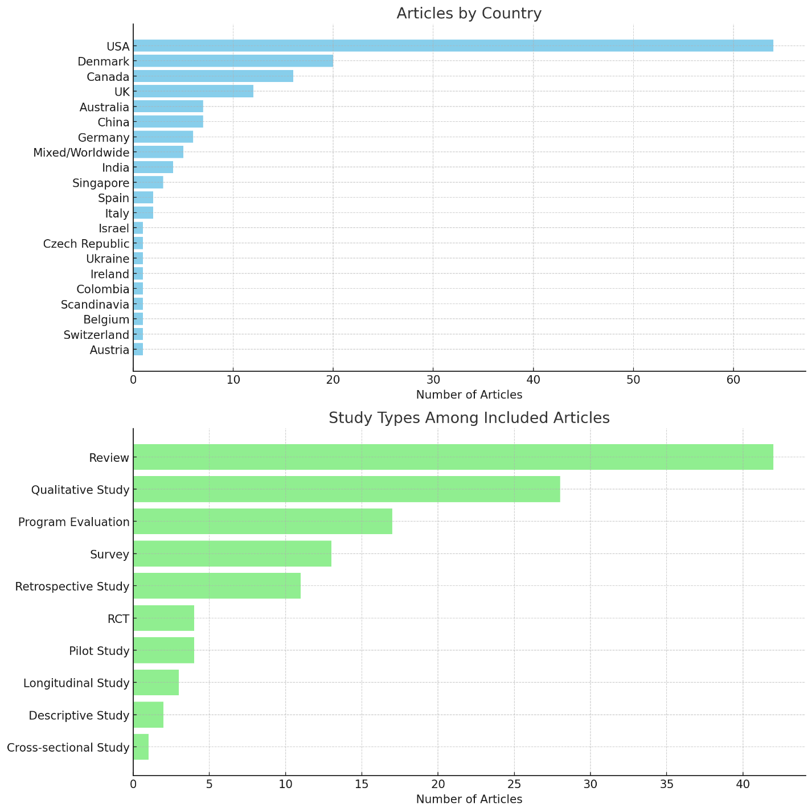
Key Findings
Scoping Review
157 articles on RPC
Country: USA=64, Denmark=20, Canada=16, UK=12, Australia=7, China=7, Germany=6, India=4, Singapore=3, Spain / Italy=2 and other countries
Article types: 125 reported on a study

Slide 7
Key Findings
Scoping review (themes)
Integration of rehabilitation with palliative and end-of-life care
Interdisciplinary and team-based models
Patient and caregiver experiences
Populations with complex or chronic illness
Outcome measures quality of life, functionality, symptom burden
Potential healthcare and economic benefits
Impact of COVID-19 pandemic on service delivery
Integration of spiritual and psychosocial support elements

Slide 8

Key Findings
Seminar and Workshop
11 June 2025
Strong support for RPC
Desire for interdisciplinary collaboration
Need for leadership and strategic development
Opportunities to spread innovation NI/ROI
Need to raise public awareness

Slide 9
Key Findings
Post Seminar Discussion Groups (Themes)
RPC as an ethos for care
Interdisciplinary working is essential but underdeveloped
Should engage and be led by all health professions
Systemic challenges require coordinated solutions
Centrality of the person and their network to RPC
Risk confidence and risk communication
Spreading innovation across settings
Positive impact on workforce culture
Education and training needs

Slide 10


Research
For policy and practice

Slide 11
Key Findings
Rehabilitative Palliative Care (RPC) – Definition
RPC is a person-centred, interdisciplinary approach that empowers people with life-limiting illnesses to maintain, improve, or slow the rate of decline of their function, independence, and quality of life.
RPC involves person-led collaborative care, early assessment, and tailored interventions that address a person’s physical, psychosocial, and nutritional needs and what matters to them.
RPC integrates rehabilitation within palliative care to reduce symptoms, prevent deconditioning, and support patients in living meaningfully. It promotes shared decision-making and supports carers and families.
RPC is embedded within a culture that values holistic care, teamwork, staff wellbeing, and ongoing training and education, while also aiming to reduce healthcare costs and unplanned hospital admissions.

Slide 12

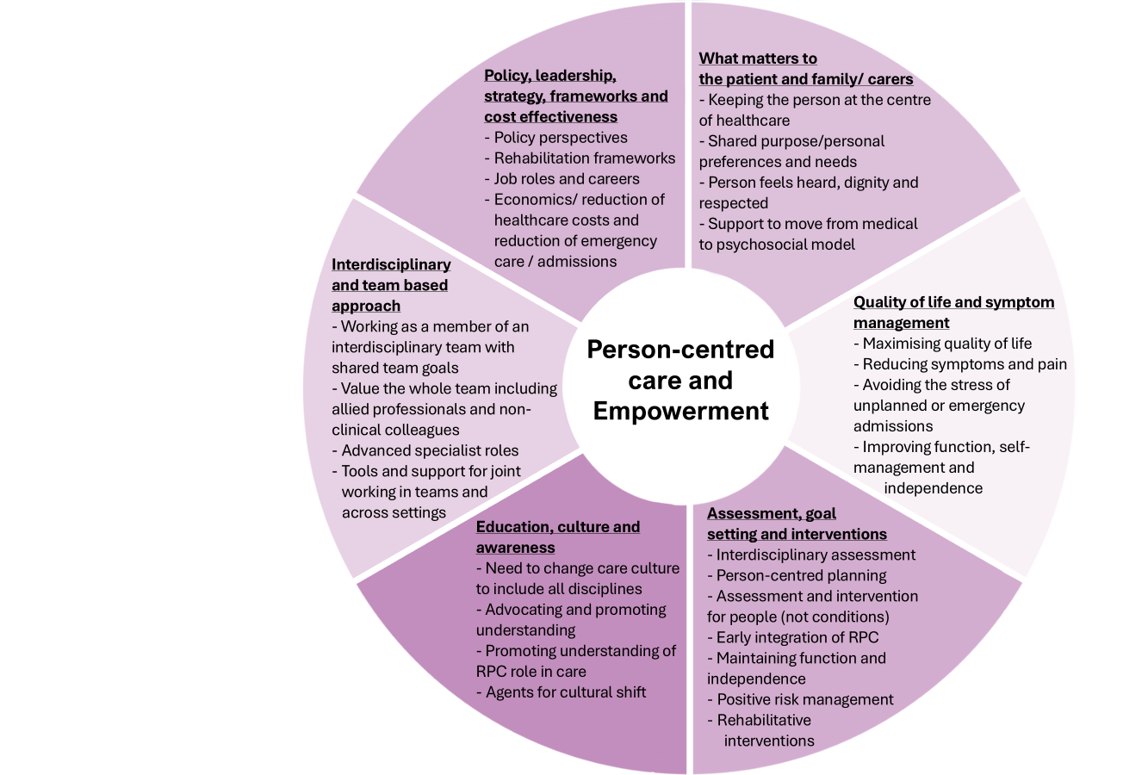
Key Findings
Key features of RPC
Person-centred
Quality of life and dignity
Support through illness
Interdisciplinary
Supports patients and families

Slide 13
1. Definition and model of Rehabilitative Palliative Care
2. Policy and demographic insights
3. Evidence to inform development of RPC
4. Stakeholder engagement
5. Informed implementation
6. Innovations in RPC
7. Training and education
Recommendations

Slide 14



Thank you
LINKS
Prof Mary Lynch
Maryalynch@rcsi.ie
Dr Elizabeth Morrow
Elizabethmorrow@rcsi.ie
Rehabilitative palliative care - evidence to inform an all Ireland position paper: https://doi.org/10.25419/rcsi.30501020
All Ireland position paper on rehabilitative palliative care: green paper November 2025: https://doi.org/10.25419/rcsi.30501026

