Slide 1

‘AIIHPC Expert Topic Webinar on Integrated Palliative Care in Oncology: key findings and recommendations for policy and practice’
Presented by
Prof Joanne Reid and
Dr Carolyn Blair, Queens University Belfast
professionalpalliativehub.com/research/

Slide 2




Integrated Palliative Care in Oncology: key findings and recommendations for policy and practice
Jan 22, 2025, 11:00 AM
Professor Joanne Reid - Professor of Cancer and Palliative Care, Queens University Belfast, AIIHPC Board Director and PCRN member
Dr Carolyn Blair - Research Fellow, Queens University Belfast and PCRN member

Slide 3
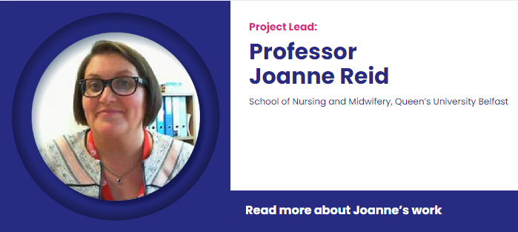



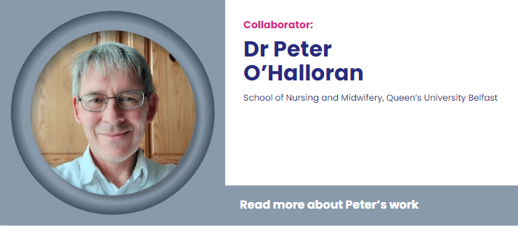





Research Team

Slide 4
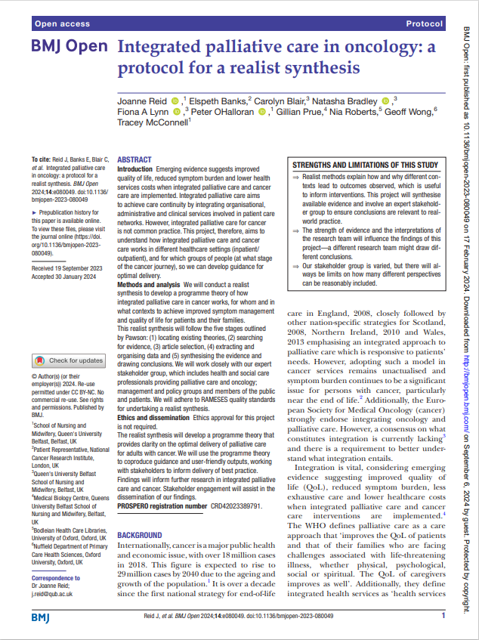
Background
The number of people living with cancer is expected to rise ​
Quality of life​, symptom burden and health service resource use improves with palliative care ​
National strategies and international guidelines promote integrated palliative care ​
Consensus is lacking on how best to implement and deliver
Integrated palliative care is not yet standard practice ​

Slide 5
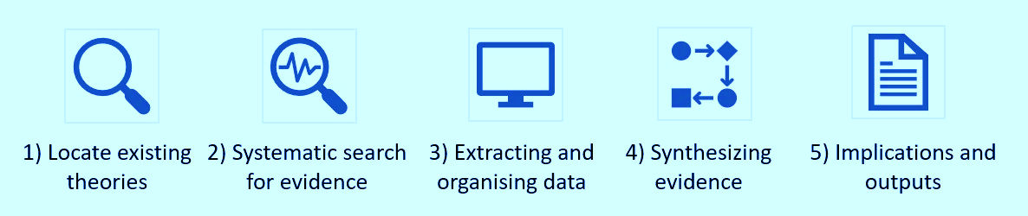
Methods
AIM: Explain how integrated palliative care in oncology works, for whom, and in what contexts ​
METHODOLOGY: Realist approach to unpick ‘what works’ (or doesn’t work), how and why, for whom, and in what circumstances ​
SYNTHESIS: Develop explanations of how contexts and mechanisms lead to outcomes ​
OUTCOMES: use this understanding to develop guidance to optimise implementation and delivery.

Slide 6
International Stakeholder Group
NHS Management and Leadership | Professor Sam H Ahmedzai: Emeritus Professor, The University of Sheffield. NIHR CRN National Specialty Lead for Cancer - Supportive care and community-based research. Co-chair of NCRI Living with and Beyond Cancer Research Group. Chair of NIHR Cancer & Nutrition Collaboration Executive Committee. Chair of British Pain Society Education Committee. Fiona Gilmour; Macmillan Palliative Care Service Improvement Lead. Northern Health and Social Care Trust.
Health care professionals involved in the delivery of palliative care and cancer management | Dr Selina Mellon: Macmillan General Practitioner, Northern Health and Social Care Trust. Bernie McGreevey; Principal Physiotherapist Northern Ireland Cancer Centre, Belfast Health and Social Care Trust, CSP Northern Ireland Board member; Allied Health Care Professional Palliative Care Forum Northern Ireland co-chair. Julieanne Conlon, Palliative Care Social Worker, Northern Ireland Hospice Dr Stephen Marshall, Social Worker and Lecturer at King’s College London and Hospital, Co-Chair of European Association of Palliative Care Social Work Taskforce.
National and International Research Clinicians in palliative care and cancer | Professor Peter Martin: Professor of Communication and End of Life Care, Deakin University, Australia. Professor Aminah Jatoi: Medical Oncologist, Mayo Clinic, Rochester, USA. Professor Daniel Kelly OBE: Royal College of Nursing Chair of Nursing Research, Cardiff University. Professor Jose Andres Calvache: Professor of Pain Management, Anaesthesiology and Epidemiology at the Universidad del Cauca, Colombia. Dr Esther de Vries: Associate Professor and Director of Doctoral Programme in Clinical Epidemiology at Pontificia Universidad Javeriana, Colombia.
Policy and Community Groups | Sally Convery: Public Health Agency Northern Ireland / Palliative Care in Partnership programme board Austin Orr: Marie Curie Policy team.

Slide 7
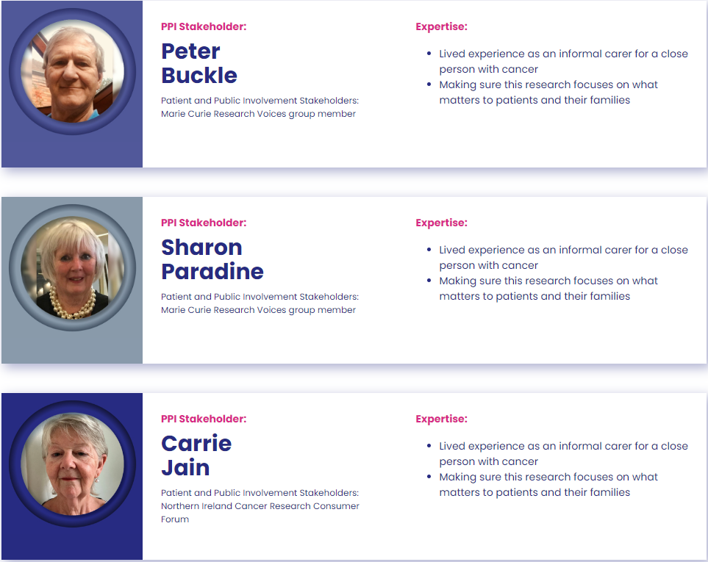
Our Patient and Public Involvement Partners

Slide 8
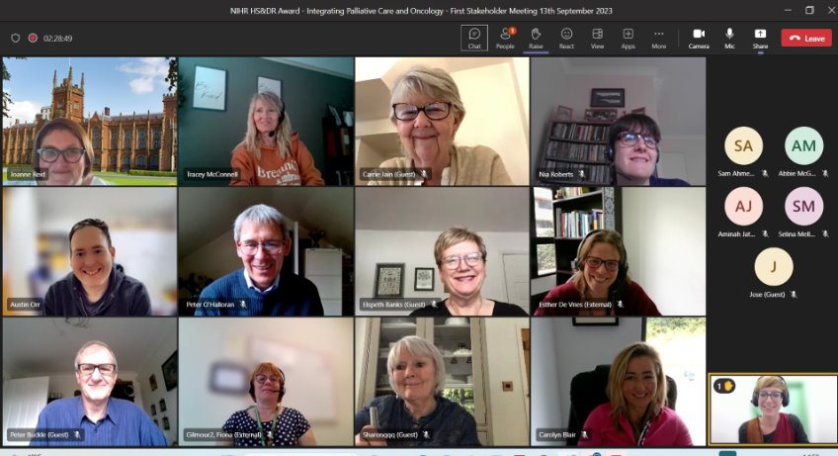
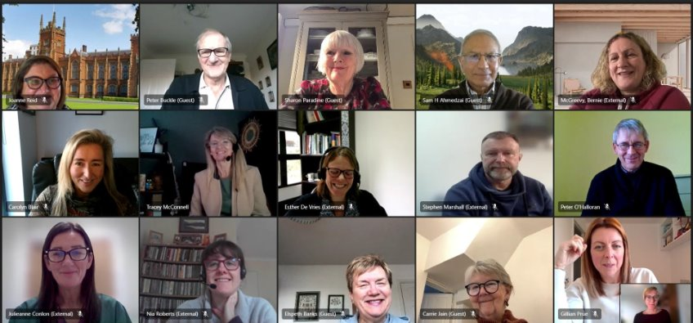
Today’s task
The purpose of our PPI and Stakeholder Group
to help us develop our initial programme theory;
for their advice and feedback on our programme theory as it evolves;
to consider our findings and implications from their varied perspectives;
provide input and support into our dissemination strategy and;
review and contribute to our materials, to ensure they meet the needs of people with cancer and the wider public.

Slide 9
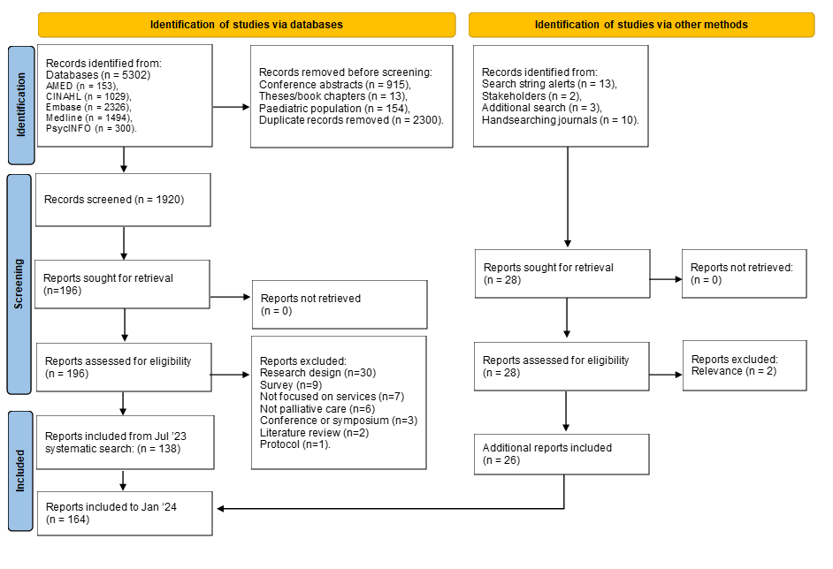
Today’s task
Results of the searches

Slide 10
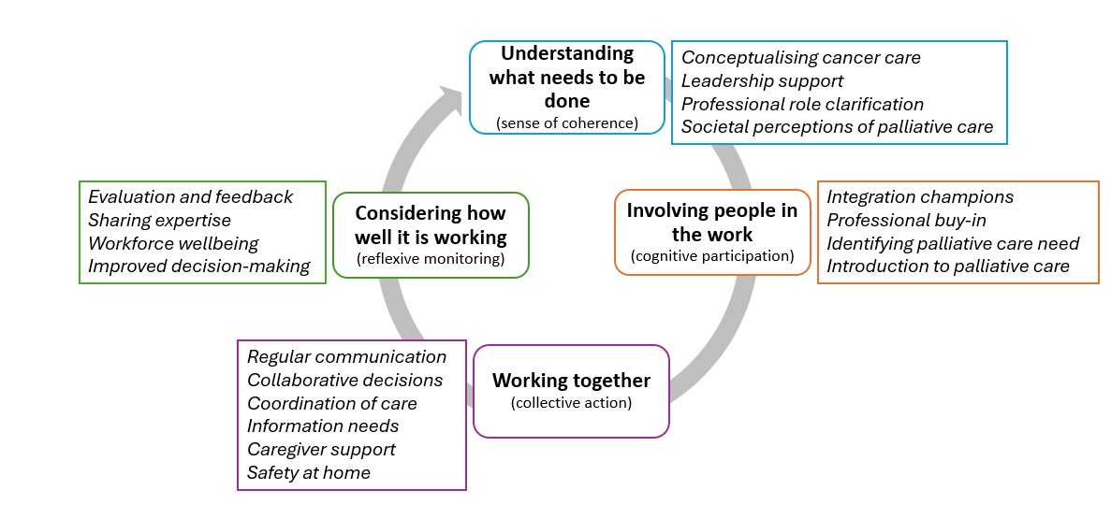
Today’s task
Results of realist theory development
Realist theory development led to the development of 18 Context-mechanism-outcome configurations (CMOCs), which are presented in four sections.

Slide 11


Our animation summarising the results

Slide 12









Understanding what needs to be done
Education providers (Universities, Royal Colleges, including organisations overseeing continuous professional development (CPD))
Organisation and system leaders (NHS leadership, NHS Trust Executives, Integrated Care Systems (ICS) leads)
Organisation and professional leaders (e.g. Professional bodies, Allied Health Professions Federation, and national health bodies)
Funders/commissioners (Relevant government departments, Clinical Commissioning Groups (CCGs), Integrated Care Boards (ICBs))
Sense of coherence
Public health agencies, public health bodies, government health ministries, and relevant communication partnerships
Academic research institutions, public health research agencies, large research funders (e.g., NIHR, The Health Foundation)

Slide 13

Involving people in the work
Organisation and professional leaders (e.g. Director of Cancer Services)
Education providers and regulatory bodies
Cognitive participation
Oncology and PC professionals, organisation and system leaders
Organisation and professional leaders NHS Trusts

Slide 14

Regulatory and accreditation bodies
Service leads
NHS Trusts and third-sector healthcare providers
Oncology and PC teams
Information hubs (e.g., Macmillan) and equality departments
Primary care providers, social workers and AHPs
Commissioners and NHS Trusts
Health and social care professionals
Working together and becoming a team
Collective action

Slide 15


Considering how well it is working
System and organisational leaders
Health and social care professionals
Reflexive monitoring
Commissioners, NHS Trusts, third-sector healthcare providers, research funders and academic institutions
Professional
leaders and specialist PC

Slide 16
Co-produced Research Priorities
Optimum communication modes and routines to facilitate collaboration within and between professional teams.
Approaches to improve (all) stakeholder’s understanding of integrated palliative care, especially those outside of specialist palliative care, such as community members and policymakers.
Appropriate accountability and meaningful evaluation strategies and how can these be introduced.
Interventions to develop and support the role of generalist palliative care in a wider range of professionals.
Optimum modes of communication to meet the needs of people with cancer and their families (informational, emotional, clinical, practical etc).
Research to understand and influence how integration of palliative care could benefit health equity/ population health.
Approaches to maximise benefits of collaborative working environments for workforce wellbeing and to minimise risk of moral distress experienced by professionals.
Research to develop strategies to close the implementation gap between policy and practice (e.g., Holistic Needs Assessment guidelines not being delivered).

Slide 17

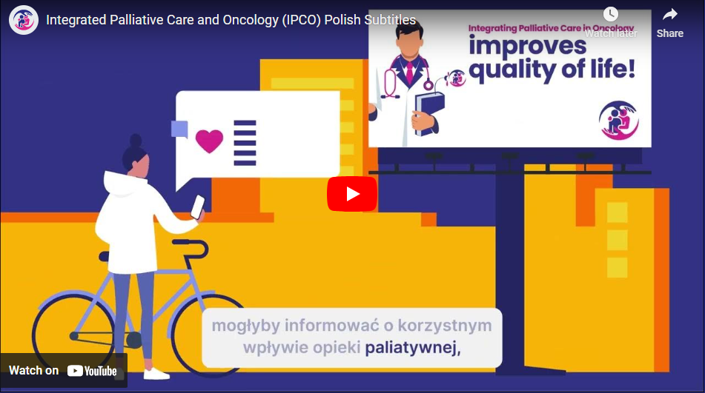
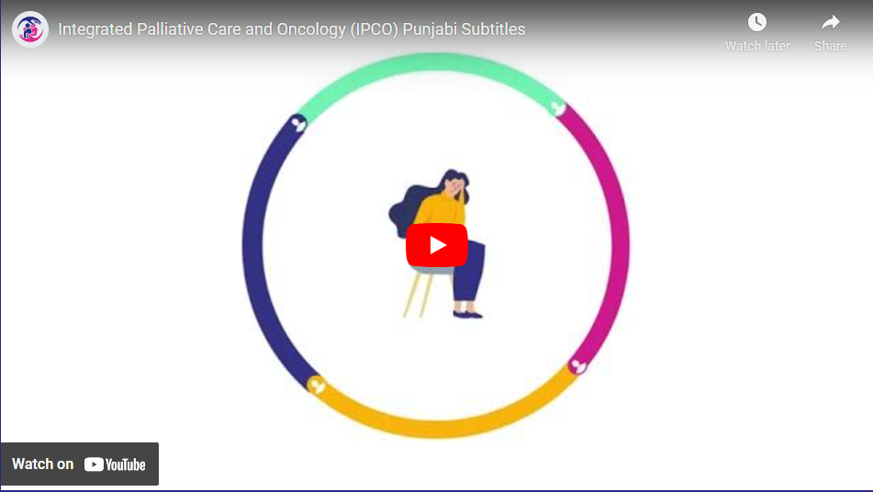
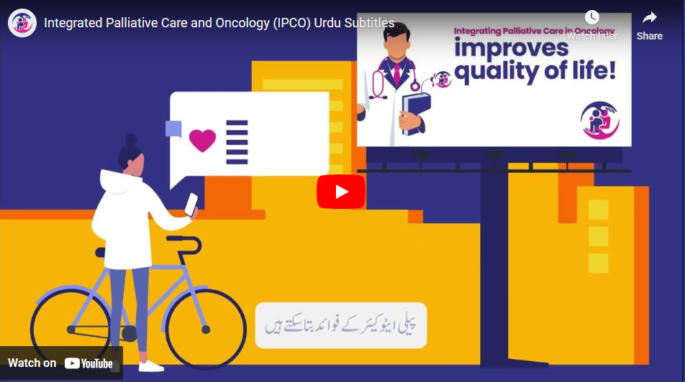
Outputs - Animation (English, Polish, Punjabi and Urdu)

Slide 18

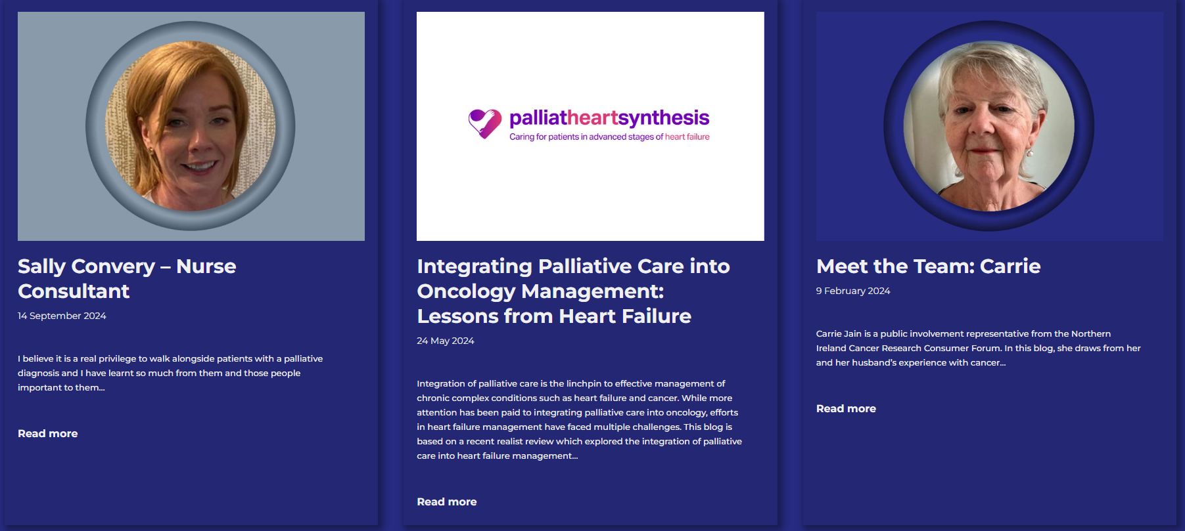
IPCO Website https://ipcoresearch.co.uk/blog/

Slide 19


NEXT STEPS for
putting our programme theory to the test
Aim: refine and develop initial programme theory and develop more detailed guidance on how to set up integrated palliative care and oncology (IPCO) services in the NHS
Research Question: What can we learn from existing successful NHS integrated palliative care and oncology services to develop detailed 'how to' guidance for setting up these services across the NHS?
Methods
Realist evaluation approach
Recruitment across care settings: (England, Northern Ireland, Scotland and Wales) purposively sampled to involve existing successful IPCO services
Interviews service providers, observation of service delivery etc.

Slide 20

…for taking the time to listen.
ANY QUESTIONS?
Email j.reid@qub.ac.uk / c.blair@qub.ac.uk

Slide 21

Files will be available on
Past Events - The Palliative Hub Professional (professionalpalliativehub.com/events)
)
Thank you for your time

