Slide 1
Launch of AIIHPC Children’s Palliative Care Research Special Interest Group
Dr Samantha Smith, Research Assistant Professor, Trinity College Dublin
Dr Busra Ertugrul, AIIHPC Research Support and Knowledge Translation Lead

Slide 2
Children’s Palliative Care
Active total care of child’s body, mind and spirit;
Providing support to the child and family;
Beginning when illness is diagnosed;
Continuing regardless of whether or not curative treatment is received
(WHO, 2023)
….planning for the worst, hoping for the best

Slide 3
What We Know And Need To Know
Changing profile and volume of needs for children’s palliative care
  reducing neonatal and paediatric mortality
  increasing survival of children with complex care and palliative care needs over longer time periods
Significant evidence gaps in children’s palliative care
  transition from child to adult services
  key challenges faced by families
  access to respite
  optimal modes of delivery and costs

Slide 4


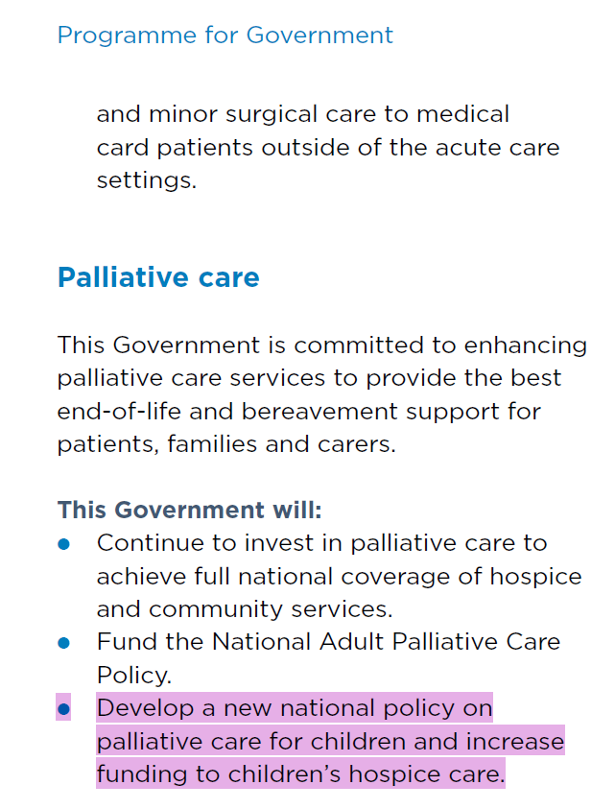
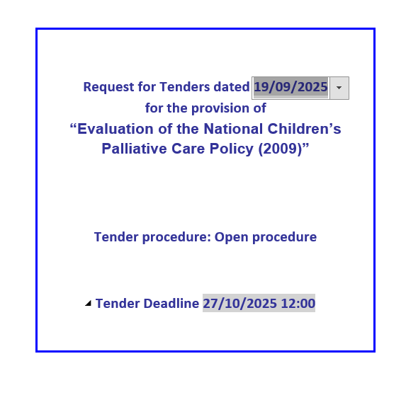
Building Blocks for progressing Children’s Palliative Care across the Island of Ireland
National policy on Children’s Palliative Care
Notes:
Samatha’s presentation

Slide 5
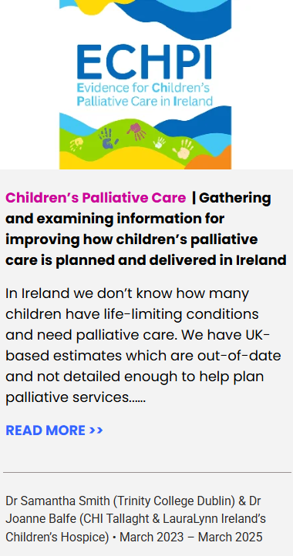
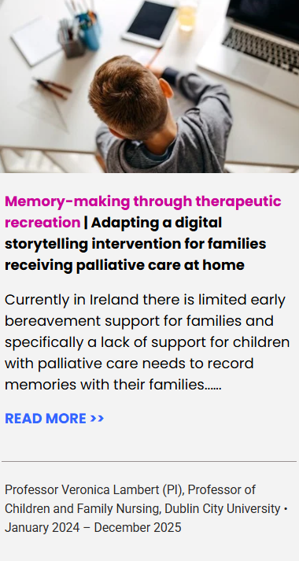
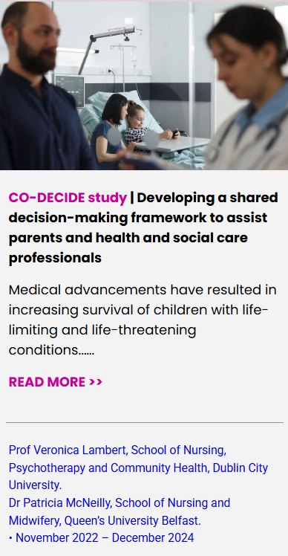
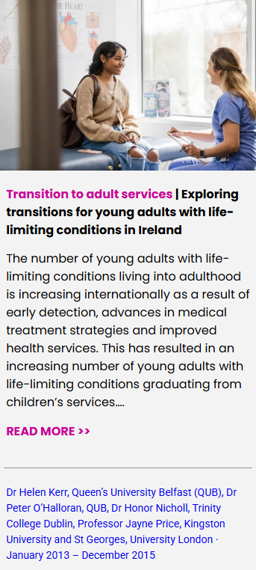
Building Blocks for progressing Children’s Palliative Care across the Island of Ireland
National policy on Children’s Palliative Care
Multi-disciplinary, family-centred care including: Specialist tertiary Children’s Palliative Care teams; clinical nurse co-ordinators; specialist hospice care etc.
Specialist Children’s Palliative Care delivery structures
Growing pool of researchers & research
Notes:
Samatha’s presentation

Slide 6
Building Blocks For Progressing Children’s Palliative Care Across the Island of Ireland
National policy on Children’s Palliative Care
PPI in ECHPI, Memory-Making, Co-Decide;
Voices4Care
e.g., Children’s Palliative Care Strategic Advisory Group; HSE National Lead for Palliative Care
Evidence to support
Children’s Palliative Care policy, planning
and delivery
PPI
Specialist Children’s Palliative Care delivery structures
Multi perspective implementation oversight
Growing pool of researchers and research
Notes:
Samatha’s presentation

Slide 7

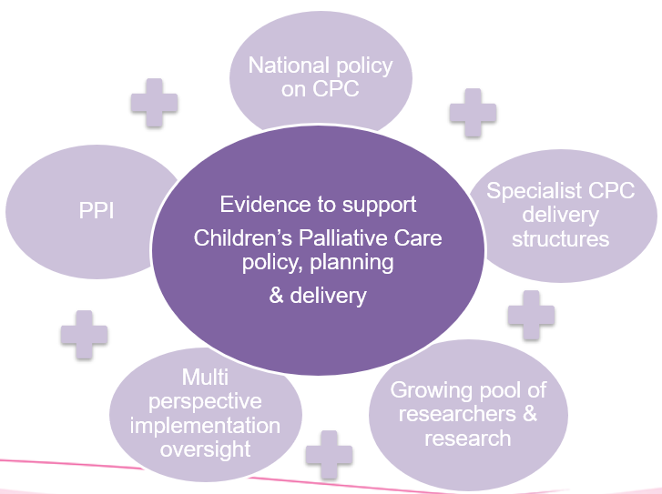
Children’s Palliative Care Research Special Interest Group
National policy on CPC
Evidence to support
Children’s Palliative Care policy, planning
& delivery
PPI
Specialist CPC delivery structures
Aim: Advance a co-ordinated programme of multidisciplinary Children’s Palliative Care research across the island of Ireland
Objectives:
Co-ordinate stakeholders in Children’s Palliative Care research across the island of Ireland
Incorporate family voices
Collate available evidence
Jointly identify evidence gaps and research goals
Develop joint funding applications to address evidence gaps
Multi perspective implementation oversight
Growing pool of researchers & research
Notes:
Samatha’s presentation

Slide 8

Invitation To Join
Open to all Palliative Care Research Network, Early Career Researcher Forum, and Voices4Care members
First meeting is scheduled for 3rd of December at 10 AM
More information:
palliativehubresearch.com/special-interest-groups/childrens-palliative-care-research-special-interest-group
Email bertugrul@aiihpc.org
QR Code to Sign Up Form

