Slide 1

‘Introduction to Mixed Methods’
Presented by
Dr Julie Doherty, Queens University Belfast
professionalpalliativehub.com/research/

Slide 2



Introduction to Mixed Methods
Dr Julie Doherty
Webinar ECRF
Friday 27th March 2026
SHAPING A
BETTER WORLD
SINCE 1845

Slide 3
Session overview and objectives
Introduction to mixed methods research
Why it matter in palliative care
Key mixed methods designs
Integration
Research examples
Key takeaway messages

Slide 4
The complexity of palliative care research
Clinical outcomes
Patient experiences
Multiple approaches are required to understand these elements
Family & caregiver experience
Care context

Slide 5
Why does mixed methods matter in palliative care research
Can produce a broader and actionable understanding of the topic
Different types of questions require different approaches
Triangulation improves credibility of findings
Enhances validity by combining strengths of both approaches

Slide 6
What is mixed methods?
Mixed methods research involves:
Combining qualitative and quantitative approaches within a single study
Used within a single study or programme of research
Collecting and analysing different types of data
Integrating findings to develop a deeper understanding of a research question

Slide 7

Mixed methods designs
Convergent Parallel
Explanatory Sequential
Exploratory Sequential
Multiphase

Slide 8
Mixed Methods research designs
Convergent Parallel Design:
Qualitative and quantitative data are collected at the same time
Results compared.
Convergent designs allow researchers to compare measured outcomes with lived experiences.
Question | How do patients receiving palliative care at home experience symptom management, and how effective are current treatments.
Quantitative | Standardised measures of pain, fatigue, quality of life
Qualitative | Individual interviews to explore experiences of symptom management at home
Integration | Analysed separately and compared to see if symptoms aligns with experiences

Slide 9
Mixed Methods research designs
Explanatory Sequential Design:
Begins with quantitative data collection followed by a qualitative phase
Helps explain or expand results
Explanatory sequential designs help researchers understand the ‘why’ behind quantitative findings.
Question | Family caregivers satisfaction with care provided in care homes
Quantitative | Satisfaction with care survey
Qualitative | Individual interviews to explore views on satisfaction with care
Integration | Qualitative findings are used to explain and provide context for the quantitative results.

Slide 10
Mixed Methods research designs
Exploratory Sequential design:
Starts with qualitative data collection followed by a quantitative measure
Qualitative findings inform quantitative stage.
Exploratory sequential designs can researchers develop quantitative tools
based on qualitative insights
Question | How can we support individuals with life-limiting conditions to engage with social prescribing activities
Qualitative | Interviews or focus groups to explore barriers and facilitators to engagement using a theoretical framework.
Quantitative | Findings are used to develop a questionnaire to understand what factors influence engagement and tested in a larger sample.
Integration | Allows the topic to be explored/measured more broadly

Slide 11
Mixed Methods research designs
Multi-phased designs:
Involves phases of qualitative and quantitative data collection
Builds on previous phase to create a more complete understanding
Multi phased designs allow researchers to explore, develop, test, and refine complex interventions over multiple stages.
Question | How does the Family Carer Decision Support Intervention support family carers involved in decision making at end-of-life
Qualitative | Interviews with family caregivers and healthcare professionals to explore experiences, access needs and understand barriers/facilitators to implementation of the intervention prior to delivery
Quantitative | Intervention implementation and quantitative testing e.g., decisional conflict, number of ACP
Qualitative | Process evaluation to understand experiences of the intervention.

Slide 12

What is integration?
Combining qualitative and quantitative data
Consider at multiple stages:
> Design
> Data collection
> Analysis
> Interpretation.

Slide 13
Types of integration
Triangulation: Cross checking results to corroborate findings.
Complementary: Exploring different aspects to achieve richer understanding.
Development : Using results from one method to inform the design of another.
Expansion: Qualitative research explores processes. Quantitative research assesses outcomes.

Slide 14
Practical considerations in mixed methods Research
Is mixed methods justified?
> Approach should be driven by the research question. Consider if both approaches are necessary to answer the question.
Have you considered timing and sequencing?
> Should align with the design chosen. Consideration given to the time required to carry other both approaches.
Have you planned for integration?
> A plan should be established on how the datasets will be integrated during analysis and interpretation.

Slide 15
Benefits and Challenges
Benefits | Challenges
Capture both measurable outcomes (quantitative) and experiences (qualitative) | Time-consuming
Fuller picture | Requires knowledge of both approaches
Stronger evidence base | Integration can be difficult
Improved intervention design/implementation

Slide 16
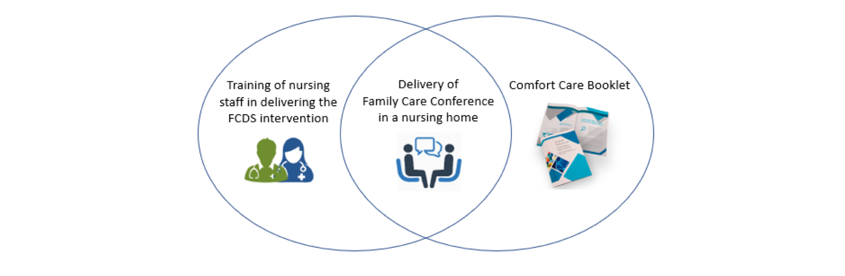
Mixed Methods Research in practice
Family Carer Decision Support Intervention

Slide 17
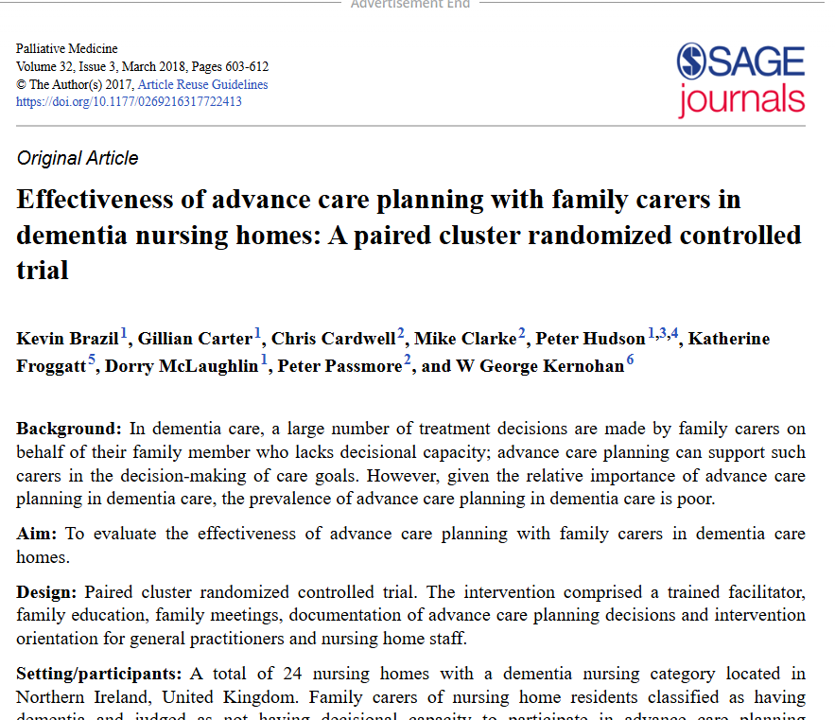
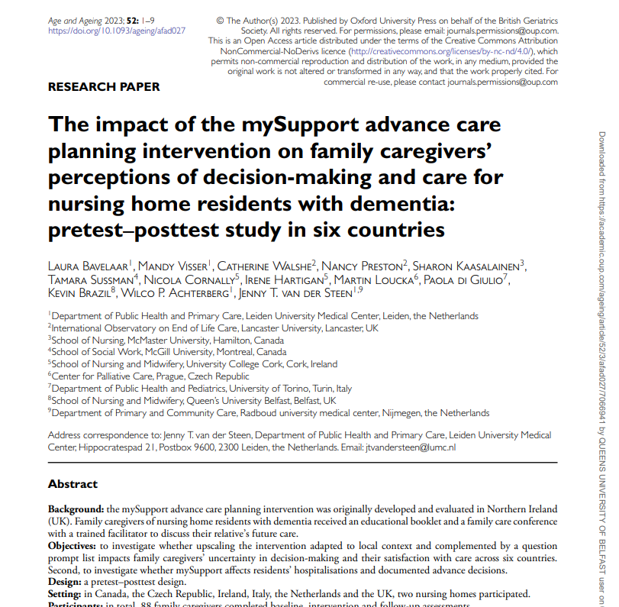

Mixed Methods Research
Less decisional conflict
More positive perceptions of care
Provided reassurance and relieved concerns
Helped develop trust and supportive relationships

Slide 18

In-Touch

Slide 19
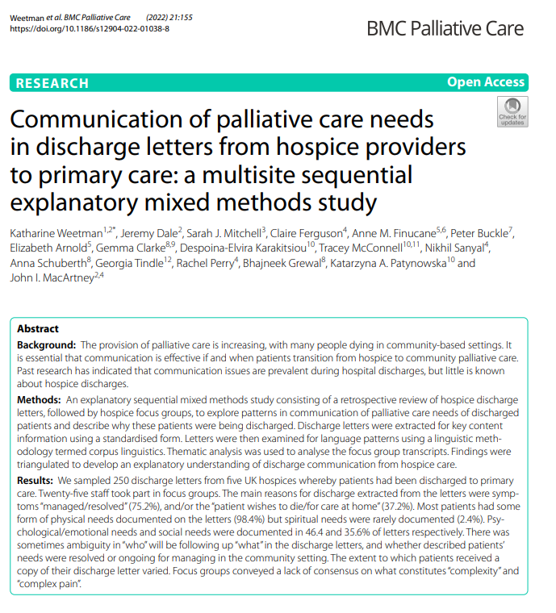
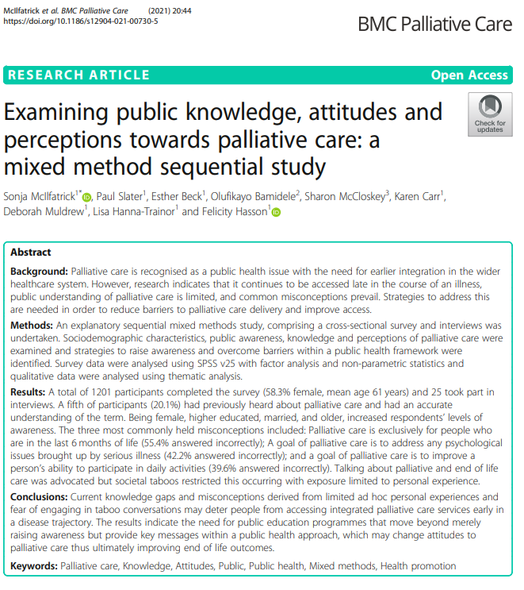
Mixed Methods Research

Slide 20

Mixed Methods Research

Slide 21
Key messages
Mixed methods = integration of quantitative approaches
Ideal for research questions in palliative care
Design choice depends on the research question
Can contribute to a broader understanding of care contexts in palliative and end-of-life care research

Slide 22

Contact details
Dr Julie Doherty
Lecturer
School of Nursing & Midwifery
julie.doherty@qub.ac.uk

Slide 23
Files will be available on
Past Events - The Palliative Hub Professional (professionalpalliativehub.com/events)
)
Thank you for your time

