Slide 1

‘ECRF Webinar: Introduction to Quantitative Research in Palliative Care’
Presented by
Dr Paul Slater, Ulster University
professionalpalliativehub.com/research/

Slide 2
Notes:
2

Slide 3
Quantitative Research in Palliative Care
Notes:
3

Slide 4
What is Quantitative Research?
OVERVIEW:
Definition
Assumptions
Research Designs
Methods
Statistical Analysis
Ethics
Notes:
Ontology/Epistemology: Positivism and measurable
A priori and often based on qualitative findings. Evolutionary.
Experimental Vs Nonexperimental
Measurement (Tools/biometric/incidents)
Appropriate for statistical analysis
Set within ethical standards
4

Slide 5
Conceptual Model
Location A
Satisfaction with Care
Location B
Notes:
5

Slide 6
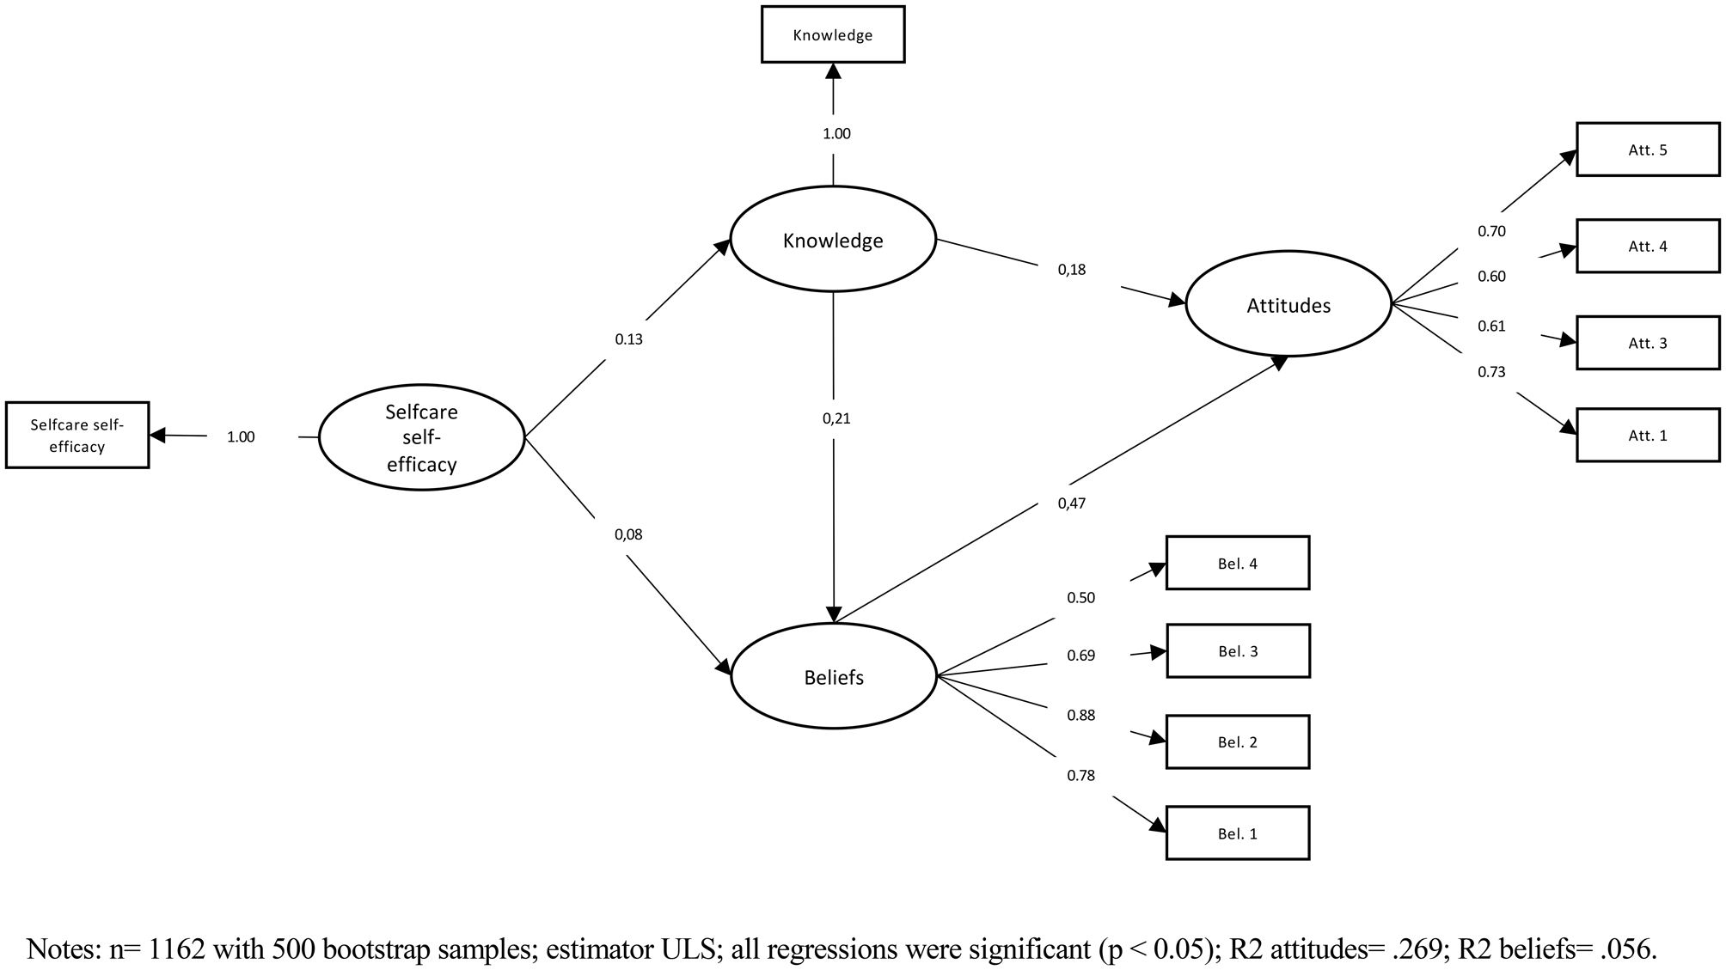
Theoretical Model
Ramos-Vera, C., Krikorian, A., & Saldarriaga, J. V. (2023). Factors related to positive attitudes toward palliative care: Direct and indirect effects of self-care self-efficacy, knowledge, and beliefs. Palliative & Supportive Care, 21(6), 973-979.
Notes:
6

Slide 7
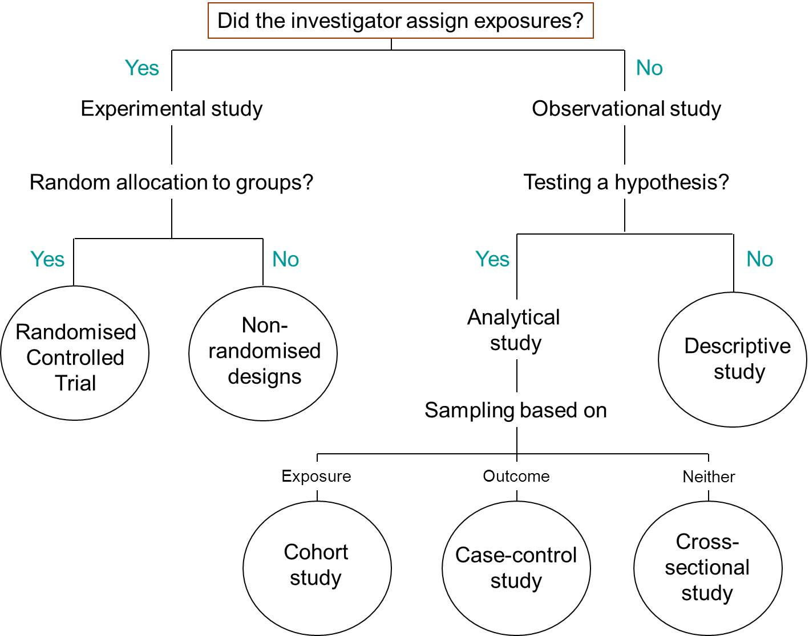
Quantitative Designs
Notes:
7

Slide 8
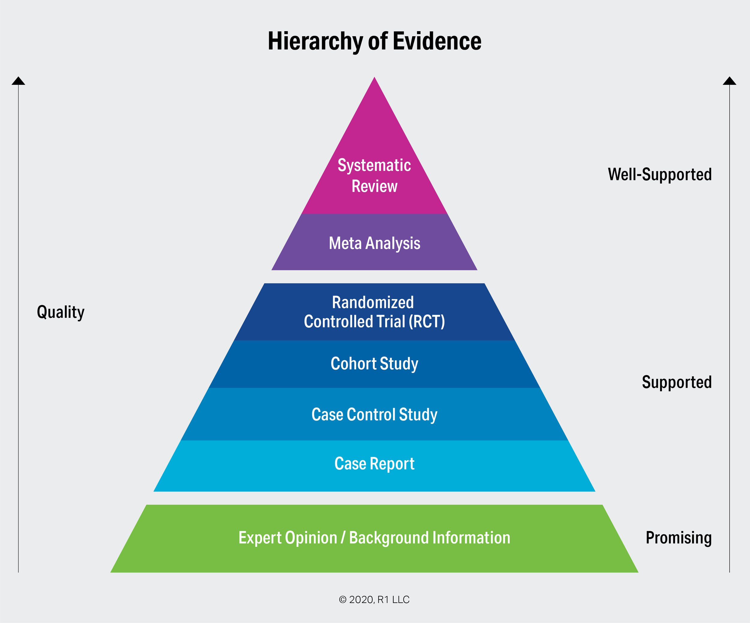
Quantitative Research Design
Notes:
8

Slide 9
Core Quantitative Methodologies in Palliative Care
Clinical Trials
Survey Research
Epidemiological Methods
Health Economics
Big Data and Registry-Based Studies
Measurement and Psychometrics
Notes:
Core Quantitative Methodologies in Palliative Care Research
Clinical Trials
Often adapted to accommodate ethical and practical constraints in palliative settings.
May use pragmatic or cluster-randomized designs to evaluate interventions like symptom management or communication strategies.
Survey Research
Commonly used to assess patient and caregiver experiences, quality of life, and service satisfaction.
Requires careful questionnaire design to ensure sensitivity and relevance to palliative populations.
Epidemiological Methods
Used to study disease prevalence, symptom burden, and healthcare utilization.
Can include cohort studies, case-control studies, and cross-sectional designs.
Health Economics
Evaluates cost-effectiveness of interventions and models resource allocation.
Often integrated with clinical trials or observational studies.
Big Data and Registry-Based Studies
Increasingly used to analyze large datasets from electronic health records or national registries.
Useful for identifying patterns in care delivery and outcomes across populations.
Measurement and Psychometrics
Focus on developing and validating instruments to assess outcomes like pain, distress, and quality of life.
Emphasis on reliability, validity, responsiveness, and appropriateness of measures.
9

Slide 10
Quantitative Research Protocol
Rigorous Study design
Standardized Data Collection
Data Management Protocols
Quality Assurance Procedures
Statistical Rigour
Ethical/Regulatory Compliance
Notes:
1. Rigorous Study Design
Clear objectives and hypotheses: Define what you're measuring and why.
Appropriate methodology: Choose the right design (e.g., RCT, cohort study) to minimize bias and confounding.
Sample size calculation: Ensure statistical power to detect meaningful effects.
2. Standardized Data Collection
Validated instruments: Use tools that are tested for reliability and validity (e.g., SF-36 for quality of life).
Training for data collectors: Ensure consistency in how data is gathered.
Pilot testing: Run a small-scale trial to identify issues before full deployment.
3. Data Management Protocols
Data entry checks: Use double data entry or automated validation rules.
Secure storage: Protect data integrity and confidentiality with encrypted systems.
Version control: Track changes to datasets and documentation.
4. Quality Assurance Procedures
Monitoring and auditing: Regular checks for completeness, accuracy, and protocol adherence.
Missing data handling: Use appropriate imputation or sensitivity analyses.
Outlier detection: Identify and assess extreme values for potential errors.
5. Statistical Rigor
Appropriate analysis techniques: Match statistical methods to data type and study design.
Assumption testing: Check for normality, homoscedasticity, and independence.
Transparent reporting: Follow guidelines like CONSORT, STROBE, or RECORD.
6. Ethical and Regulatory Compliance
Informed consent: Ensure participants understand data use and rights.
Ethics approval: Obtain clearance from relevant boards or committees.
Data anonymization: Protect participant identity in analysis and reporting.
10

Slide 11
Quantitative Research: Challenges and Considerations
Ethical Sensitivity
Recruitment and Retention
Statistical Knowledge
Multidisciplinary Collaboration
Integration with qualitative methods
Notes:
Challenges and Considerations
Ethical Sensitivity: Research must respect the vulnerability of patients and families, often requiring tailored consent processes and minimal burden designs.
Recruitment and Retention: High attrition rates and difficulty in enrolling participants necessitate innovative strategies and flexible protocols.
Multidisciplinary Collaboration: Effective studies often involve teams from medicine, nursing, psychology, sociology, and ethics.
Integration with Qualitative Methods: Mixed methods are frequently employed to capture both numerical trends and lived experiences.
11

Slide 12
Quantitative Research in Palliative Care
Applications in Healthcare:
Policy Development: Quantitative data informs health policy decisions and resource allocation.
Clinical Decision-Making: Supports guidelines and protocols based on statistically significant findings.
Quality Improvement: Helps identify inefficiencies and measure the impact of interventions. [aiamc.org]
Health Technology Assessment: Evaluates new technologies for safety, effectiveness, and economic impact.
Notes:
Challenges and Considerations
Ethical Sensitivity: Research must respect the vulnerability of patients and families, often requiring tailored consent processes and minimal burden designs.
Recruitment and Retention: High attrition rates and difficulty in enrolling participants necessitate innovative strategies and flexible protocols.
Multidisciplinary Collaboration: Effective studies often involve teams from medicine, nursing, psychology, sociology, and ethics.
Integration with Qualitative Methods: Mixed methods are frequently employed to capture both numerical trends and lived experiences.
12

Slide 13
Quantitative Research in Palliative Care
Recent Developments:
Evidence Synthesis
Systematic Reviews/Meta-analysis
Core Outcome Measures (COMET/COSMIN)
Notes:
1. Evidence Synthesis in Healthcare
Definition: Evidence synthesis is the process of systematically gathering, evaluating, and summarizing research findings to inform clinical practice, policy, and future research.
Types of Evidence Synthesis:
Systematic Reviews
Meta-analyses
Scoping Reviews
Rapid Reviews
Realist Reviews
Purpose:
Identify gaps in knowledge
Support decision-making
Avoid duplication of research
Improve healthcare outcomes
2. Systematic Reviews and Meta-Analysis
Systematic Review
A structured method to identify, appraise, and synthesize all relevant studies on a specific question.
Follows protocols like PRISMA for transparency and reproducibility.
Involves defining inclusion/exclusion criteria, searching databases, assessing study quality, and summarizing findings. [epitechresearch.com], [content.sp...arvard.edu], [thepafp.org]
Meta-Analysis
A statistical technique used within a systematic review to combine results from multiple studies.
Increases statistical power and precision.
Often visualized using forest plots to show pooled effect sizes.
Best Practices:
Use validated tools for quality assessment (e.g., GRADE).
Ensure heterogeneity is assessed and addressed.
Register protocols (e.g., PROSPERO).
3. Core Outcome Measures (COMET & COSMIN)
COMET Initiative
Focuses on developing Core Outcome Sets (COS)—standardized sets of outcomes that should be measured and reported in all clinical trials for a specific condition.
Aims to improve consistency and comparability across studies.
Maintains a searchable database of COS projects. [comet-initiative.org]
COSMIN Guidelines
Provides standards for selecting outcome measurement instruments for COS.
Emphasizes:
Content validity
Reliability
Responsiveness
Feasibility
Developed through consensus methods like Delphi studies. [cosmin.nl], [cometinitiative.org]
4-Step COSMIN/COMET Process:
Conceptual considerations – Define what to measure.
Search for instruments – Systematic review of existing tools.
Quality assessment – Evaluate measurement properties.
Consensus and recommendation – Select the best instrument for each outcome.
13

Slide 14
References
Slater, P. (2024). Fundamentals of quantitative research methods in mental health nursing. Journal of Psychiatric and Mental Health Nursing, 32(2), 457.
Slater, P., & Hasson, F. (2025). Quantitative research designs, hierarchy of evidence and validity. Journal of Psychiatric and Mental Health Nursing, 32(3), 656-660.
Slater, P., & Hasson, F. (2025). Data Measurement, Instruments and Sampling. Journal of Psychiatric and Mental Health Nursing, 32(3), 680-685.
Slater, P., & Hasson, F. (2025). Quantitative Data Quality Assurance, Analysis and Presentation. Journal of Psychiatric and Mental Health Nursing, 32(3), 723-727.
Notes:
1. Evidence Synthesis in Healthcare
Definition: Evidence synthesis is the process of systematically gathering, evaluating, and summarizing research findings to inform clinical practice, policy, and future research.
Types of Evidence Synthesis:
Systematic Reviews
Meta-analyses
Scoping Reviews
Rapid Reviews
Realist Reviews
Purpose:
Identify gaps in knowledge
Support decision-making
Avoid duplication of research
Improve healthcare outcomes
2. Systematic Reviews and Meta-Analysis
Systematic Review
A structured method to identify, appraise, and synthesize all relevant studies on a specific question.
Follows protocols like PRISMA for transparency and reproducibility.
Involves defining inclusion/exclusion criteria, searching databases, assessing study quality, and summarizing findings. [epitechresearch.com], [content.sp...arvard.edu], [thepafp.org]
Meta-Analysis
A statistical technique used within a systematic review to combine results from multiple studies.
Increases statistical power and precision.
Often visualized using forest plots to show pooled effect sizes.
Best Practices:
Use validated tools for quality assessment (e.g., GRADE).
Ensure heterogeneity is assessed and addressed.
Register protocols (e.g., PROSPERO).
3. Core Outcome Measures (COMET & COSMIN)
COMET Initiative
Focuses on developing Core Outcome Sets (COS)—standardized sets of outcomes that should be measured and reported in all clinical trials for a specific condition.
Aims to improve consistency and comparability across studies.
Maintains a searchable database of COS projects. [comet-initiative.org]
COSMIN Guidelines
Provides standards for selecting outcome measurement instruments for COS.
Emphasizes:
Content validity
Reliability
Responsiveness
Feasibility
Developed through consensus methods like Delphi studies. [cosmin.nl], [cometinitiative.org]
4-Step COSMIN/COMET Process:
Conceptual considerations – Define what to measure.
Search for instruments – Systematic review of existing tools.
Quality assessment – Evaluate measurement properties.
Consensus and recommendation – Select the best instrument for each outcome.
14

Slide 15
Files will be available on
Past Events - The Palliative Hub Professional (professionalpalliativehub.com/events)
)
Thank you for your time

